Slide 1
Care Coordinator Monthly Webinar
January 18th 2023

Slide 2
Agenda
Introductions
Better Care Home Health (30 Mins)
Marvin Javellana – CEO
Sherry Jen, RN – Agency Manager
Basinger (10 Mins)
Sonia Kaur – Program Manager
Member Escalations & Extra Benefits (8 Mins)
Heather Holberg – Director of Enrollment and Outreach
FoodCare – Emergency Meals (8 Mins)
Andrew Gillen - Project Manager
Wrap Up 4 (Mins)

Slide 3
Home Based Care Community Care
“Better Outcomes Start with Better Care”
2340 S. River Rd. Ste. 430 Des Plaines, IL 60018
Office 800-518-8943
Fax 800-518-8953
Presented by:
Marvin Javellana - CEO
Sherry Jen, RN – Agency Manager

Slide 4

Objectives and Goals
Understand the difference between home-based care programs.
Have the knowledge of the challenges facing the home- based care industry.
Be able to refer patients to the proper programs.

Slide 5

Who is Better Care Home Health?
Medicare and IDPH Certified Home Health Care Agency
Closely works with County Care for the past 5 years
Services Include: SN, PT, OT, Speech Therapy
Dedicated Patient Care Coordinators

Slide 6


Types of Home-Based Care
Home Health Care
Hospice Care
Home Care Non-Skilled or Private Duty Non-Skilled

Slide 7
What is Home Health Care
Allows payment for skilled nursing care, physical therapy, occupational therapy, speech therapy, medical social work, home health aide services, and medical supplies provided to the patient’s home.
Focuses primarily on short term, post acute and post hospitalization care.
A physician must make the referral to a home health care agency and oversee the plan of care.

Slide 8
Home Health Care Focus
Home health care provides patients with services for acute episodic periods based on patient acuity and needs.
Patients are discharged from home health care when the acute defined goals have been met, even though they continue to have chronic debilitating medical conditions and functional limitations.
The focus is on post acute and episodic, not long-term care.

Slide 9
Home Health Care Examples
Hip Fracture discharged from the Hospital or Rehab Facility.
Diabetic Foot Ulcer discharged from the Hospital on a Negative Pressure Wound Therapy device.
Abdominal Surgery from the Hospital or Rehab Facility with new Ostomy.
IV Antibiotics
LVAD

Slide 10
What is Hospice Care
Hospice is a service provided for persons with a life limiting illness
that, through the normal course of the disease, have 6 months or less to live as determined by a physician.
Hospice is generally appropriate for long-term nursing home patients who are declining.

Slide 11
Hospice Care Focus
Physical Well-Being: pain relief, wound care, massage, PT and OT as needed to maintain function.
Emotional Well-Being: social work counseling, how to cope w/ prognosis, medication for depression or anxiety.
Spiritual Well-Being: chaplain is available for patient and family/friends.
Bereavement Services/Memorials: when a loved one dies, staff assists family and friends w/ the grieving process, memorial services, and counseling.

Slide 12
Hospice Care Examples
Stage 4 Cancer and patient refuses further life-prolonging therapy OR continues to decline despite definitive therapy
Renal Failure (ESRD) Patient refuses dialysis or renal transplant or requests to discontinue dialysis.
Dementia Stage 7C or beyond according to FAST Scale and other significant condition that suggests limited prognosis.
Liver Disease (ESLD) Progressive malnutrition, muscle wasting with dec. strength, ongoing alcoholism.

Slide 13
What is Home Care Non-Skilled or Personal Care
Non-Skilled In-Home Care refers to supportive home care including social care, domiciliary care, and other non-medical services. The term “non-skilled” is used to differentiate care from home health care services that patients may receive from a nurse or nursing assistant.

Slide 14
Home Health (Skilled) vs Home Care (Non-Skilled)
The difference between skilled and non-skilled care comes down to one factor – medical need. Skilled nurses provide medical assistance with medication, wound care, and other recovery and medical needs. Non-skilled, or home care, providers assistance with the everyday care and needs of patients.

Slide 15
Home Care Non-Skilled Focus
Personal Care
Walking and wheelchair assistance
Bathing, grooming, and dressing assistance
Medication reminders
Incontinence and toilet assistance
Assistance with activities of daily living (ADL)

Slide 16
Home Care Non-Skilled Focus
Support
Non-medical services
Housekeeping
Meal preparation
Laundry and bedding
Shopping
Assistance with transportation
Maintenance of household records
Companionship

Slide 17

Questions?

Slide 18
Thank You
“Better Outcomes Start with Better Care”
2340 S. River Rd. Ste. 430 Des Plaines, IL 60018
Office 800-518-8943
Fax 800-518-8953

Slide 19


Slide 20
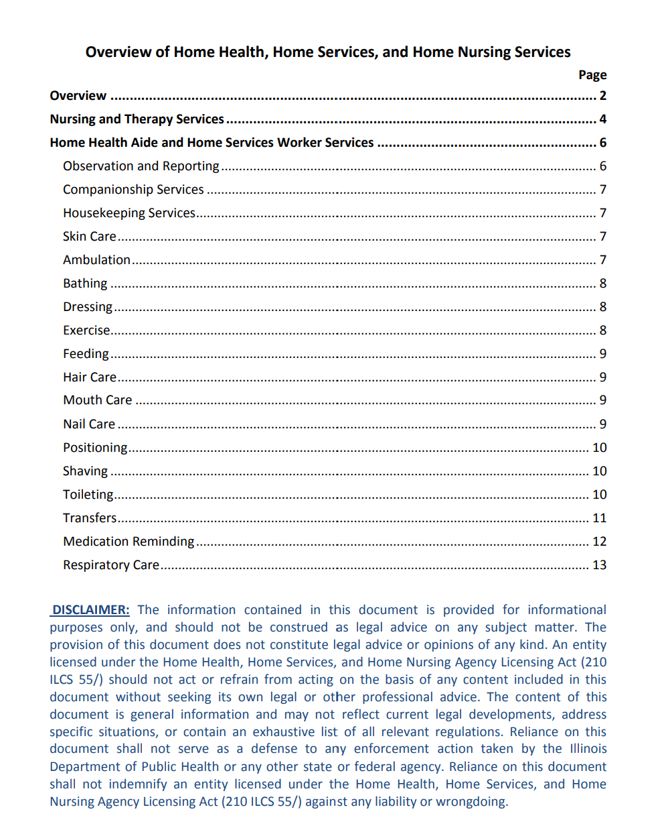

Slide 21
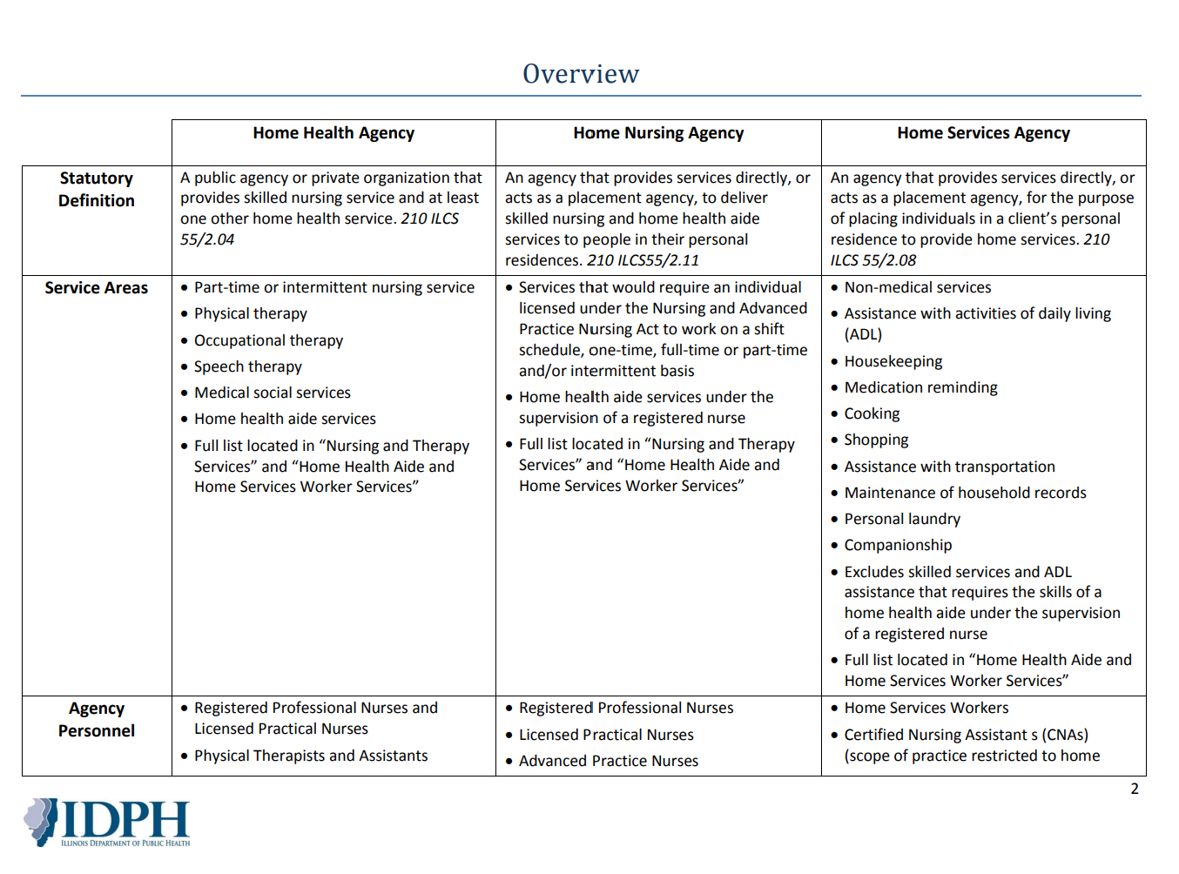

Slide 22
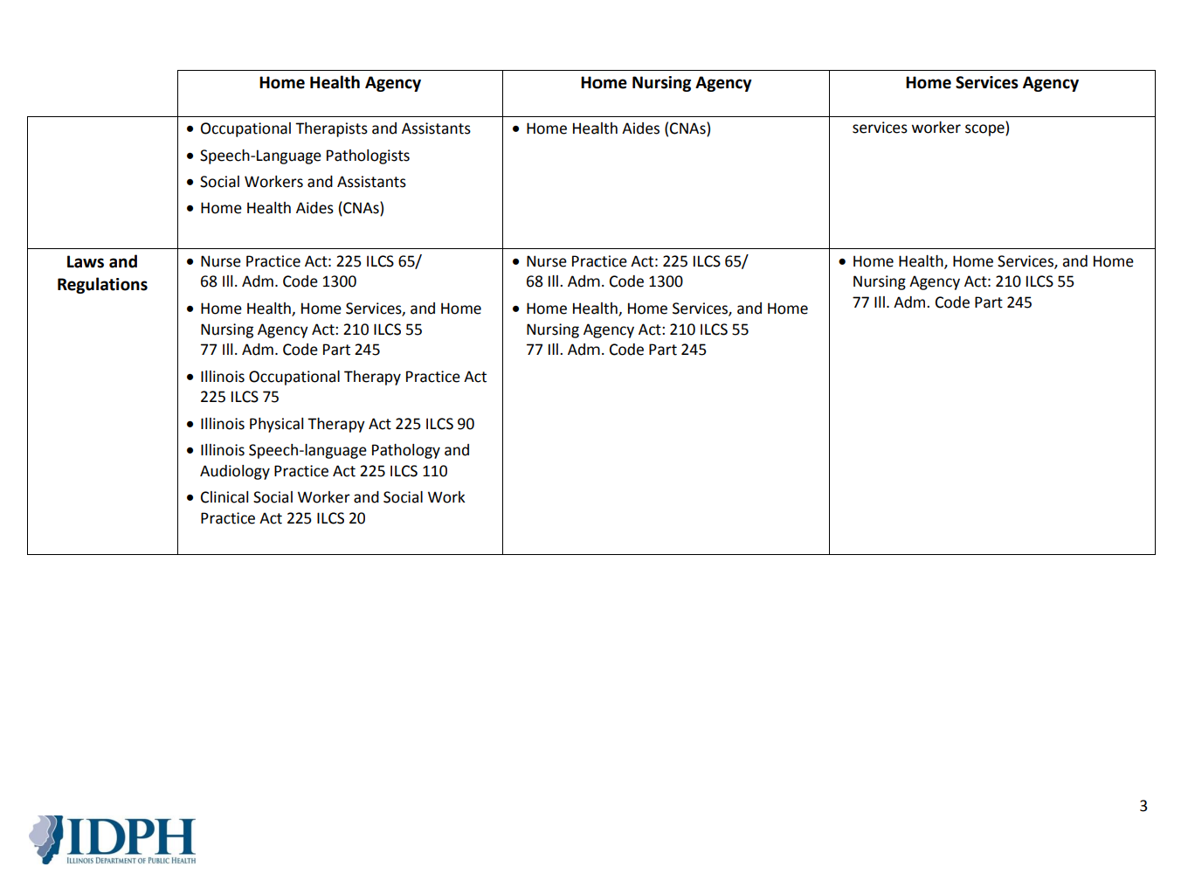

Slide 23
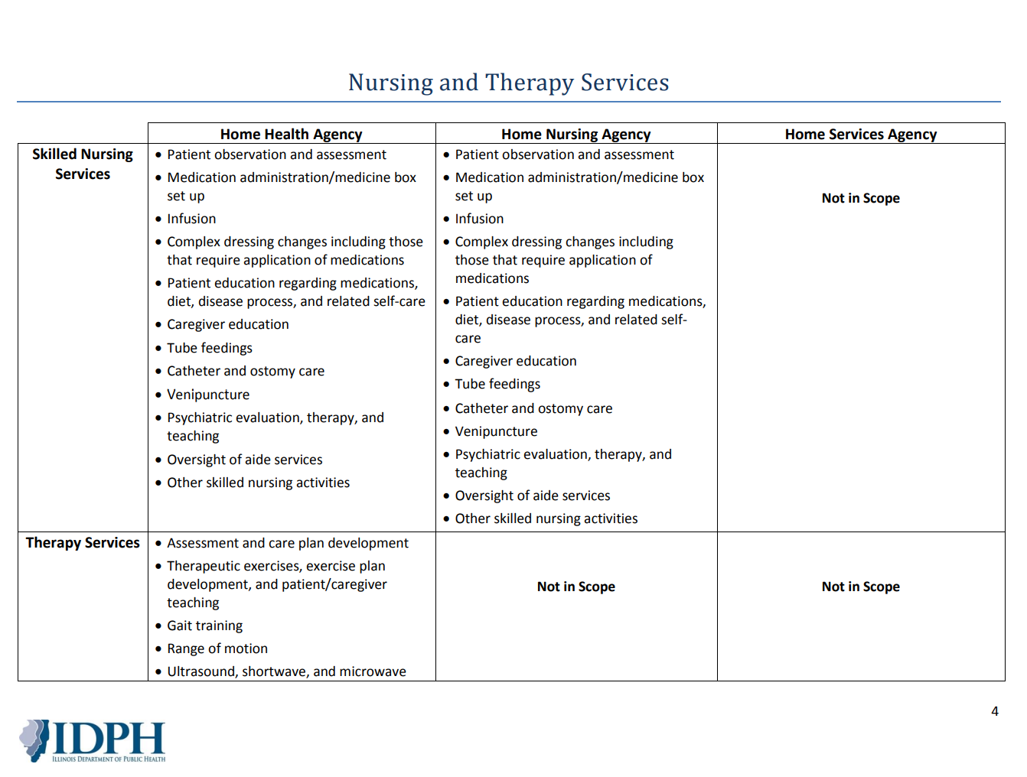

Slide 24
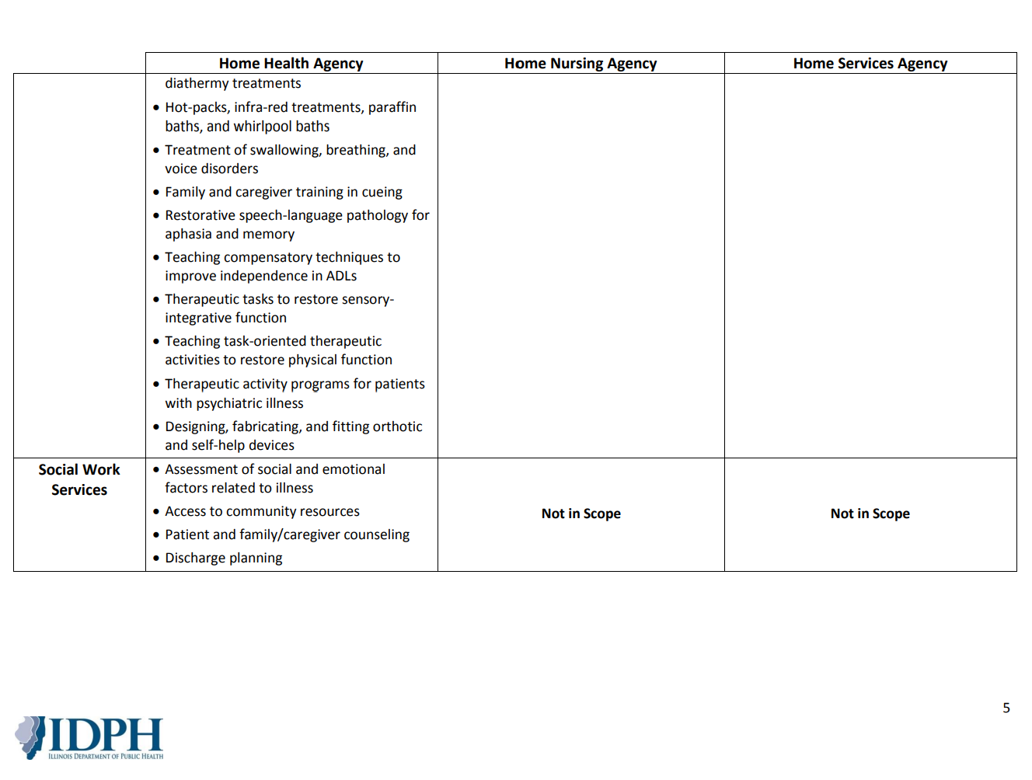

Slide 25
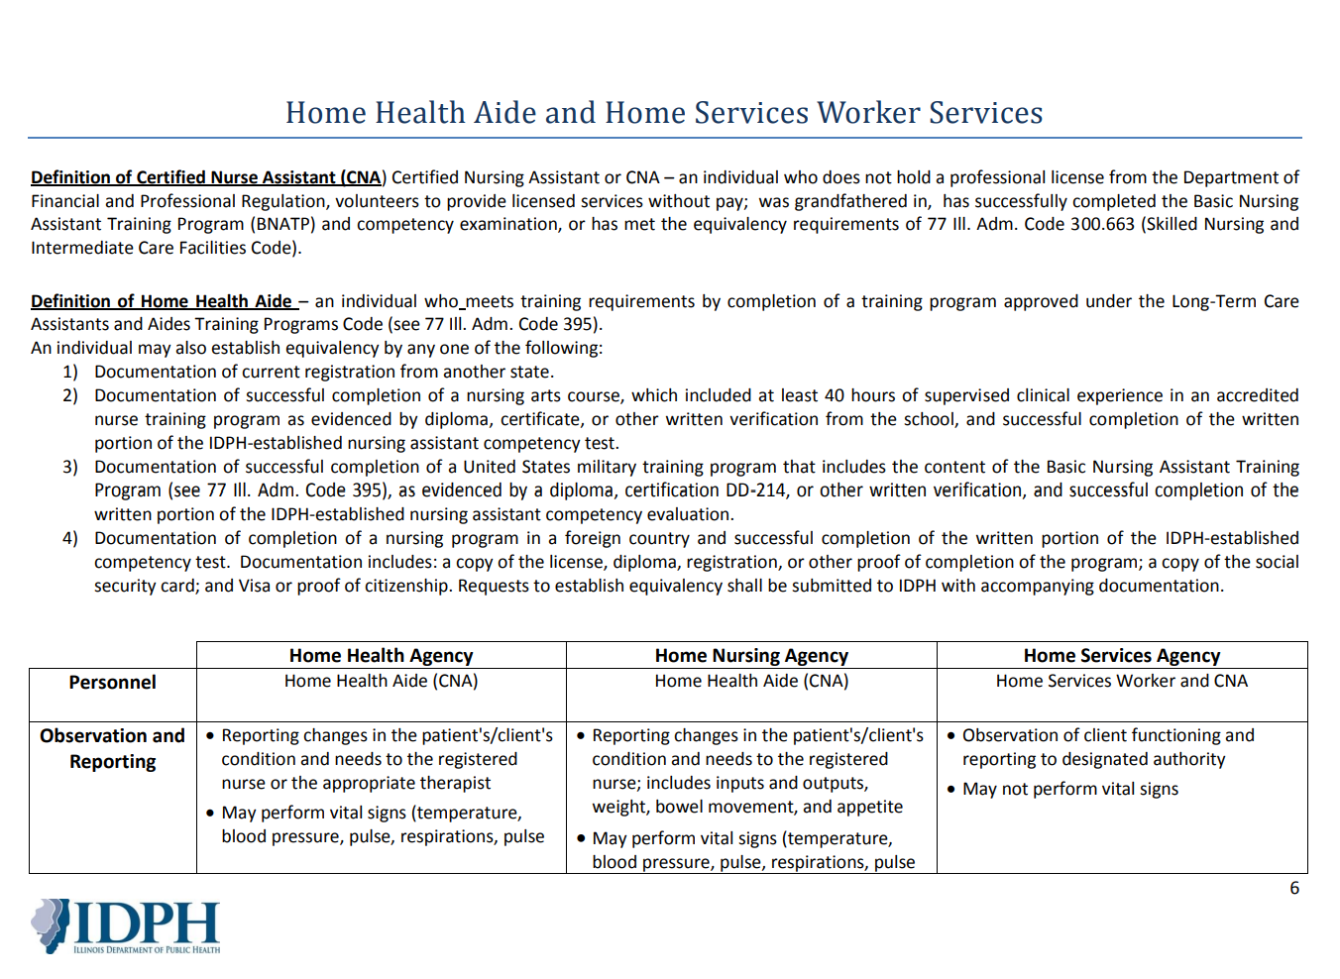

Slide 26
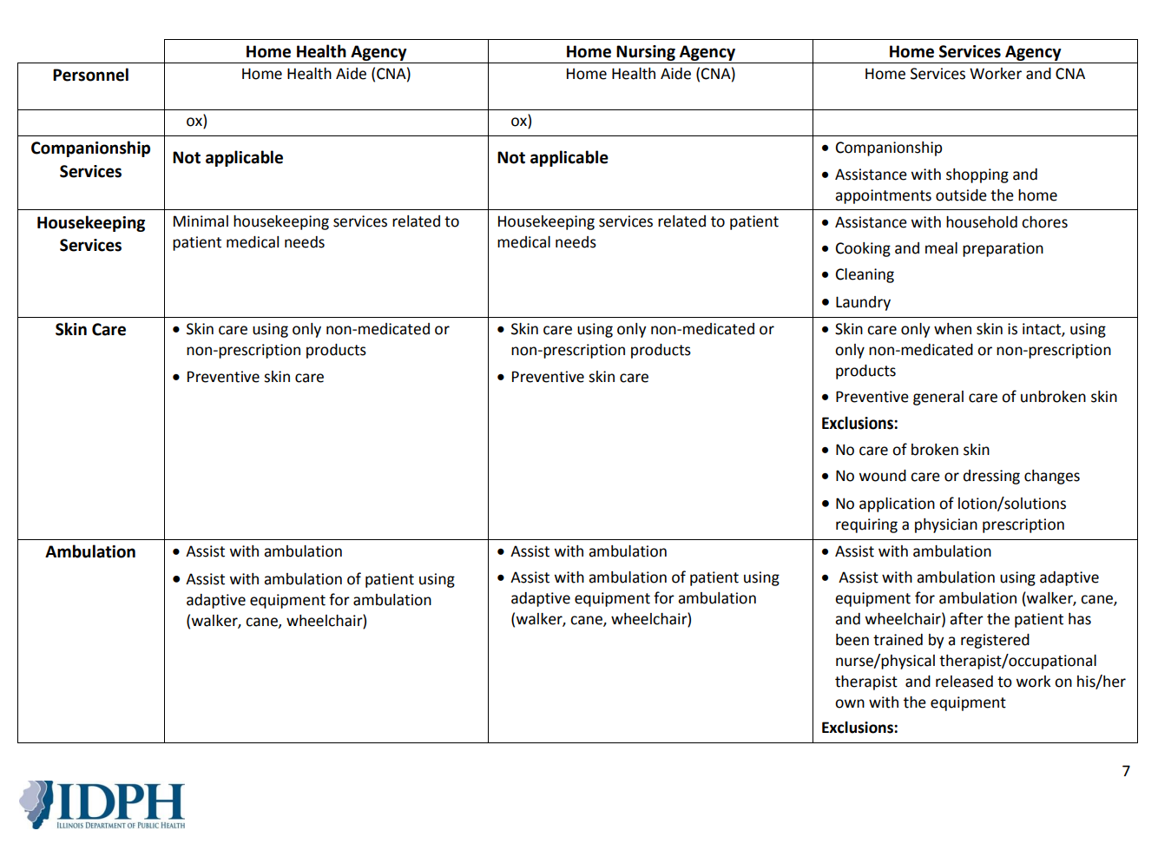

Slide 27
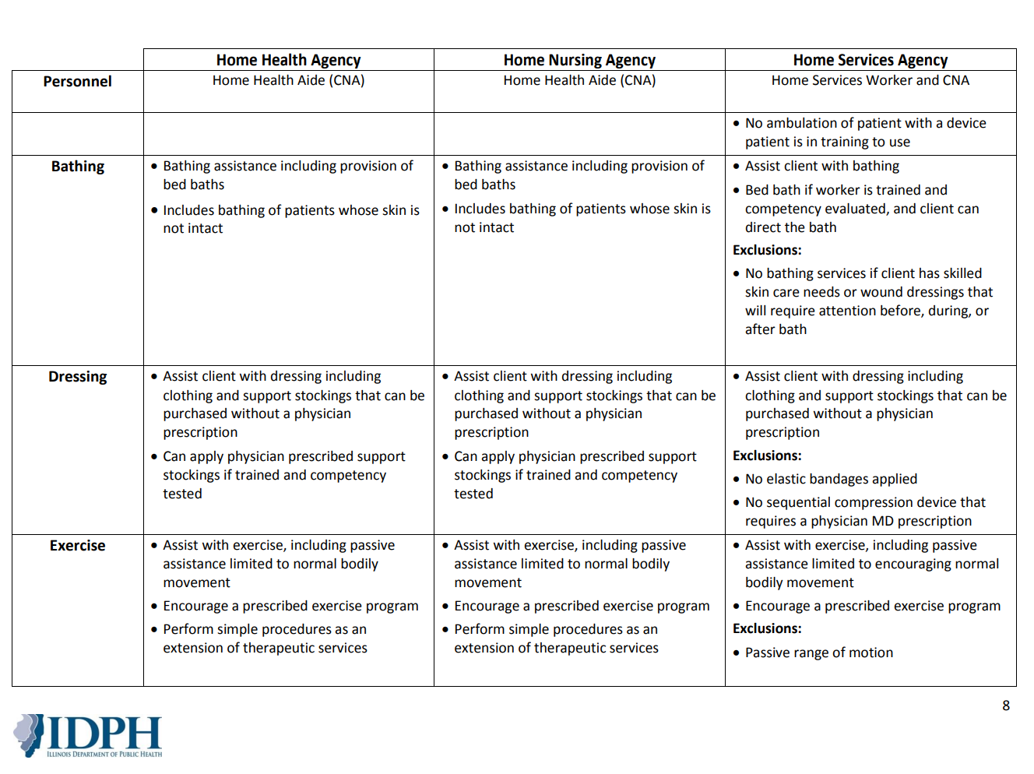

Slide 28
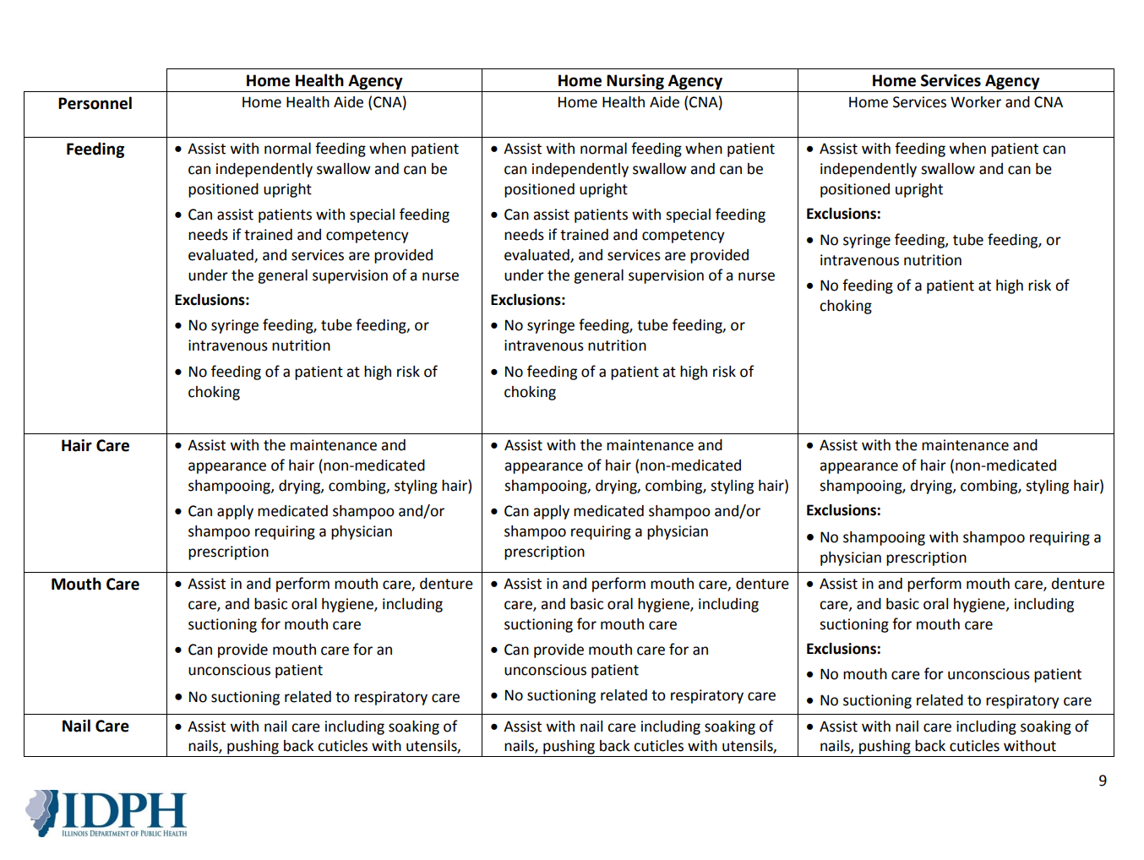

Slide 29
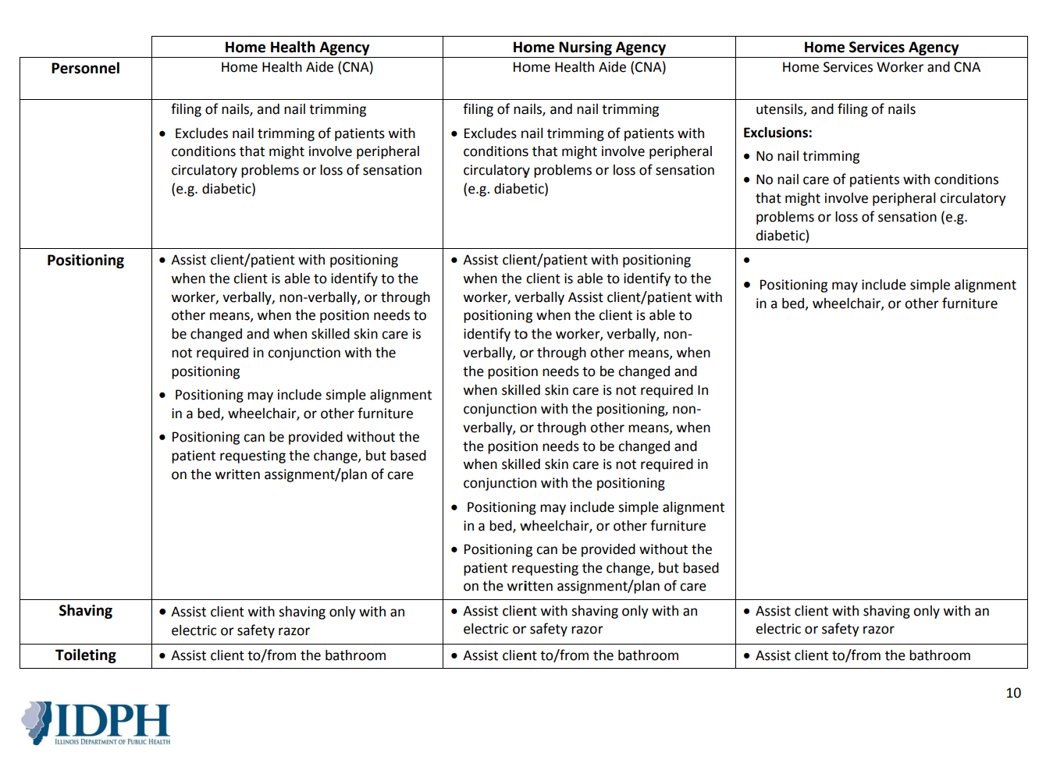

Slide 30
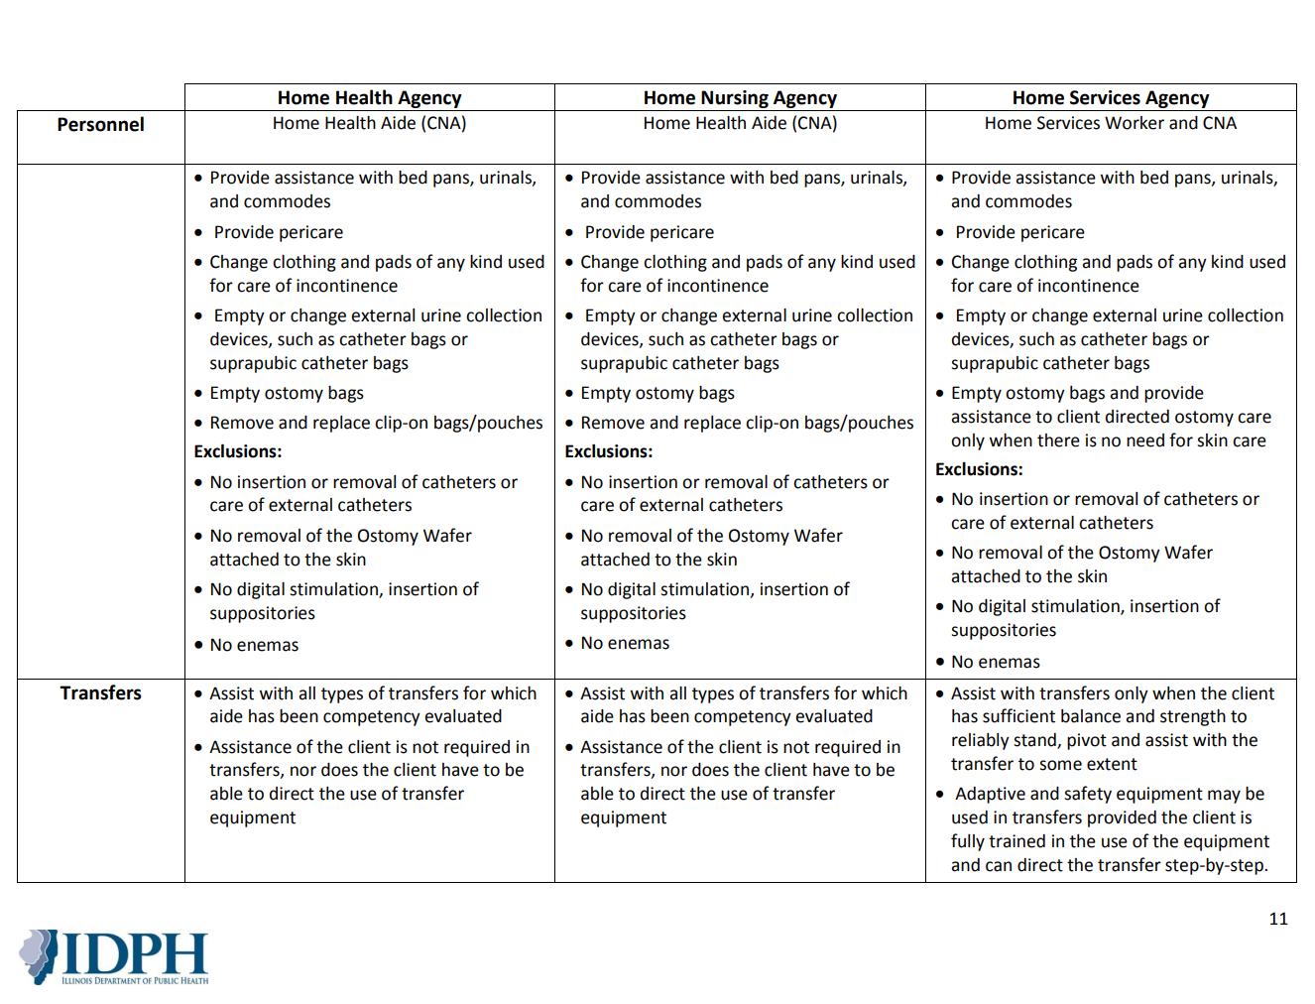

Slide 31
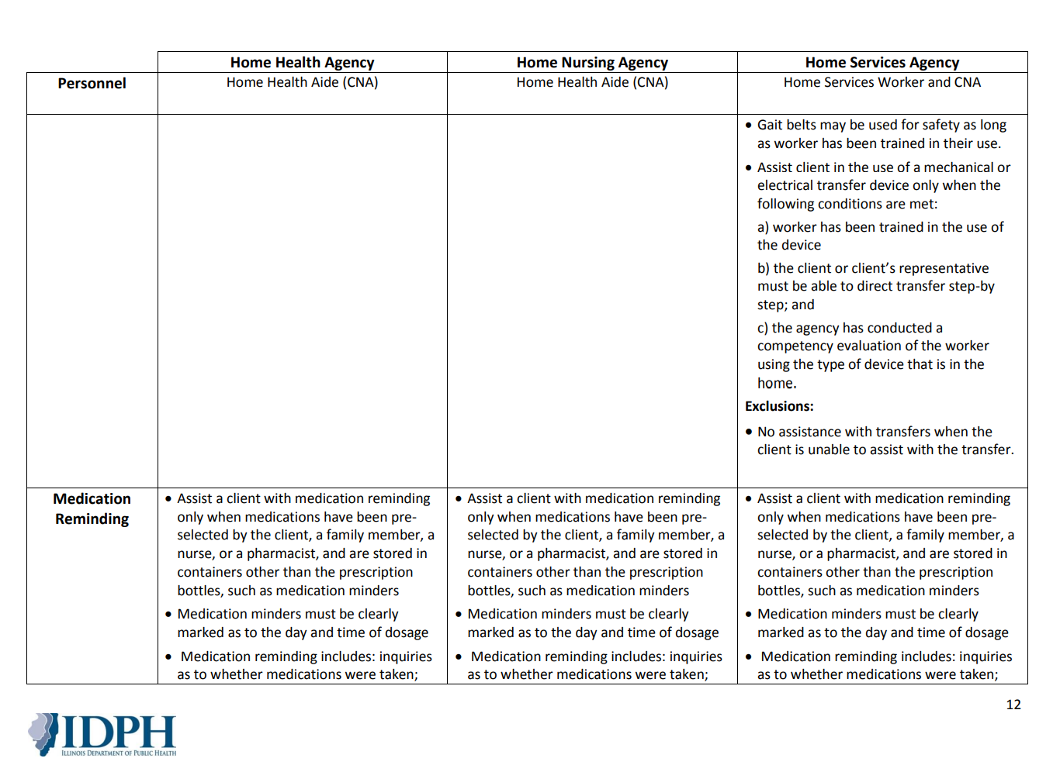

Slide 32
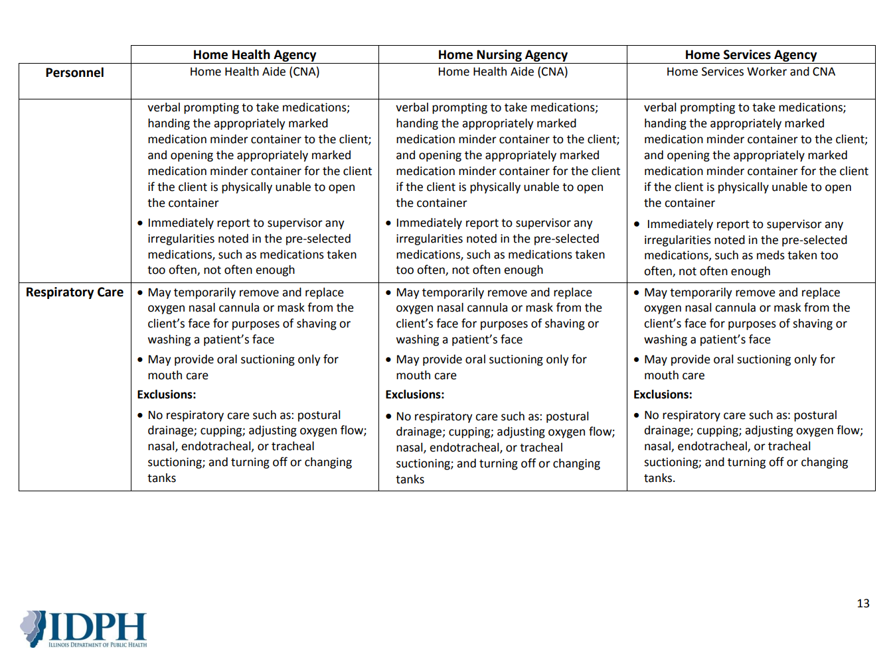

Slide 33
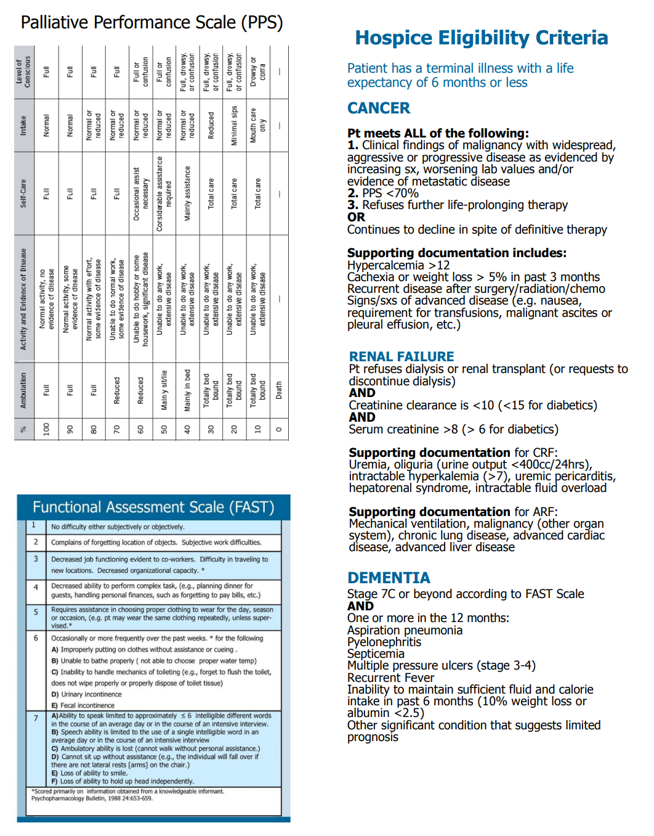
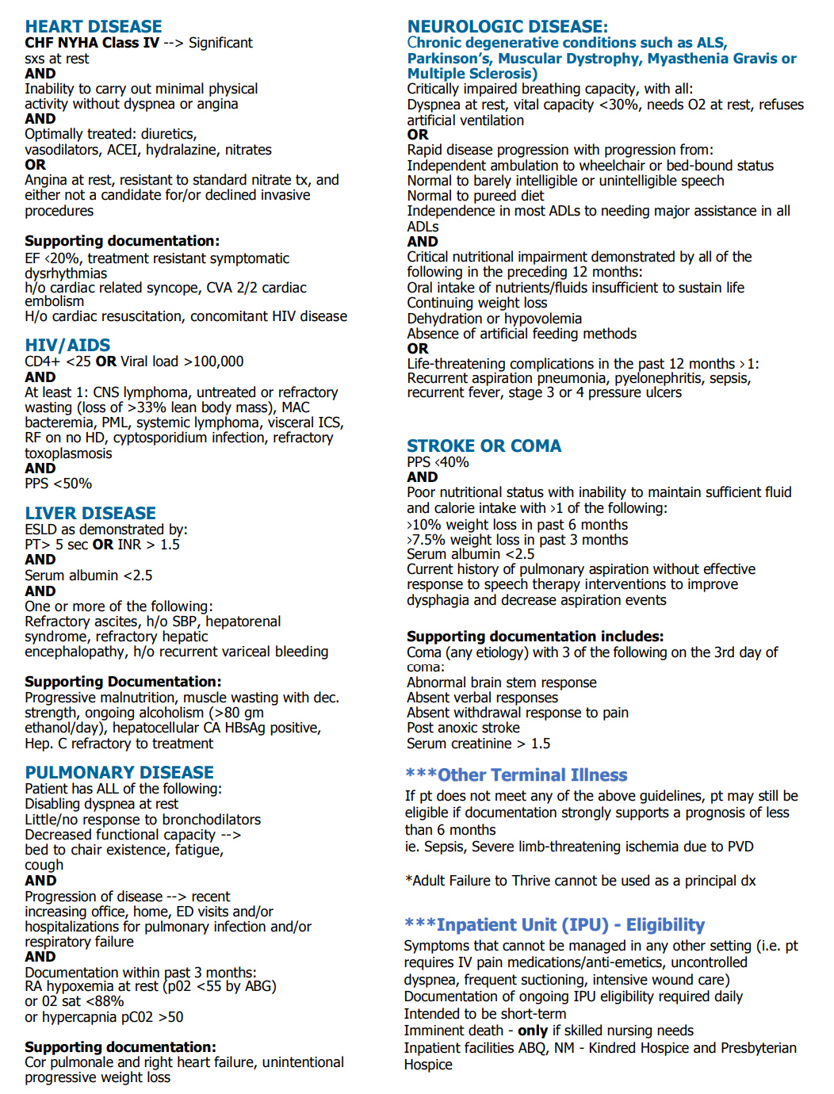

Slide 34
Q & A

Slide 35


Prepared for

Slide 36
Background on Basinger
Serving the community for 60 years
Minority-owned business registered under the Business Enterprise Program in the state of Illinois
Owned by Harish Bhatt who is credentialed as a pharmacist
5 convenient locations in Joliet, IL
Accredited by the Joint Commission
Member of the Joliet Chamber of Commerce, Continuity of Care, AIPHA, and IPHA
Contracted with Cornerstone Services and many other similar services across the Chicagoland area
We are proud to have provided exceptional service to Cornerstone Services for over 25 years

Slide 37
Overview
Free delivery anywhere in the Chicagoland area as well as Indiana and Michigan
One stop shop for pharmacy, durable medical equipment, over the counter medications and braces, and full line bill payment center
Our primary location is open daily from 8:30am-9pm, 365 days per year
Our caring staff of 50 receives ongoing training in order to help meet our patient’s and your member’s needs
Preferred providers for Medicare, Medicaid, and Blue Cross Blue Shield (PPOs and HMOs), Humana, and Meridian

Slide 38
Why Choose Basinger?
Personalized support from our caring and experience team
We will work with your member, family caregiver, and care coordinator to ensure equipment is delivered and received via a follow-up call
One stop shop for pharmacy and medical equipment-you can make 1 phone call to resolve all of your concerns
We have a loyal and passionate team that has been working with us for 10+ years
We are a preferred provider for Medicare, Medicaid, and Blue Cross Blue Shield, Meridian, Humana, Molina
We accept all insurances for DME and Pharmacy services
We work with a utilization manger, Care coordinator, Transition of care coordinator, occupational therapist, and physical therapist.
once the order for DME supplies is delivered then we call within 24 hours and we follow up with the patient in 10 days.
We will accommodate vacation supplies, emergency supplies, early refills, and replacement of lost medication
We are Minority-owned business certified through IL CMS BEP

Slide 39
About Our DME (DURABLE MEDICAL EQUIPMENT)
At Basinger’s Pharmacy, we understand that living with certain medical conditions and disorders or recovering from injuries and surgeries can be difficult to cope with, and that shopping for specialty products can be frustrating. It is this understanding that leaves us confident that our trained and experienced consultants will help you find the right solution for managing your condition and regaining your independence. We provide quality care and products in a comfortable and professional setting and offer educational information designed to help you come to a better understanding of your condition and its methods of treatment.
When you’re recovering from surgery or learning to live with a chronic condition, it’s important to keep your energy focused on your health. You shouldn’t have to worry about your medical supplies or whether you have the right equipment to help ease your transition home. At Mars Medical, we’ll do all of that for you and more. We provide you with the latest and best in home health care equipment to make your life more enjoyable. Stop by and see us—help us help you.

Slide 40
Our Services

Slide 41
Durable Medical Equipment and Medical Supplies
Part B billing for diabetic supplies and shoes and nebulizer solutions (no prior auth required)
Respiratory: BiPAP, CPAP, nebulizers, oxygen concentrators, oxygen conservors, portable oxygen tanks (no prior auth required)
Wheelchairs: lift chairs, manual wheelchairs (no prior auth required)
mobility scooters, and powered wheelchairs and scooters (prior auth required)
Mobility: aircast boots, canes, crutches, knee walkers, and walkers (no prior auth required)
Aids: bathroom safety and commodes (no prior auth required)
Urinary supplies: catheters and insertion trays (no prior auth required)
Wound care: bandages, unna boots, and gauze (no prior auth required)
Incontinence supplies (no prior auth required)
Ostomy supplies ( no prior auth required)
Free blood glucose monitors
We offer free same day delivery * We will match or beat any of our competitors’ pricing * We offer free repairs for DME* DME Orders require Doctors Prescription and Clinical notes

Slide 42
Prior Authorization Process
Services that require authorization can be found on Basingers website.
https://www.basingers.com/
These Items are the ones that need prior auth
Power scooter
Power wheelchair
Power air mattress
The authorization process should be initiated at least 5 days in advance for non-emergent services
Contact the DME department via phone, fax, e-mail, mail or through the secure web portal if you have any questions regarding prior auth on these above mentioned items.

Slide 43
Vaccinations
COVID
Pfizer (5-11 years old and 12-adult)
Moderna (18 years old and older)
Janssen (18 years old and older)
Influenza
Shingles
Travel vaccines
Hepatitis B
Pneumonia

Slide 44
Durable Medical Equipment
- We offer delivery of our medical equipment within 75 miles. We offer 24-hour emergency service to our customers. Basinger's Pharmacy can provide additional E tanks at no charge and oxygen conserving devices for client's ease of portability of O2.
Basinger's Pharmacy provides evaluation of our client for specialized products and evaluation of client's home and workplace for wheelchair accessibility and evaluation of the client's feasibility for wheelchair transport.
Basinger's Pharmacy provides time and travel to secure proper documentation for patient and time and labor involved with trial fittings, product sampling and pressure mapping to ensure customer satisfaction.
We know that every product needs maintenance, work and repair at some time, so Basinger’s Pharmacy provides labor to build or assemble and testing of sophisticated mobility equipment, monitoring, pick-up and delivery, cleaning of equipment, loaner products while the client's product is in for service and labor for warranty repair of defective products.
We believe in providing the maximum benefit of each product, so we offer product and technology training for physicians and therapists, respiratory health education to seniors in assisted living centers and in-store health clinics on such topics as blood pressure, respiratory, glucose and more.
- We will file your claim with the insurance company or Medicare so you receive the maximum benefit available, rework any denied claims complete compliance reports and bill primary or secondary payer sources for you. Basinger's Pharmacy will also follow up with your doctor. We can even provide equipment in special cases prior to being able to bill for them.

Slide 45
Delivery
Deliveries made daily at any time convenient for you
Urgent deliveries
Deliveries can be requested on an urgent basis to be delivered within 3 hours
Staff member should call the DME department to indicate the supplies is needed urgently
We can deliver 7 days a week, 8:30am-9pm to meet your needs

Slide 46
DME Services
In addition to dedicated customer care, we provide only the top manufactured equipment and supplies..
Our manufacturers include:
- Invacare
- Pride Mobility Products
Drive Medical
Medline
Delivery is available within the greater Chicagoland area.
We bill to Medicare, Medicaid (Pubic Aid) and Private Insurance.
We accept all major credit cards

Slide 47
Benefits and Limitations
DME
Durable Medical Equipment is covered in accordance to the Medicaid guidelines.
Basinger’s reimburses 100% of Medicaid benefits for participating providers. Non-participating providers will be reimbursed 50% of Medicaid’s fee schedule with a prior authorization.
Authorization is required for some DME.
DME is covered based on medical necessity
Orthotics and Prosthetics (O&P)
O&P are covered for members under the age of 21.
Items categorized as orthotics are sleeves or braces.
Items categorized as prosthetics are items physically attached to the body (legs, hands, arms,etc.).

Slide 48
Fee Schedule and Policy
You may access the fee schedule on the DME page of the IL Medicaid website:
https://www2.illinois.gov/hfs/MedicalProviders/MedicaidReimbursement/Pages/DME.aspx

Slide 49
Durable Medical Equipment (DME) Payment/Reimbursement
The payment for purchase of new durable medical equipment is made from a statewide uniform fee
schedule which is updated by July 1 of each year and is effective for services provided on or after
that date based on one of the following instances:
The lesser of the provider’s usual and customary charge or:.
80% of the Medicare Durable Medical Equipment, Prosthetics, Orthotics, and Supplies (DEMPOS) fee schedule in effect by January 1.
If no DEMPOS fee is available and a fee cannot be calculated the item will be manually priced at the Manufacturer’s Suggested Retail Price (MSRP) minus 20% to provide the 80% price range that is offered by Medicare. (Items that do not have a fee or MSRP may be priced at the provider’s cost plus 20 %.)
The payment for the rental of DME is made from a statewide uniform fee schedule which is based on 10% of the purchase allowance for new DME not to exceed 10 months. After the rental benefits are paid for 10 month, the equipment becomes property of the beneficiary/member unless, otherwise authorized by the Division of Medicaid through specific coverage criteria.
If you received the item from us the payment of repair of DME equipment will be covered through insurance
The payment for other individual consideration items must receive prior authorization from the Utilization Management Department.

Slide 50
DME Contact Support
DME Based Provider Services Call Center:
- Provides phone support
First line of communication
Answer questions regarding intake, eligibility,
authorizations, claims, payment inquiries.
Available Monday through Friday, 8am to 5pm CST
Phone : (815) 725- 1102
Ext : 104 – Oscar (Billing Specialist Spanish/English)
Ext : 121 – Sonia ( Billing Manger)
Ext : 102 – Uma (Intaker)
Fax : (815) 725-1844
Fax # 2 : (815) 725-7500
Email : DMEBASINGERS1@GMAIL.COM
WWW.Basingers.com

Slide 51
Q & A

Slide 52
Member Escalations
Care Coordination Resources

Slide 53
Member Escalations
Email Resources
Care Coordinators may email member requests and escalations rather than assist with a 3-way call to member services
PCP Changes:
Verify the new PCP is in-network: CountyCare Find-A-Provider
Complete the PCP change form: CountyCare PCP Change Form
Email completed form to: PCPChangeRequest@cookcountyhhs.org
ID Cards, Member Incentives and CTA/PACE Cards
Requests for Extra Benefits (Sleep Safe Kit, Car seats, Pregnancy Test, diper coupons, etc.)
Missing OTC funds
Replacement ID and OTC Cards
Requests for CTA and PACE Cards
Email requests to CountyCare@cookcountyhhs.org
Include, member’s name, member ID and mailing address

Slide 54
Q & A

Slide 55
CountyCare Rewards OTC Flex Card
Beginning January 1, 2023

Slide 56
Future Rewards Card Enhancements
OTC Card to Flex/Dual Network Card
Beginning in January 2023, CountyCare will be switching to a new type of Reward Card for members. The rewards members earn will stay the same. The new card only impacts how and where they are able to use the reward funds.
When: 1/1/23
Transition from InComm’s Legacy OTC platform to their Flex/DNBC platform
Key changes:
 | OTC Legacy Platform | Flex/Dual Network Benefit Card (DNBC) platform
Card Type | OTC card | Visa card
Store Restrictions | Only purchase from stores within OTC network | Can use funds to buy/pay for/purchase from almost any type of merchant category.
Purchase Restrictions | Members can purchase household and health items at the approved vendors or they can purchase items from the online OTC catalog and have them shipped to their home. | Can use their funds to pay for a wide variety of things from anyone who accepts Visa (online and in-store), including: Gas Utilities Internet Clothes Groceries Transportation The restrictions on firearms, alcohol, and tobacco remain the same.
Member portal | https://www.otcnetwork.com/ | www.mybenefitscenter.com

Slide 57
Merchant Categories Member’s Can Purchase From:
Utilities – electric, gas, water, phone bills, and more
Transportation (CTA, Uber, Lyft, Taxi, and more)
Child Care Services
Hardware stores
Dental and vision services
Clothing
Drug stores and pharmacies
Gas
Discount stores
Department stores
Grocery stores, convenience stores, and supermarkets
Automotive parts and repairs
Furniture
Household appliances
Electronics
Court Costs
Restaurants and fast food
Footwear
Used merchandise and secondhand stores
Books
Cosmetics
Pet supplies
Veterinary services
Lodging
Laundry, cleaning, and garment services
Beauty and barber shops
Repair shops
Recreation activities
And much more!

Slide 58
Rewards Card - What Remains the Same
While the card will look different and members will be able to use it more broadly, the rewards members are currently eligible for and how they earn them will not change. Below are some other things that will not be changing:
Rewards earned will still expire 6 months after the reward is added to the member’s card.
Members will still be able to call our call center for questions regarding the benefit, card replacements, card issues, etc.
Members can still use the OTC Network App or call our call center to see their balance.
Like the current OTC card, the new Flex card will have to be activated before it can be used.
High Level Timeline
Activity | Date | Notes
Communication to Active OTC Reward Card members | Mid December 2022 | Will communicate the changes to the program and what their next steps are.
Current Active OTC members receive new card for new rewards program | Mid to late December 2022 | Card carrier contains brief overview of program, activation instructions, and a list of merchant categories members can purchase from.
Old OTC Reward Card shuts off* | 12/31/22 | Old card can no longer be used.
New Reward Card can be used | 1/1/23 | New card can only be used after 1/1/23
*Any members who were not transferred to the new Reward Card platform will receive a new Reward Card when they earn their first reward after 1/1/23

Slide 59
Current CountyCare OTC Rewards – Amount Added to Card for Services
Annual Health Risk Screen (HRS) | $50 per member per year AS 0F 7/1/22
PCP Annual Check-Up | $50 per member per year. AS OF 8/1/22
Well-Child Visits up to 15 months | $50 for visit in the first 30 days after birth and $10 for each of the next five visits
Prenatal Visits | $10 per visit up to 14 visits
Post-Partum Visit | $25 for seeing doctor within 21 to 56 days after delivery
Childhood immunizations (ages 0-24 months) | $10 per immunization up to 10
Mammogram (Female 45-74) | $50 per member per year. AS OF 8/1/22
Colorectal Cancer Screening (ages 45-70) | $50 per member per year. AS OF 8/1/22
Cervical Cancer Screening (Female ages 21-64) | $50 per member per year. AS OF 8/1/22
Annual Diabetic PCP Visit and Screening | $25 when member gets annual blood tests and urine screens
Flu Shot | $10 per member per year, 6 months and older. AS OF 9/1/22
Notification of Pregnancy | $50 for completing and submitting the form. AS OF 10/1/22
Behavioral Health Follow-up Visit | $20 for follow-up within 7 days after an ER visit or hospital inpatient BH stay $10 for follow-up between 8-30 days after an ER visit or hospital inpatient BH stay
Hospital Admission Follow-up Visit | $20 for follow-up with your doctor within 14 days of inpatient stay
Notes:
Hetal

Slide 60
Future OTC Reward Program Enhancements
Reward for Completing Redetermination
Current: None
Future: $40 for completing redetermination
Implementation Date: TBD
COVID Vaccination Reward
Current: $25 for first vaccination only
Future: $50 for first vaccination, $10 for all subsequent COVID vaccination
Implementation Date: Receive vaccination on or after 1/1/23

Slide 61
Q & A

Slide 62
FoodCare: Emergency Meals Program
January 18th, 2022
Andrew Gillen, Project Manager
andrew.gillen@cookcountyhealth.org
Work Cell: 312-720-6678
Confidential. Draft for discussion and not for distribution

Slide 63
FoodCare
Phase 1: Reinstatement of Emergency Food Program
Background
CountyCare’s previous Emergency Food Program contract ended in November 2022
The new Emergency Food Program has launched as of January 1
Care Coordinators can submit referrals on behalf of a member to receive 14 meals (two meals per day for seven days)
Currently, there are three types of meals available to members:
Allergen-free (requires microwave / oven; requires refrigerator)
Diabetic (requires microwave / oven; requires refrigerator)
Regular / Wellness (requires microwave / oven; requires refrigerator)
This is the first phase of CountyCare’s new program, FoodCare, with a goal to reduce food insecurity and improve access to healthy food!

Slide 64
Emergency Meals Referral Instructions

Slide 65
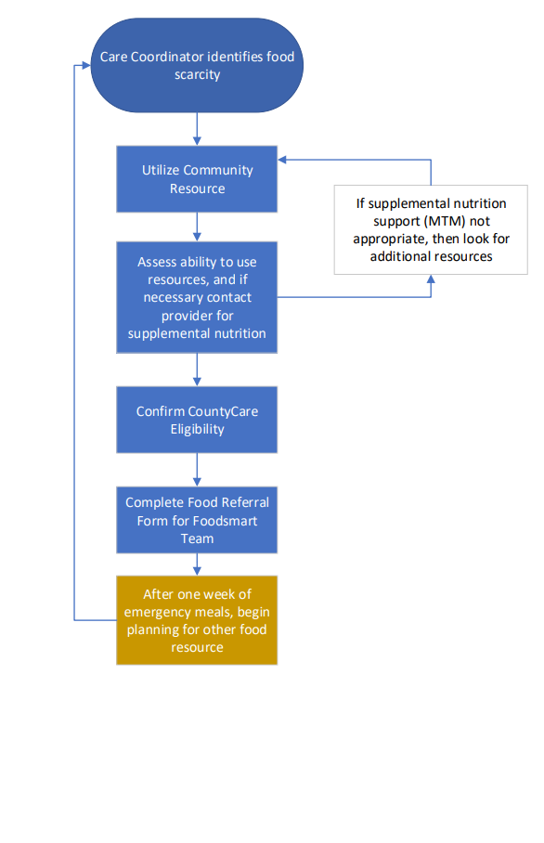
Workflow Review
Strategic Review
Notes:
Review the Workfllow with the Gathered team

Slide 66
Submission Instructions
Instructions for submitting an Emergency Meals referral are nearly identical to the previous process with our past vendor, with a few minor differences:
Identification of emergent food need
Completion of Excel Form with member input
Submission to Foodsmart using an encrypted email
Follow up services for referred member

Slide 67
Form Walkthrough and Submission Instructions
Notes:
AG to Project Screen that hosts the Form, walk through the full form with dummy data. Attach the form to a pre-drafted email, that meets criteria for submission.

Slide 68
Questions and Resources
Notes:
Sharing of form via email post-meeting
Sharing of written instructions post-meeting
AG availability to answer questions moving forward

Slide 69
Thank you!

Slide 70
COVID-19 Updates
CountyCare CM Webinar | For CountyCare Care Coordination Staff – Not for Distribution

Slide 71
COVID-19 Updates
COVID-19 Case Overview (Year to Date) |  | Vaccination Overview (10/17/2022)**
# Cases | 55960 | # only 1 dose* | 22,367 (5.10%)
# Deaths | 293 | # fully vaccinated #3rd doses/Booster | 197,902 (45.15%) 78,228 (17.85%)
CountyCare CM Webinar | For CountyCare Care Coordination Staff – Not for Distribution

Slide 72
Vaccination Locations Updates
All Illinois residents age 5 and older are eligible for the vaccine. Some members may be eligible for a booster dose.
Chicago
Make an appointment by phone (in home or at a site): 312.746.4835
Suburban Cook County
Make an appointment by phone: 833-308-1988
Make an appointment online: www.zocdoc.com/vaccine
Find a Vaccine: https://www.chicago.gov/city/en/sites/covid19-vaccine/home/vaccine-finder.html
Find a vaccination location
Make a vaccination appointment
Request in-home vaccination
Request a vaccine team for an event or workplace
CountyCare CM Webinar | For CountyCare Care Coordination Staff – Not for Distribution

Slide 73

FREE AT HOME COVID TEST KITS
The Federal government have provided a program for free at home covid test kit for families.
Members can make order via this website (COVIDtests.gov - Free at-home COVID-19 tests)
For those that may need help placing an order for your at-⁠home tests. They can Call 1-800-232-0233 (TTY 1-888-720-7489).
COVID Vaccines for Children
CDC recommends everyone ages 5 and older get a COVID-19 vaccine
Pfizer authorized for children ages 5-11 and 12-17
Where can children be vaccinated? Pediatricians’ offices, hospitals, pharmacies, community events, and dedicated CPS, CDPH clinics, and CCH sites
For more information for Chicago: https://www.chicago.gov/city/en/sites/covid19-vaccine/home/for-youth.html
Cook County Residents: Cook County Health will begin offering the Pfizer COVID-19 vaccine to current patients ages 5-11 on Friday, November 5. Patients can walk-in to any CCH site to get vaccinated or make an appointment by calling 833-308-1988 (Monday through Friday 8:00 am – 8:00 pm) or visiting vaccine.cookcountyil.gov
For more information for Cook County: MyShotCookCounty.com

Slide 74
CountyCare COVID Vaccine Reward
What is the reward?
Members who receive their first of two doses or single dose after 8/1/2021 will receive $25 on their OTC Reward Card
How and when do they get their reward?
If the member has an active OTC card, the funds will automatically load to their OTC Reward within 30-45 days
If the member does not have an OTC card, an OTC card will be mailed to them with 30-45 days
Ensure we have member’s preferred mailing address on file
How do members check their OTC Reward Card balance?
Members can check their OTC reward card by calling 312-864-8200 or going online to www.MyOTCCard.com
CountyCare CM Webinar | For CountyCare Care Coordination Staff – Not for Distribution

Slide 75

COVID19 Vaccine for Pregnant Members
CDC recommending COVID19 vaccination for pregnant and breastfeeding people (including booster)
Care Coordinators: Encourage pregnant members to get vaccinated
CountyCare CM Webinar | For CountyCare Care Coordination Staff – Not for Distribution
Source: https://www.cdc.gov/coronavirus/2019-ncov/vaccines/recommendations/pregnancy.html

Slide 76

Care Coordinator Spotlight Reminder
Please email nominations to: iva.Elliott@cookcountyhealth.org
If you have been nominated, I will reach out to you prior to the webinar
CountyCare CM Webinar | For CountyCare Care Coordination Staff – Not for Distribution

Slide 77

Resources & Reminders
CountyCare CM Webinar | For CountyCare Care Coordination Staff – Not for Distribution

Slide 78
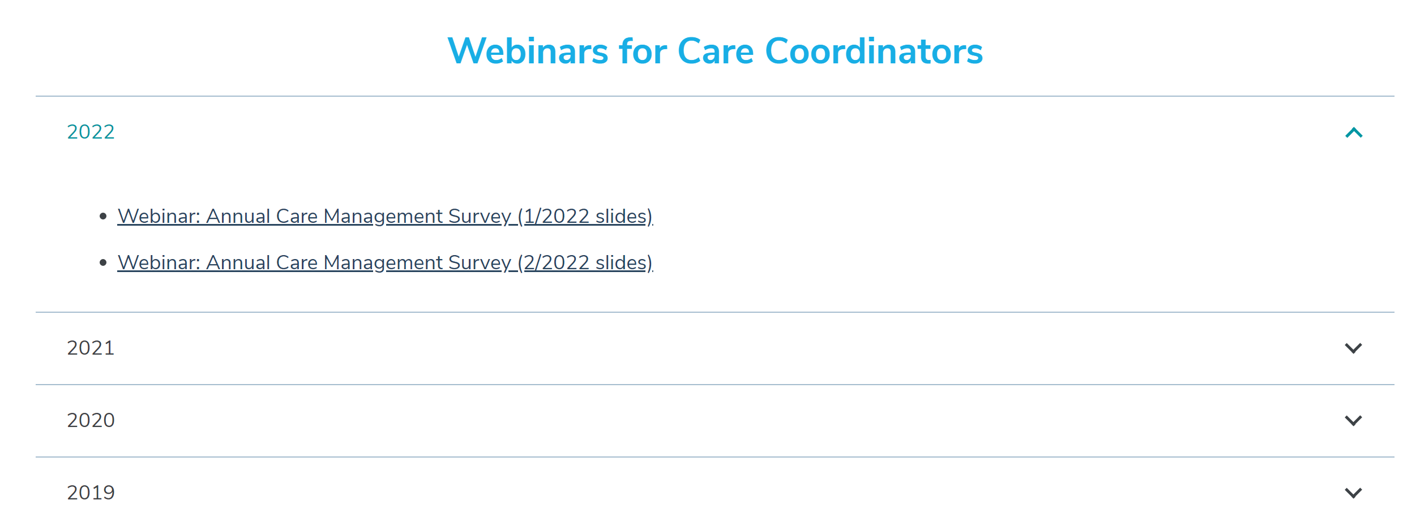
Reminders
The next webinar is scheduled for February 15^{th,} 2023
Webinar feedback: https://redcap.link/23k1fzzb
Slides will be posted to the CountyCare Care Coordination Webpage: http://www.countycare.com/carecoordination
CountyCare CM Webinar | For CountyCare Care Coordination Staff – Not for Distribution

Slide 79
Open Forum
Please share any needs or questions you have by typing in the chat box
CountyCare CM Webinar | For CountyCare Care Coordination Staff – Not for Distribution

