Slide 1









CountyCare Network Provider Orientation
Revised 2025

Slide 2


CountyCare Overview
Mission & Vision
Fast Facts
Key Priorities
Mission
As a public, provider-led health plan, we improve our members’ lives by partnering with communities, supporting a vibrant safety-net, advancing health equity, and empowering providers to deliver integrated, member-centered health care.
Vision
To transform the health of our members and the communities we serve.
Lines of Business:
CountyCare: Medicaid
Membership:
~375,000 Medicaid members
Medicaid Network:
6,900 PCPs, 29,750 specialists, 90+ hospitals, 180 urgent care sites
NCQA Health Plan Rating:
Strategic Pillars
Quality, Safety, and Experience
Workforce
Fiscal Resilience
Transformation and Growth
Equity
Notes:
Aaron Galeener

Slide 3
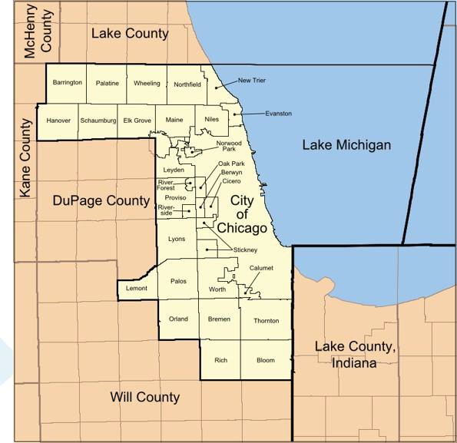
Service Area
CountyCare offers health plan services to
Medicaid members who reside in Cook County, Illinois.
Contracted providers may be in other areas surrounding Cook County.

Slide 4
HealthChoice Illinois
Medicaid eligibility is determined by the Department of Health and Family Services (HFS). To qualify, a person must be either:
Blind, Disabled or Aged (65 or older) OR
Have children under the age of 19 OR
Pregnant
Health Benefits for Immigrant Seniors(65+)
Medicaid members must also meet financial eligibility criteria, residency requirements and in most cases, must be citizens (except for children and seniors).
See the Health & Medical Services page for more information.

Slide 5
Provider Resources

Slide 6
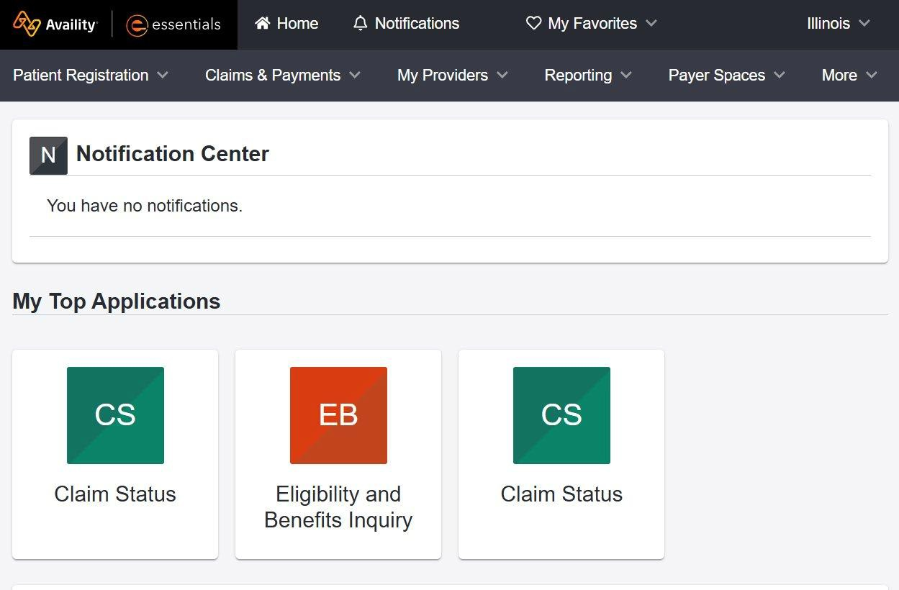

Provider Online Resources
Availity Provider Portal
  Check member eligibility
  Review claim status
  Submit claims
  View remittance and EOP payment details
  View panel roster
  Submit and view prior authorization requests and status
  Access Payer Space resources and provider notices
  Send and receive secure messages
Provider Website
  Provider Manual
  Provider forms
  Billing Manual
  Prior authorization information
  Wellness information
  Prevention and clinical care
  Provider Notices
7

Slide 7
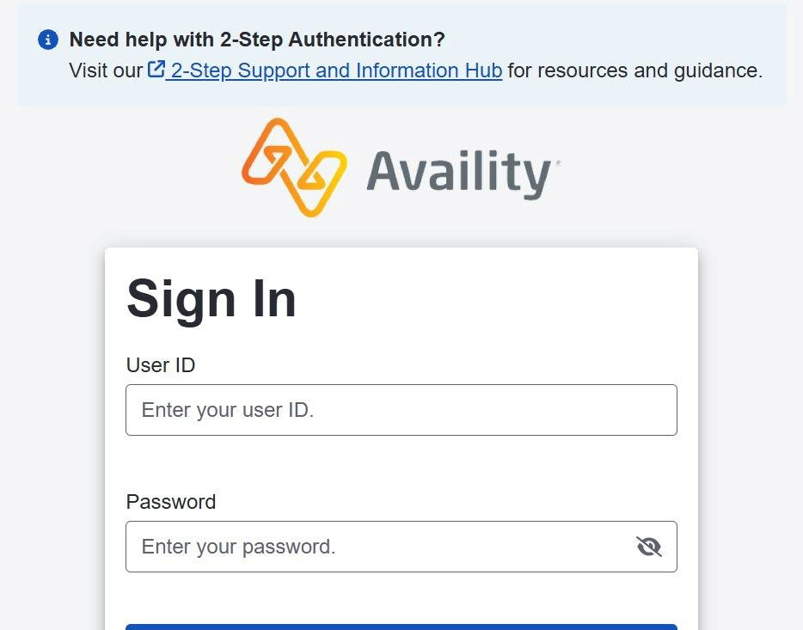
Provider Portal
Availity Essentials - Sign In
 Check Member Eligibility
 Claim Status Reports
 Submit Claims
 View EOP / Remittance Details
 View Panel Roster
 Submit Prior Authorization Requests
 View Prior Authorization Status
 Access Payer Space & Provider Resources
Click on the link above to access the Availity Essentials Portal.
8

Slide 8

Provider Portal
Welcome_New_User.pdf
Access step-by-step training resources and guides in the CountyCare Payer Space within Availity Essentials at essentials.availity.com
9

Slide 9


Provider Manual
The Provider Manual serves as an extension of your provider agreement and is a comprehensive reference tool and includes the following information:
  Administrative processes
  Prior authorization and referral processes
  Claims and encounter submission processes
  Plan benefits
  Clinical practice guidelines
  Availability and access standards
  Care management programs
  Enrollee rights
  The current Provider Manual remains the July 2025 version. Please check the CountyCare webpage for the most up-to-date Provider Manual.
Additional Provider Resources are available here

Slide 10
Provider Data Management
Submit updated provider data at least every thirty (30) days via the current Universal IAMHP Roster. Rosters not in the current Universal IAMHP Roster format will be returned and can delay new provider additions or updates which could affect claims payment.
Submit completed rosters via email to CountyCareProviderRosterSubmission@cookcountyhhs.org and copy your Provider Relations Representative.
Please remember to submit your comprehensive Universal IAMHP roster quarterly and any additions, changes, or terminations monthly.
The most updated Universal IAMHP Roster Template and IAMHP roster validation tool are located on the IAMHP website https://www.iamhp.org/providers

Slide 11
Provider Services
Top 5 reasons to contact your Provider Relations Representative:
To schedule an orientation for new staff or ongoing education for existing staff.
To learn more about our electronic solutions for authorizations, claims status and eligibility verification.
To obtain clarification on policies, procedures or your provider agreement.
To learn about HEDIS and other quality programs and initiatives.
To learn how your practice can grow with CountyCare.
Who is my CountyCare Provider Relations Representative? Click here to locate the contact information for your assigned Representative.
General provider inquiries: CountyCareProviderServices@cookcountyhhs.org
312 - 864 - 8200
11

Slide 12
Eligibility, Authorizations, and Claims

Slide 13
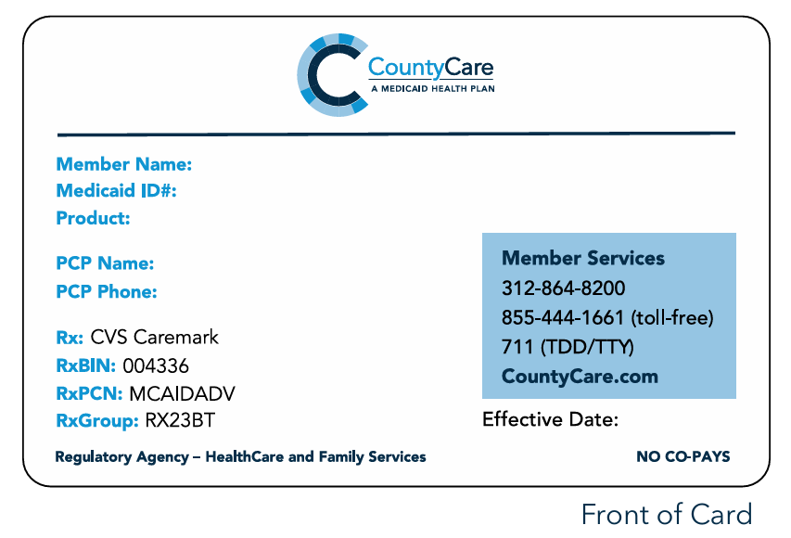
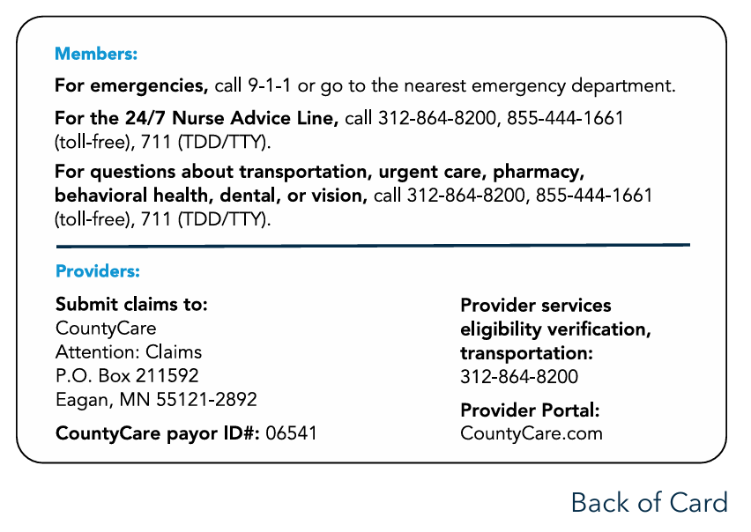
Member Identification Cards
Members should present their ID cards at the time of service
Request to see a photo ID if you are not familiar with the member
Contact Provider Services for any suspected fraud at 312-864-8200
CountyCare Member ID Card*
14
*ID Cards are not a guarantee of active member eligibility

Slide 14
Checking Member Eligibility
Secure online provider portal
https://essentials.availity.com
Automated IVR Phone Line: Call our 24-hour member eligibility interactive voice response (IVR) system at 312-864-8200, 711
(TTY/TDD)
County Care Provider Services: If you cannot confirm a member’s
eligibility using the methods above, call us at 312-864-8200, 711 (TTY/TDD)
Provide the following
  Member Name
  Member ID Number
  Member D O B
State member eligibility system, MEDI www.myhfs.Illinois.gov

Slide 15
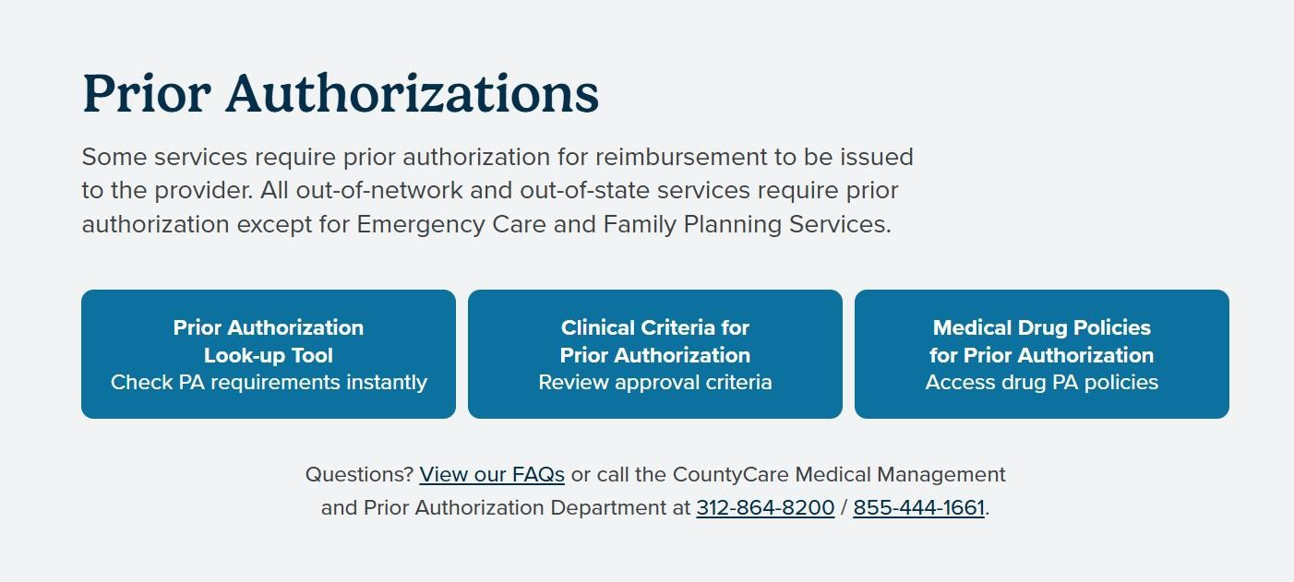
Overview of Prior Authorizations
For faster turn-around time and easier tracking, submit prior authorization requests through Availity Essentials. Log in to Availity, then access the CountyCare Payer Space to launch Identifi via Single Sign-On (SSO). Click here to Login.
To determine if a service requires a prior authorization, click here.

Slide 16
Prior Authorization
Prior authorization for any service, including behavioral health, should be requested at least 14 calendar days before the requested service delivery date.
CountyCare renders decisions on routine requests within four (4) calendar days of the receipt of request.
CountyCare renders decisions on urgent/emergent requests within 48 hours of receipt of the request.
Prior authorization requests must include all relevant clinical information* needed to make a medical necessity decision.
*”Relevant clinical information” includes the results of any face-to-face clinical evaluation (including diagnostic testing) or
second opinion that may be required. Failure to submit necessary clinical information can result in an administrative denial of
the requested service.

Slide 17
Submitting Claims
Electronic Claims
Payer ID: 06541
Paper Claims
All claims and encounters should be submitted to:
County Care Health Plan
P.O. Box 211592
Eagan, MN 55121 - 2892

Slide 18
Basic Claim Requirements
Billing guidance for all provider types is available on the IAMHP website.
Ensure members are eligible with CountyCare on the date of service.
Verify service is a covered benefit on the date of service.
Follow prior authorization processes; prior authorization requirements can be found here.
Submit all claims within 180 days from the date of service.
Claim disputes and appeals must be received within 6 0 calendar days from the date of the Explanation of Payment (EOP) or Remittance Notice.

Slide 19
Electronic Remittance Advice (ERA)
CountyCare also provides Electronic Remittance Advice (ERA) to participating providers.
Using an ERA helps reduce costs and speeds secondary billings.
For initial ERA enrollment with Availity, please contact Availity directly.
If you currently work with a different clearinghouse for your electronic claims submission, your clearinghouse will work directly with Availity to set up ERA.
Availity Provider Support: 800-282-4548

Slide 20
Electronic Funds Transfer (EFT)
CountyCare provides Electronic Funds Transfer (EFT) to participating providers.
Using EFT helps reduce costs and can improve cash flow. CountyCare joined the InstaMed Network to deliver payments via free electronic remittance advice (ERA) and electronic funds transfer (EFT).
ERA/EFT is a convenient, paperless and secure way to receive claim payments. Funds are deposited directly into your designated bank account and include the TRN Reassociation Trace Number, in accordance with C A Q H C O R E Phase III Operating Rules for HIPAA standard transactions.
Two options to register for free ERA/EFT from InstaMed:
  Online: visit www.instamed.com/eraeft
  Paper: complete the order form and fax to (877) 755-3392

Slide 21
Provider Training

Slide 22
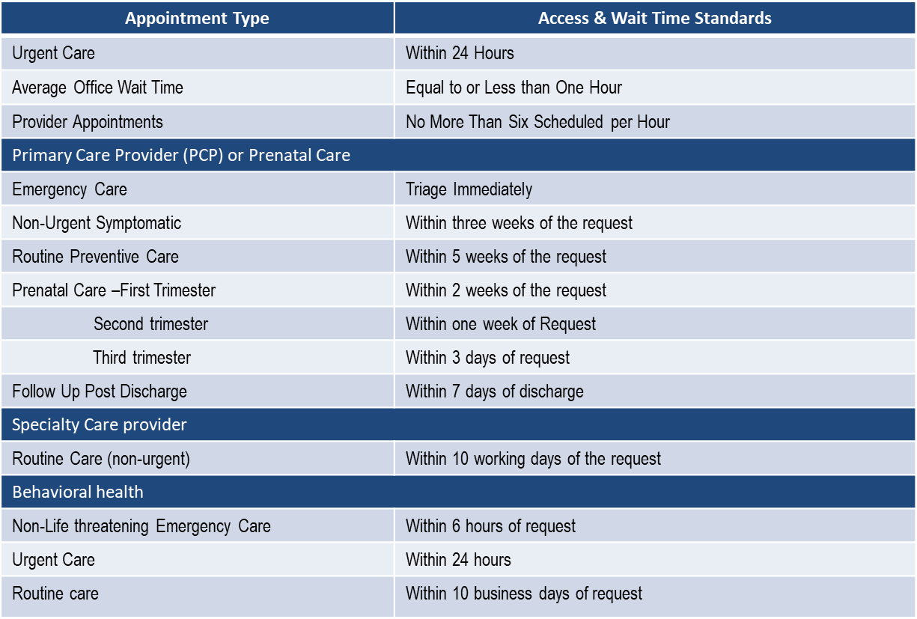
Access & Availability Standards
CountyCare monitors compliance of Access and Availability standards and conducts ongoing assessments. Providers must adhere to the following regulatory standards:

Slide 23
Access & Availability Standards
CountyCare follows the accessibility requirements set forth by regulatory and accrediting agencies.
As part of our continuous efforts to ensure CountyCare members have timely access to care, in- network providers are randomly selected to participate in telephone surveys to monitor
compliance. CountyCare will also utilize surveys to verify the following information:
  Office locations and phone numbers
  Hospital affiliations
  Accepting new patients
  Office staff awareness of the provider’s participation in the CountyCare Health Plan network.
Your participation in these surveys is greatly appreciated and ensures that we can provide our members with timely access to care and accurate information for in-network providers.
For additional information please review the CountyCare Provider Manual.

Slide 24
Required Provider Trainings
Completion of the following trainings on an annual basis is a contractual requirement. These trainings can be completed by downloading the presentation materials and submitting an attestation form.
Health, Safety, Welfare, Reporting and Follow-up of Incidents
Cultural Competency
Fraud, Waste and Abuse
For additional training opportunities available click here.
The current Provider Manual remains the July 2025 version. The 2026 Provider Manual is currently in progress and will be linked in the provider orientation slides once all updates have been completed and the final manual is available.

Slide 25
Cultural and Linguistic Competency
CountyCare is committed to having all CountyCare network providers fully recognize and care for the culturally diverse needs of the members they serve. To accomplish this, CountyCare has established a Cultural Competency and Humility training to help guide and monitor provider efforts to ensure cultural competency and humility, building on CountyCare partner experience
and established relationships in the communities served.
CountyCare’s Cultural Competency plan is based on the adoption of the National Standards for Culturally and Linguistically Appropriate Services (CLAS) in Health Care, published by the US Department of Health and Human Services’ Office of Minority Health in 2000 and N C Q A Health Plan Standards and Guidelines.
Culturally and linguistically appropriate services (CLAS) are healthcare services that are respectful of, and responsive to, the patient’s cultural and linguistic needs.
Care is designed to be effective understandable and respectful.

Slide 26

Cultural Competency Standards
To respond effectively and appropriately to different cultural/generational contexts in the provider setting

Slide 27

Cultural Humility
Recognize the importance of institutional accountability
Awareness of our own assumptions and prejudices
Learn throughout our lives as our personal and professional
experiences change
Active in redressing the imbalance of power inherent in the relationship with members and CountyCare
Be humble about our level of knowledge regarding our
patients' beliefs and values
Cultural Humility Is Critical to Health Equity |AAFP

Slide 28
What is Cultural Humility?
“[A] commitment and active engagement in a lifelong process that individuals enter into on an ongoing basis with patients, communities, colleagues, and with themselves”
Melanie Tervalon, MD, MPH & Jann Murray-Garcia, MD, MPH

Slide 29


Cultural Humility vs Cultural Competency
Culturally Competency
Cultural Humility
“I am the expert”
The community, member or patient is the expert.
Assumes there is an “end” goal to understanding others lived
experience
A lifelong process of learning and reflecting
Generalizations about populations and communities
Individualized approach and conversations with each member

Slide 30
Patient-Centered
Our team is collaborative, coordinated, and accessible. The right support is provided at the right time and the right place.
Care focuses on emotional well-being as well.
Members’ preferences, values, cultural traditions, and socioeconomic conditions are considered and respected.
Members and their desired support systems are an expected part of the care team and play a role in decisions.
Information is shared fully and in a timely manner so that members and their support system can make informed decisions.
What Is Patient-Centered Care? |NEJM Catalyst

Slide 31
Fraud, Waste, and Abuse (FWA)
CountyCare takes the detection, investigation, and prosecution of fraud and abuse very seriously, and has a fraud, waste, and abuse program that complies with Illinois and federal laws. CountyCare’s fraud, waste and abuse program performs front and back-end audits to ensure compliance with billing regulations.
A Special Investigation Unit (SIU) performs back-end audits which, in some cases, may result in taking the appropriate actions against those who, individually or as a practice, commit fraud, waste and/or abuse, including but not limited to:
Remedial education and/or training to attempt to eliminate the egregious action
Increasingly stringent utilization review
Recoupment of previously paid monies from a provider/practice
Termination of provider agreement or other contractual arrangement
Civil and/or criminal prosecution
Any other remedies available to rectify the issue identified

Slide 32
Fraud, Waste, and Abuse (FWA)
Some of the most common fraud, waste and abuse issues identified are:
Unbundling of codes
Up-coding
Add-on codes without primary CPT
Diagnosis and/or procedure code not consistent with the member’s age/gender
Use of exclusion codes
Excessive use of units
Misuse of benefits
Claims for services not rendered
If you suspect or witness a provider inappropriately billing for Medicaid services or a member receiving inappropriate services, please call our anonymous and confidential hotline at 844-509-4669. CountyCare takes all reports of potential fraud, waste and/or abuse very seriously and will investigate all reported issues.
For more information on Fraud, Waste and Abuse, please see the Provider Manual.

Slide 33
Health, Safety, Welfare, Critical Incidents
Abuse, Neglect, & Exploitation Defined
Health, safety welfare, reporting and follow-up of incidents regarding members are defined by Illinois State law. They involve actions that may jeopardize the health, safety and well-being of vulnerable adults by causing harm or creating a serious risk of harm to a person by their caregiver or other trusted individual, despite intent.
Types of Incidents:
Physical abuse – the willful infliction of physical pain or injury, or the willful deprivation of services necessary to the physical safety of an individual
Psychological abuse – an act that inflicts emotional harm, invokes fear or humiliation, or otherwise negatively impacts the mental health or safety of an individual
Neglect – the failure of an agency, facility, employee or caregiver to provide essential services necessary to maintain the physical and or mental health of a vulnerable adult
Financial exploitation – the misuse or taking of the vulnerable adult’s property or resource by means of undue influence, breach of fiduciary relationship, deception, harassment, criminal coercion, theft or other unlawful or improper means

Slide 34
Health, Safety, Welfare, Critical Incidents
Incidents involving member abuse, neglect and financial exploitation must be reported to the appropriate authorities, as mandated by state law. CountyCare takes member health, safety and welfare very seriously, and has a reporting process that complies with Illinois and federal laws
An incident must be reported before it can be investigated. Mandated reporters are required by law to report abuse, neglect and financial exploitation. Mandated reporters can be*:
employees of facilities
community agencies
doctors, nurses, psychologists, dentists, social service workers
law enforcement personnel
*Others may report incidents voluntarily. In either case, the identity of the reporter is not disclosed without the written permission of the reporter, except when required by court order.

Slide 35
Health, Safety, Welfare, Critical Incidents
How to Report an Incident: Incidents related to CountyCare members can be reported to CountyCare by fax, email, or phone.
Fax a completed Critical Incident Reporting Form to 312-637-8312
Email a completed Critical Incident Reporting Form to countycarequalityofcare@cookcountyhhs.org
Call Provider Services at 312-864-8200, 711 (TTY/TDD)
You may also report incident to the appropriate state agency, as follows:
For members age 18 and older, contact the Illinois Department on Aging, Adult Protective Services Hotline at 866-800-1409.
For members in nursing facilities, contact the IDPH Nursing Home Complaint Hotline at 800-252- 4343 24 hours a day.

Slide 36

Pay for Performance (P4P)
Provider P4P program updates are posted on the CountyCare website. Click here for more information on the CountyCare P4P program.

Slide 37
Member Rights

Slide 38
Member Rights
Be treated with respect and dignity at all times
Have personal health information and medical records kept private except where allowed by law
Be protected from discrimination
Be free from any form of restraint or seclusion used as a way to force, control, and ease of reprisal or retaliation
Receive information, including the Member Handbook from CountyCare in other languages, audio, large print or Braille
Have use of an interpreter when needed including during any complaint or appeal process
Have a candid discussion with providers about appropriate or medically necessary treatment options for your conditions, regardless of cost or benefit coverage
Receive information on available treatment options and alternatives, this includes the right to ask for a second opinion
Providers must explain treatment options in a way the member understands
Receive information necessary to be involved in making decisions about health care treatment and choices

Slide 39
Member Rights
Refuse treatment and be told what may happen to the member’s health if treatment is refused
Receive a copy of their medical records and in some cases request that they be amended or corrected
Choose and change their PCP from CountyCare
File a complaint (sometimes called a grievance), or appeal about CountyCare or the care they received without fear of mistreatment or backlash of any kind
Appeal a decision made by CountyCare on the phone or in writing
Request and receive in a reasonable amount of time, information about CountyCare, and its providers, services and polices
Receive information about CountyCare Member Rights and Responsibilities (members also have the right to suggest changes in this policy)
Receive health care services in ways that comply with federal and state law, e .g ., CountyCare must make covered services accessible to members and those services must be available twenty-four (24) hours a day, seven (7) days a week

Slide 40
Member Rewards

Slide 41
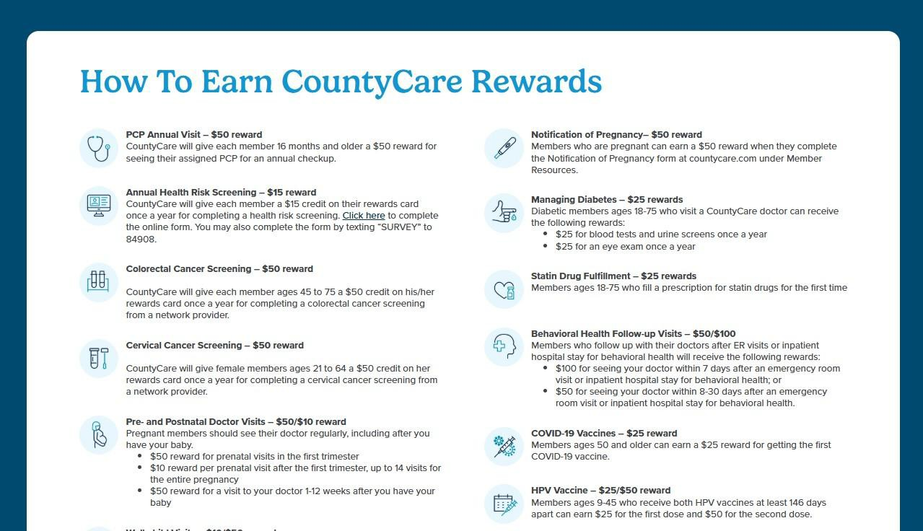
Member Rewards
CountyCare members have access to additional benefits and rewards in addition to their regular health care coverage.
For details on all member rewards, please visit the CountyCare website.

Slide 42

Free LASIK
CountyCare is the first and only Medicaid plan in Illinois that covers LASIK surgery.
Members can visit here to help find an eye care provider.
Members can call CountyCare Member Services at 312-864-8200 for details or if they have additional questions.

Slide 43
Access to Care

Slide 44
Take Care, Take Control Program
CountyCare’s Take Care & Take Control program is a guide to learning about diabetes and how to manage it.
Benefits for Members with Diabetes: CountyCare offers special benefits to help members manage their blood sugar and improve their health.
Weight Watchers
Glucometers
Continuous glucose monitors
Blood pressure monitors
Cash rewards
Help to quit smoking
Medication
Free transportation
Care coordination

Slide 45
CountyCare Care Coordination
More information on our Care
Coordination Program can be found here.
Care Management is required for all high-risk members, MLTSS, LTSS,
pregnant women, children with special health needs and anyone who requests it.
Care Management
Universal Care Coordination
Members are offered targeted support as needed to overcome barriers to accessing care. Support through health care transitions, and self-management support are offered.

Slide 46
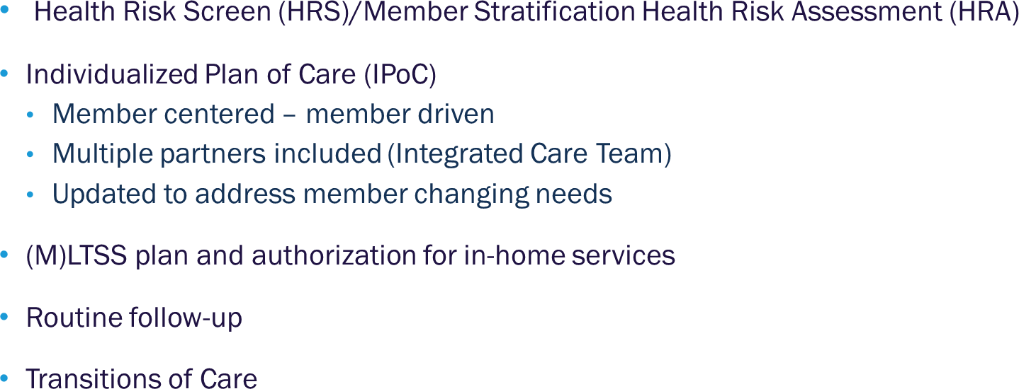

Care Management Activities

Slide 47
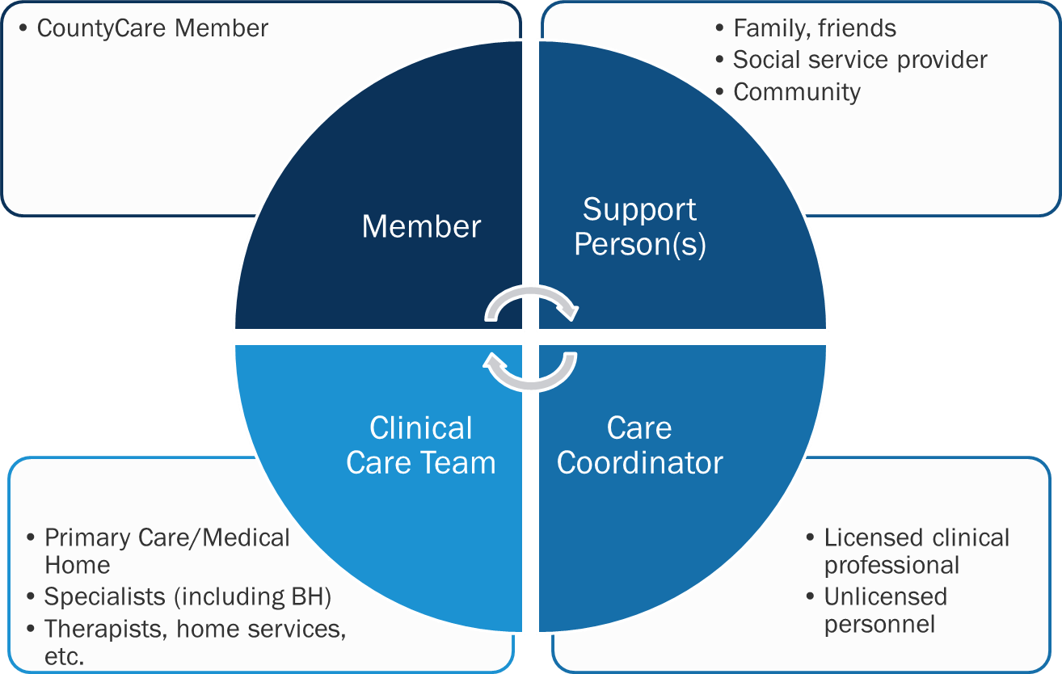
Integrated Care Team

Slide 48
Q & A

