Slide 1
December’s Care Management Webinar
Wednesday, December 18, 2024

Slide 2
For information on the Gvoke Hypo Pen please view the broucher

Slide 3

County Care Kudos
Mishell Kerr
Community based nurse care coordinator
Kudos to I want to recognize Mishell for her outstanding dedication and compassion towards our members.
Her actions improved the member's quality of life and exemplify our organization's core values. Please join me in expressing our heartfelt appreciation to Mishell for her exceptional service and commitment to our mission.

Slide 4
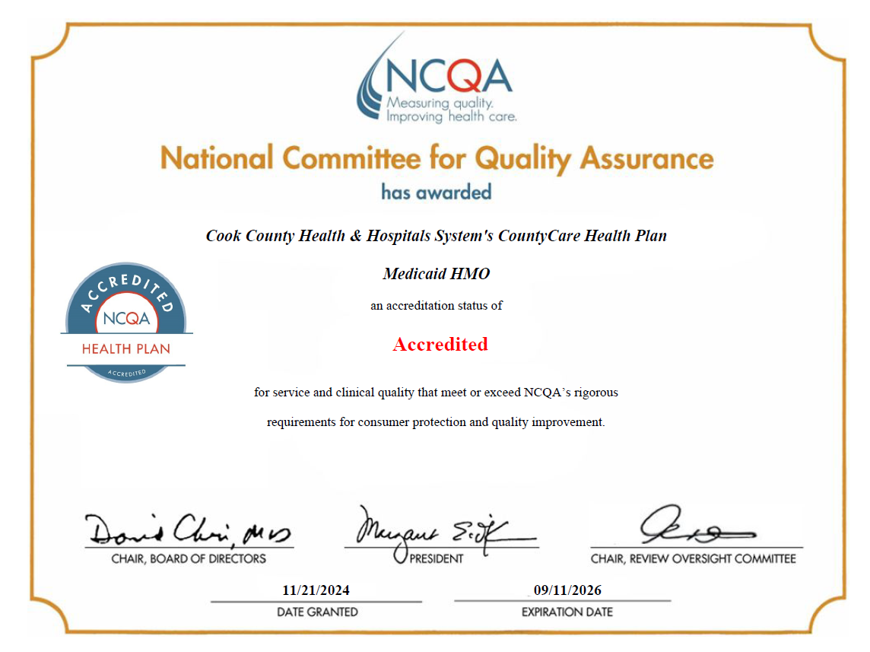

Slide 5
Announcements
Next webinar is January 15th, 2024!
Slides posted on CountyCare Care Coordination Webpage:
  http://www.countycare.com/carecoordination
Have feedback? Ideas for future topics? Please share!
  https://redcap.link/23k1fzzb
Please email questions/concerns: raphael.daniels@cookcountyhealth.org

