Slide 1
March Care Management Webinar
Wednesday, March 20, 2024

Slide 2

Home Delivered Meals Program
City of Chicago, Department of Family & Support Services
Chicago Area Agency on Aging

Slide 3
Agenda
Overview of the Aging Network
Overview of DFSS & Senior Services Area Agency on Aging
Older American Act Requirements for Senior Nutrition Programs
Home Delivered Meals Program Requirements
Role of Managed Care Organizations (MCOs)
Role of Home Delivered Meals (HDM) Provider

Slide 4
The Aging Network
The Aging Services Network
U.S. Federal Government Department of Health and Human Services (Administration on Community Living)
State Units on Aging (IDOA)
Area Agencies on Aging
Local Service Providers
Access Services
Community Services
Institutional Services
In-Home Services
Voluntary Organizations
Legal Assistance
Senior Centers
Nutrition Services

Slide 5
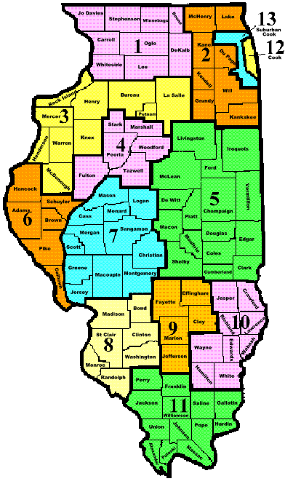
Illinois Area Agencies on Aging(AAA)
1. Northwestern Illinois Area Agency on Aging
2. Northeastern Illinois Area Agency on Aging
3. Western Illinois Area Agency on Aging
4. Central Illinois Area Agency on Aging
5. East Central Illinois Area Agency on Aging
6. West Central Illinois Area Agency on Aging
7. Area Agency on Aging for Lincoln land
8. AgeSmart Community Resources
9. Midland Area Agency on Aging
10. Southeastern Illinois Agency on Aging
11. Egyptian Area Agency on Aging
12. Chicago Area Agency on Aging
13. AgeOptions

Slide 6
Area Agencies on Aging(AAA) Five Core Services
The 13 Illinois AAAs efficiently and effectively deliver 5 vital core support services to thousands of older adults every year.
Community Based Services and Supports
Information and Assistance
Options Counseling
Assistance with Medicare or Medicaid
Benefits Assistance
In-Home Services
Senior Center Activities
Recreation Programs
Legal Assistance
Health and Wellness Programs
Evidence-based healthy aging programs
Elder Rights Services
Adult Protective Services
Ombudsman Program advocating for residents of long-term care facilities, home-care clients & MCO enrollees
Caregiver Services
Support to caregivers
Respite for caregivers
Support to Grandparents raising grandchildren
Nutrition Services
Home Delivered Meals
Congregate (Group) Meals

Slide 7
City of Chicago Department of Family & Support Services (DFSS) Divisions
Division on Domestic Violence
What
24/7 DV hotline
Legal counseling & advocacy
How
Counseling providers
Legal advocates
Homeless Services
What
Prevention
Outreach & shelter
Housing supports
System coordination
How
Service providers
Call center
Youth Services
What
One Summer Chicago
Out of School Time
Services for youth with complex needs
How
Afterschool programs
Mentoring
Senior Services/Area Agency on Aging
What
Nutrition Services
Caregiver Services
In-home Care (i.e., Chore)
Information & Benefits
Elder Rights & Advocacy
How
Senior Centers staffed by DFSS employees
Service providers
Children Services
What
Early Head Start
Head Start
Childcare
Preschool
How
Community-based early learning sites
Workforce Services
What
Job preparation, training & placement
Connection to supports
How
Job training providers
Community Re-Entry Support Centers
Human Services
What
Case management
Referrals to services
Public benefits assessment
How
Community Service Centers with DFSS staffing
Service providers

Slide 8
DFSS Senior Nutrition Program
Like many of the programs and services offered through our division, the nutrition programs are primarily funded through the Older American Act (OAA). There are two core nutrition programs for older adults:
Congregate Dining (Golden Diners Program)
Home Delivered Meals (Meals on Wheels)
As outlined in the OAA, the goals of the Senior Nutrition Programs are to:
Reduce hunger and food insecurity
Reduce social isolation of older adults
Promote the health and wellbeing of older adults
Delay adverse health conditions

Slide 9
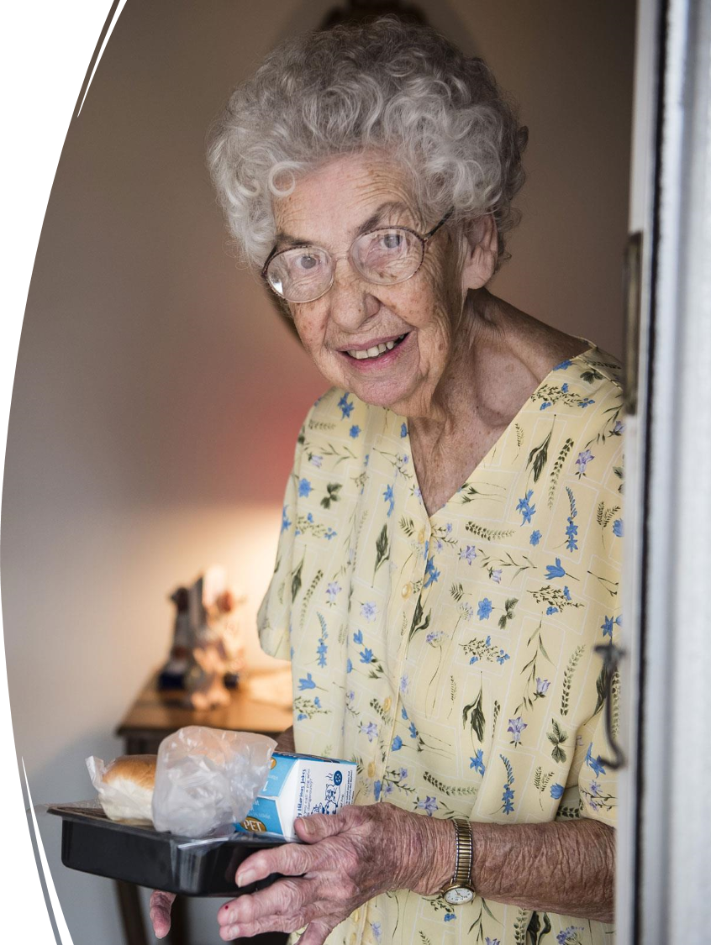
Chicago’s Home Delivered Meals (HDM) Program
Provides nutritious meals to older adults (60 years and older) who are frail and/or homebound because of illness or incapacitating disability or are otherwise isolated

Slide 10
Chicago's Home Delivered Meals (HDM) Program
Client eligibility includes the following:
A resident of the City of Chicago.
60 years of age or older.
The spouse of the senior, regardless of age or condition, may receive a meal if delivery of the meal is in the best interest of the senior. Individuals of the same sex who are legally married may also receive a meal;
Frail and/or homebound* because of acute or chronic illness, incapacitating illness, impaired cognition or are otherwise isolated which leaves them unable to shop, prepare or obtain meals; 3+ days with acute/chronic/incapacitating illness
Not receiving HDM from another source.
No other assistance is available to shop and/or prepare meals.

Slide 11
Chicago's Home Delivered Meals (HDM) Program
Served Weekly: Over 8,000 clients & 76,000 meals
Served Annually: Over 11,000 distinct clients and over 4 million meals.
All meals provided follow the nutrition guidelines set forth by IDoA and all menus are approved by a Registered Dietician.
Clients are deemed eligible for the program through the CCUs, MCOs, or DFSS (emergency cases only).
There is one HDM provider for DFSS.
No client waiting list in the City of Chicago.

Slide 12
Chicago's Home Delivered Meals Program
The majority of our clients receive two meals a day through a variety of meal program combinations that are based on the following:
Weekday hot meal program consists of 5-day (daily) deliveries of one hot & one cold meal delivered Monday- Friday.
Weekday frozen meal programs are once-a-week deliveries of either 3 or 5 days of frozen & cold meals depending on diet.
Weekend frozen meal program consists of two frozen & two cold meals, typically delivered on Friday for the weekend, or as part of the weekday delivery.
Shelf Stable meals consist of one or two complete meals for each day depending on diet and are typically provided for a minimum of five days.
The meal program combinations offered to clients depend on the meal type, meal diet, number of days, and duration of service that best meets the needs of the client.

Slide 13
HDM Meal Types
During HDM assessment, the MCO should determine the meal type (Hot or Frozen/Weekend) based on the clients needs.
Clients eligible for frozen meals:
Clients able to reheat meals using a working stove or microwave oven.
Clients receive (3) meal UNITS or (5) meal UNITS per week. One frozen and one cold meal for each day of service, delivered once a week.
Weekend meals are also available whereby the clients receive (2) meal UNITS for the weekend (two frozen and two cold meals). These meals are delivered as a separate delivery or part of the weekday frozen meal service.
The vast majority of clients enrolled in the HDM program receive frozen meals.
Clients eligible for hot meals:
Clients do not have the ability to heat their own meals because of a physical or mental impairment, or they do not have a working microwave or stove.
Clients receive (1) meal UNIT for each day which consists of one hot and one cold meal delivered daily Monday through Friday.
Typically, if a client is unable to manage frozen meals, they are not eligible for the weekend program, unless the client has someone who can assist in the preparation of the weekend frozen meals.

Slide 14
HDM Meal Diets Offered
General Diet (frozen, cold, and hot): Offered to more widely address the needs of older adults. This diet provides a variety of general cuisine meals with the inclusion of culturally inspired meals.
Vegetarian Diet (frozen, cold, and hot): Offers meatless meals that include eggs, dairy, and fish/seafood.
Kosher Diet (frozen only): Follows Jewish dietary framework for food processing, preparation, and consumption.
Pureed (frozen only): Offers options for adults who have trouble swallowing. The food is blended or put through a food processor and modified to a smooth, pudding-like consistency.
South Asian Diet (frozen only): Offers Indian and Pakistani meal options.
East Asian Diet (frozen only): Offers a blended menu that includes Chinese, Korean, and Vietnamese meal options.
Shelf Stable: Meals that can be safely stored at room temperature in a sealed container or package that follow the diets listed.
All clients enrolled by both CCUs & MCOs have access to all meal programs & diets.

Slide 15
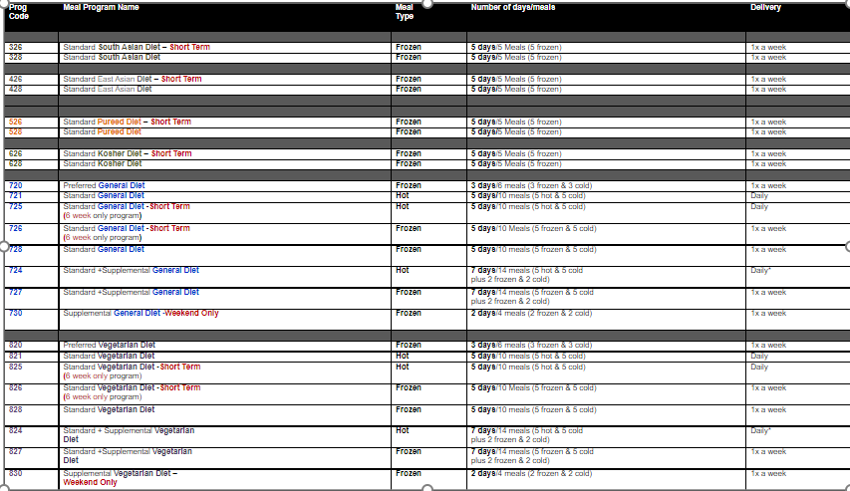
Home Delivered Meal Program Combinations
A shared folder with HDM program information and applicable forms will be shared with MCOs.

Slide 16
Accessing Home Delivered Meal Services
Clients are typically connected to services via our Information and Assistance Center (I&A) which is the gateway to services for seniors, calls are received through (312-744-4016) for all services including HDM and are routed to appropriate agencies to initiate services.
Typically, clients in need of meals are also assessed for other services (i.e., CCP)
The Care Coordination Units (CCUs) and/or Managed Care Organizations (MCOs) are responsible for conducting the assessments and determining the eligibility for Home Delivered Meal Services.

Slide 17
Role of CCUs & MCOs
Conduct in-home Assessments to Determine Need/Eligibility for HDM based on referral type: Standard, Urgent, or Emergency
Determine the Meal Type: Hot or Frozen/Weekend
Determine Meal Service Program Duration: Short-term Meal Service (Presumes eligibility/temporary urgent need) or Long-term Meal Service
Determine Meal Diet Type: General/ Vegetarian/ Kosher/ Pureed/ Southern Asian/Eastern Asian
Review Contribution Letter with Client
Complete HDM Referral Form & Submit to HDM Provider
Conduct Re-assessment of HDM Clients annually or more frequently depending on physical, mental, environmental changes of HDM client.

Slide 18
Home Delivered Meals Referral Types
Determine the Level of Urgency: There are three type of referrals
Standard Referral:
The MCO must complete the “HDM Nutrition Referral Form” and email the HDM Provider within 5 business days.
The MCO must contact the client within 72 hours to schedule a home visit to conduct the HDM assessment. The case manager has up to 30 calendar days to conduct the home visit.
Urgent Referral:
Clients who are not in immediate danger or risking their health or entering a nursing home, but whose situation warrants prompt attention, primarily when the client’s situation is likely to change or deteriorate in less than two weeks.
Complete the “HDM Nutrition Referral Form” and email to HDM Provider;
The MCO must contact the client within 72 hours and if necessary, the case manager must make a home visit to conduct an assessment within 7 calendar days.
Emergency Referral
Clients who have extenuating circumstances and/ or are at imminent risk.
Complete the “HDM Nutrition Referral Form "and email to HDM Provider asap.
MCO must contact the client immediately and if necessary, a case manager will make a visit to conduct an assessment within 24 hours.
Meals begin next day (if hot) or next delivery day of assigned route (if frozen).

Slide 19
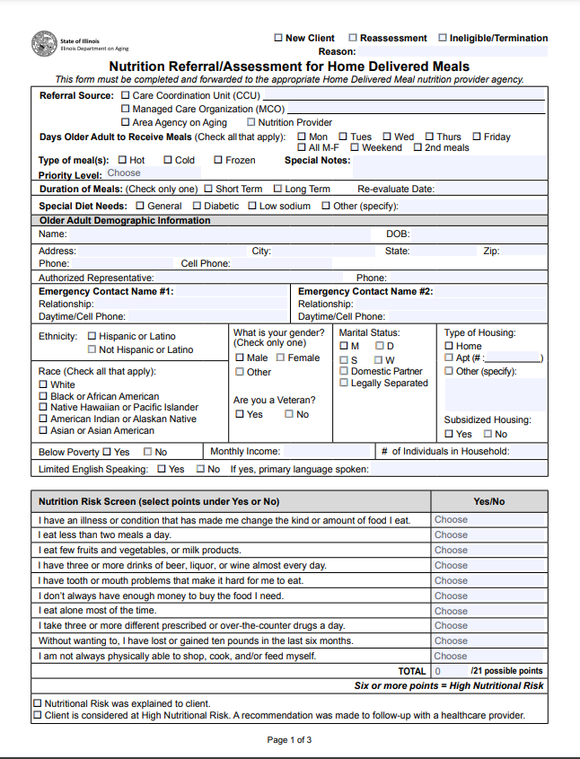
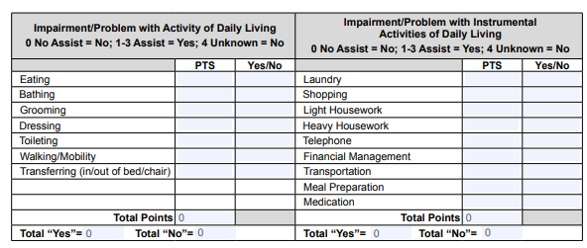
HDM Nutrition Referral
The HDM Nutrition Referral form must be completed entirely with special attention to the following sections which are federally required fields:
Demographic Information (A.)
Nutrition Risk Screen (B.)
ADL/ IADL Information (C.)
HDM referrals submitted with incomplete and/or missing information from these sections will experience delays in services.
Once completed, please email HDM Provider at: HDMreferrals@openkitchens.com
A.
B.
C.

Slide 20
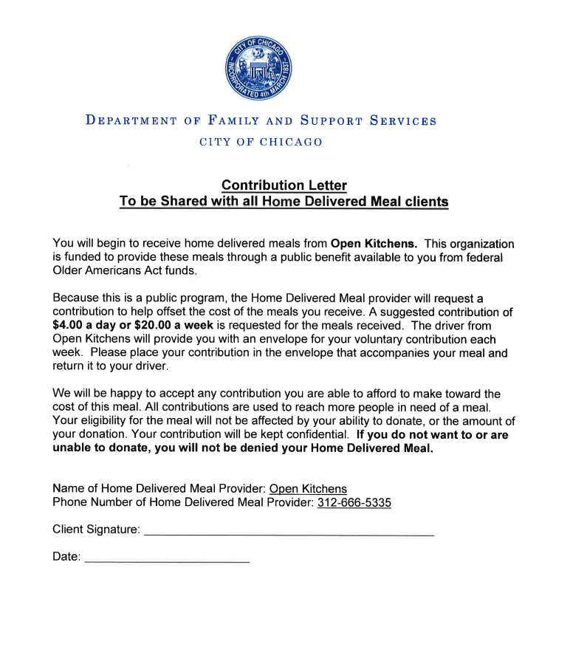
HDM Client Contribution Letter
MCOs must review HDM Client Contribution Letter with all clients assessed and referred.
The HDM contribution letter template is available in the HDM program document shared folder.
As a reminder, contributions towards the cost of home delivered meals are voluntary. Individuals unable or unwilling to contribute will not denied meals.

Slide 21
Changes in HDM Client Status or Information
Once clients are enrolled, the CCUs/MCOs may report the following changes in client status or information to the HDM Provider at: HDMreferrals@openkitchens.com
Temporary suspension of meals (skips)
Terminations
Continuance of meals (resume)
Other information that impacts client services
HDM Clients may also call I&A to report any status changes (temporary hold on meals, termination, continuance, etc.).
All changes are then forwarded to the HDM Provider for appropriate action.
Changes are then implemented by the HDM Provider as requested.

Slide 22
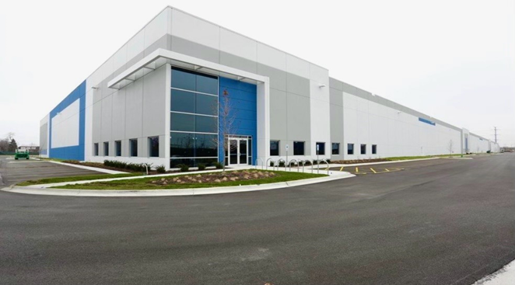
HDM Provider: Open Kitchens, Inc.
Open Kitchens, Inc. is the HDM Provider for the City of Chicago and is responsible for the operation of the program citywide. This includes:
The preparation and delivery of various meal types and diets into clients’ homes.
Working with referring agencies to collect, track, implement and manage client enrollment information and activity changes.
Meals are produced in a 55,000 square foot facility located in Chicago’s Little Village neighborhood.
The agency employs over 250 staff with diverse backgrounds and many of whom have long-standing employment histories with the agency.

Slide 23
HDM Provider Role
Client Enrollment:
Receives referrals from CCUs & MCOs
Enters information from the referral including client demographic and assessment data into AgingIS
Assigns route to client
Assigns meal program based on information included in the referral.
Meals are started the next day (for hot meals) or the next delivery day for the route assigned to the client for frozen meals
Notifies new clients of anticipated start date
Prepares new client enrollment packet

Slide 24
HDM Provider Role
Client Activity & Status Management
The HDM Provider receives and implements changes in client activity and client information as received from I&A, CCUs, MCO’s and DFSS Senior Services Program Staff to include: skips, resumes, terminations, changes in address, phone numbers, meal diet or meal type, changes in delivery days, etc.
Documenting and Reporting Clients that Did Not Respond to an Attempted Delivery
Clients who do not answer upon an attempted delivery are documented as “no answer” and listed on a report which is sent to the CCU’s and DFSS Program Staff daily for awareness and follow-up as deemed necessary.

Slide 25
HDM Provider Role
Client Engagement and Check-in
Each delivery presents an opportunity to engage and check on the well-being of clients enrolled in the program. Each encounter can be a welcomed interaction for the older adult, possibly their only interaction and an opportunity to identify unmet needs or challenges the older adult might be experiencing.
Nutrition Education
The HDM provider is responsible for the provision of nutrition education as well as the distribution of other informational materials to older adults enrolled in the program through the meal delivery process.
Voluntary Contributions
As required by federal funding, all clients must be given the opportunity to voluntarily contribute toward the cost of their meals.
The HDM provider provides each client with an envelope for their contribution that is collected by the HDM drivers on a weekly basis.
The HDM Provider is then responsible for counting, reconciling, recording and reporting this information to DFSS as well as for the distribution of reminder notifications to clients enrolled in the program.

Slide 26
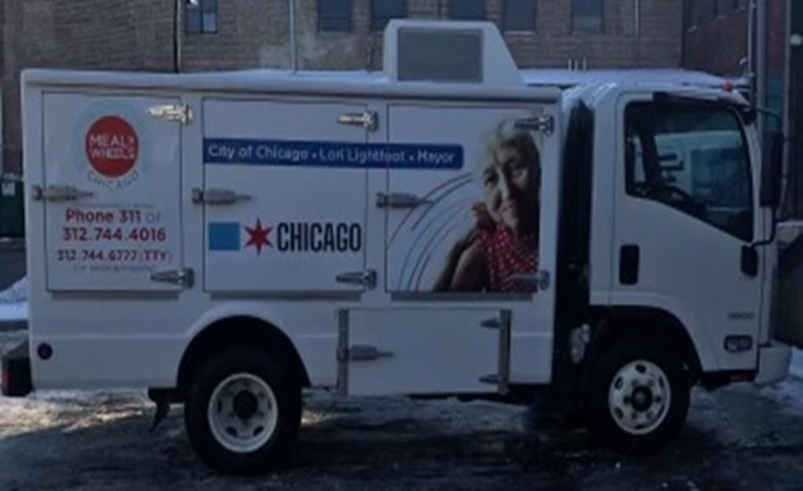
Open Kitchens HDM Delivery Vehicles
All meals are delivered to the client’s home in oven, freezer, and refrigerator-equipped vehicles which have continuous temperature monitoring in view of the driver to assure proper temperatures throughout delivery.
Deliveries are made between 8:00am – 4:00pm.
There are approximately 100 routes and 25 drivers delivering meals.

Slide 27
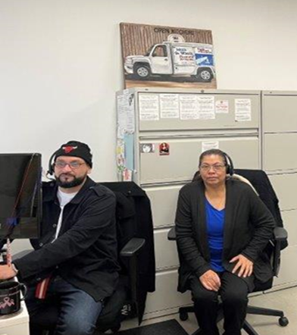
Open Kitchens HDM Program Staff
The HDM Team at Open Kitchens receives and processes information regarding new and existing clients as well as communicates with drivers during the client deliveries.

Slide 28
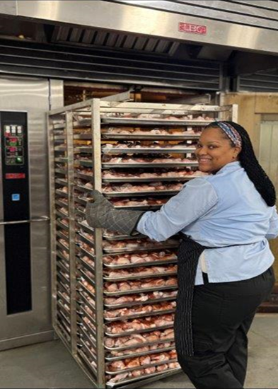
Open Kitchens, Inc.
Open Kitchens' executive chef preparing fresh chicken legs for HDM clients.

Slide 29
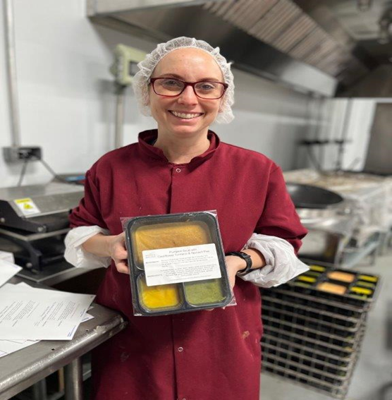
Open Kitchens, Inc.
Open Kitchens has teamed up with a local, woman-owned company (Momma Gourmet) to prepare meals out of their facility.

Slide 30
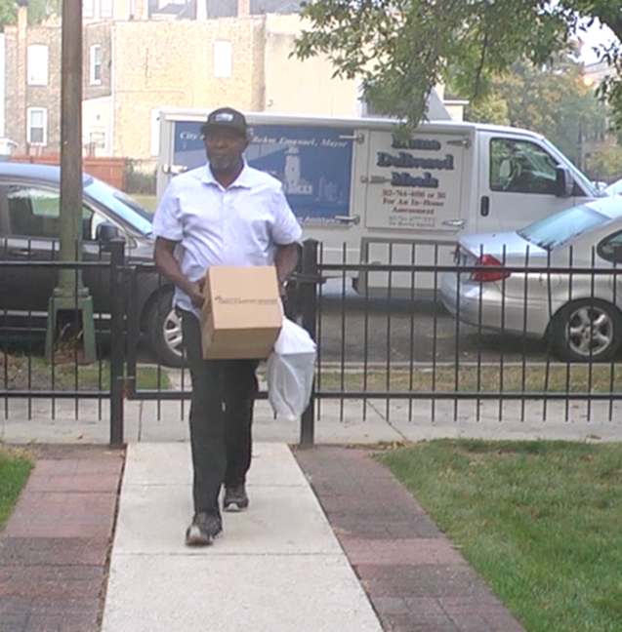
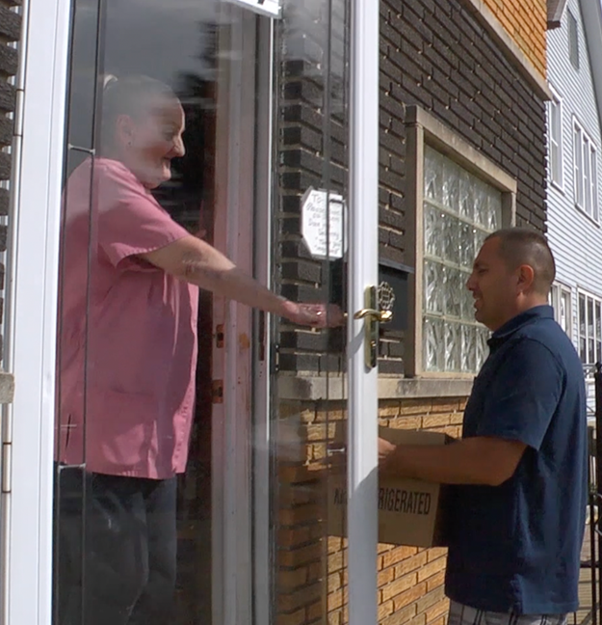
Open Kitchens: Delivering more than just a meal...

Slide 31
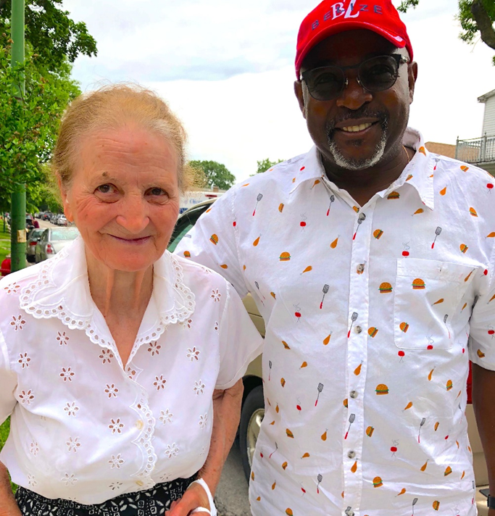
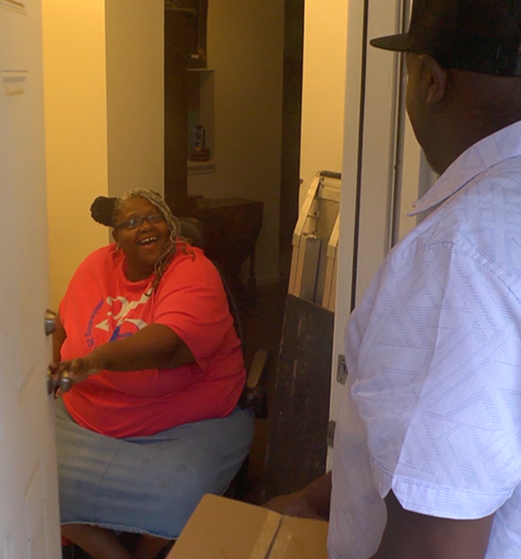
Open Kitchens, Inc.

Slide 32
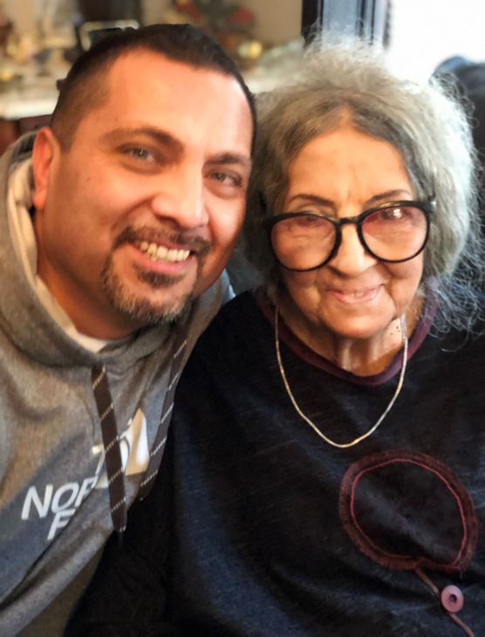
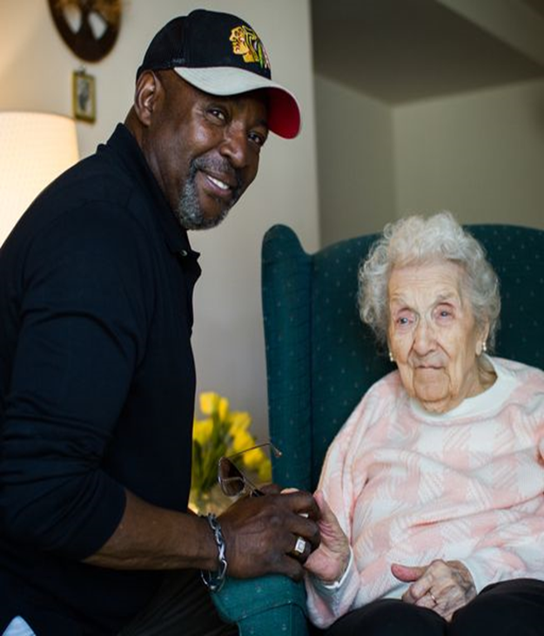
Together, we all play an important part in improving the lives of over 10,000 older Chicagoans and helping them remain living in their homes longer

Slide 33
HDM Program Contacts
Chicago Area Agency on Aging
(DFSS/ Senior Services)
Christine Velez
(312)-746-8665
Christine.Velez@cityofchicago.org
Madeline Pietryla
(312)746-8591
Madeline.Pietryla@cityofchicago.org
Janiece Johnson
(312)746-7084
Janiece.Johnson@cityofchicago.org
Nikki Garbis Proutsos
(312)743-0178
Nikki.Garbis_Proutsos@cityofchicago.org
HDM Provider: Open Kitchens
Please email referrals directly to:
HDMReferrals@openkitchens.org
(312)666-5335

Slide 34
Thank you! Questions?

Slide 35
March Announcements

Slide 36

The theme for 2024 is “Empowering Social Workers!” This theme highlights the critical role social workers play in our society and emphasizes the need for better compensation and support for their vital work.
Social workers are on the front lines, addressing pressing issues such as homelessness, the opioid crisis, and rising suicide rates. They are uniquely qualified to handle these challenges, providing support to individuals, families, and communities. Despite their essential role, social workers often face financial constraints.
Per SocialWorker.org, here are some key points about Social Work Month 2024:
Demand for Social Workers: By 2030, there will be more than 782,000 social workers in the United States, making social work one of the fastest-growing professions. However, this high demand requires adequate support¹.
Compensation: The median pay for social workers in 2022 was $55,350. Considering the education and licensure requirements, this falls short. A national survey found that over half of respondents believe social workers should receive higher pay¹.
Advocacy: During Social Work Month, the National Association of Social Workers (NASW) will raise awareness and advocate for better compensation. Initiatives include supporting legislation for mental health access, student loan debt relief, and social work safety¹.
Let’s celebrate and empower social workers who make a difference every day! For more information visit Socialworkers.org
Celebrating National Social Work Month – March

Slide 37

The Social Work Census is a large-scale survey of the social work profession in the United States and Canada. The data from this survey will be aggregated and used to develop a comprehensive and up-to-date picture of who social workers are and what they do.
How will this data be used?
Workforce data will be shared with the profession, and the Social Work Census will form the core of the practice analysis for the next iteration of the social work licensing exams.
Continuing education credits
Each participant will be eligible to earn two hours of continuing education credit upon the completion of the survey.
Social workers count! (swcensus.org)
The SW census is available through March 31st in English, French, and Spanish.

Slide 38

Happy International Women's Day
March 8th

Slide 39

County Care Kudos
Donna Bakare
Care Coordinator- Elderly- Tishawn Mitchell
Kudos to Donna Bakare for her outstanding dedication and compassion as a care coordinator! Your proactive support and diligent efforts in helping a member access essential healthcare services have truly changed their life for the better. Your commitment to going above and beyond, from arranging therapy sessions to ensuring they received necessary equipment, is commendable. Thank you for being a valuable asset to our County Care LTSS team and for making such a positive impact on the lives of our members. Keep up the fantastic work!
Lamont Boswell
Community Resource Navigator-Donna Hampton-Smith
Kudos to Lamont for their exemplary leadership! Your guidance, dedication, and ability to inspire others have truly propelled our team forward. Your clear vision, coupled with your unwavering support, has made a remarkable impact on our collective success. Your leadership is not just about achieving goals but also about nurturing talent and fostering a culture of collaboration and innovation. Thank you for being a beacon of excellence and for continuously raising the bar. You're a true leader, and we're fortunate to have you steering the ship!
Thank you, Donna & Lamont

Slide 40
Announcements
Next webinar is April 17th, 2024!
Slides posted on CountyCare Care Coordination Webpage:
http://www.countycare.com/carecoordination
Have feedback? Please share.
https://redcap.link/23k1fzzb
Please email questions/concerns: raphael.daniels@cookcountyhealth.org

