Slide 1
May’s Care Management Webinar
Wednesday, May 21st , 2025

Slide 2
Meeting Schedule
May 21, 2025
Kera Beskin – HBIA
Ankur Singhal -Blue Kite Wellness
Paige Clincy- Housing
Andrew Gillen- Medicaid Member Stories Campaign
Tyree Brinson- Open Roads (Separate PDF Slides)

Slide 3
HBIA/HBIS Updates
Kera Beskin, Senior Manager of Policy & Innovation

Slide 4
Policy Team at CountyCare-within the PMO
Project Management Department
(Maeve Dixon –Director)
Policy Team
Project Management Office (PMO)
Gillian Feldmeth
Kera Beskin
Vickie Rivkin
Open -Hiring
Andrew Gillen
Erika Hall

Slide 5
Poll
The Health Benefits for Immigrant Adults (HBIA) is being eliminated in the state of Illinois
Yes
No
I don’t know
The Health Benefits for Immigrant Seniors (HBIS) is being eliminated in the state of Illinois
Yes
No (as of 5/21/2025 this could change)
I don’t know

Slide 6
CountyCare Access - Health Benefits for Immigrant Adults
On February 19th, 2025, Governor Pritzker gave his 7th budget address, which included the proposed elimination of the Health Benefits for Immigrant Adults (HBIA) program. The Health Benefits for Immigrant Seniors (HBIS) program is not being eliminated.
The Illinois Department of Human Services posted an informational memo on their website that references the sunsetting of the HBIA program in the Governor’s proposed FY26 budget, effective July 1, 2025.
The memo shares that HBIA enrollees will receive at least 90 days notice before their coverage will end and that more information will be forthcoming. In the next few weeks, the Illinois Department of Healthcare and Family Services is expected to file administrative rules that outline the process to sunset HBIA.
HFS released a letter on the sunsetting of this program on 3/10/2025 IDHS: Health Benefits for Immigrant Adults (HBIA) Sunset on 3/21/2025 Emergency Rules that repeal the HBIA program were published. HFS has also published an FAQ document.

Slide 7
HBIA Sunsetting
CountyCare created FAQs for care managers.
Main takeaway: The HBIA program is sunsetting. Last day of benefits are June 30th.
CountyCare encourages current HBIA members to continue to use their benefits, including primary care, preventive and specialty care, pharmacy, and rewards benefits.
CountyCare will be texting all of our HBIA members in June to remind them about the program sunsetting.
In June CountyCare will send a provider notice to all providers about the sunsetting.
In June CountyCare will send a letter to all of our vendors and community partners about the HBIA sunsetting
On July 1, all HBIA references will be removed from our website.

Slide 8
HBIA Sunsetting
How many members are impacted?
CountyCare has approximately 17,000 HBIA members
In the state of Illinois, there are approximately 32,000 HBIA members
What if a HBIA member turns 65 before July 1st?
HFS will automatically move them into the HBIS program.
The HBIS program is not being affected.

Slide 9
HBIA FAQ Talking Points
I heard the HBIA program is being eliminated, is that true? Yes.
When will we know when if the HBIA program is being eliminated? CountyCare is assuming this program will be eliminated. The Illinois budget will be finalized this spring.
If the HBIA program is eliminated, when do my benefits end? June 30, 2025. [mentions the letter members will receive April 1 & encouraging people to speak with a financial counselor where they seek care.]
What can I do to prepare if the HBIA program is eliminated? See providers, fill prescriptions for 90 days in June, and use rewards.
Is the HBIS program being eliminated? No
I am going to be 64 before July 1st, can I transition into the HBIS program? Yes
I don’t know who in my family has HBIA/HBIS/or other Medicaid, how can I tell? Call member services.
Is CountyCare doing any outreach to members about the HBIA program? HFS sent letters to HBIA members on April 1st. CountyCare will text members in June.

Slide 10

HBIA Sunsetting
Any questions?
Feel free to email me at kera.beskin@cookcountyhealth.org about the HBIA program any time.
CountyCare’s FAQ document is attached and the HFS FAQ link is here:
Health Benefits For Immigrant Adults FAQ

Slide 11

COUNTY CARE
May 21, 2025

Slide 12

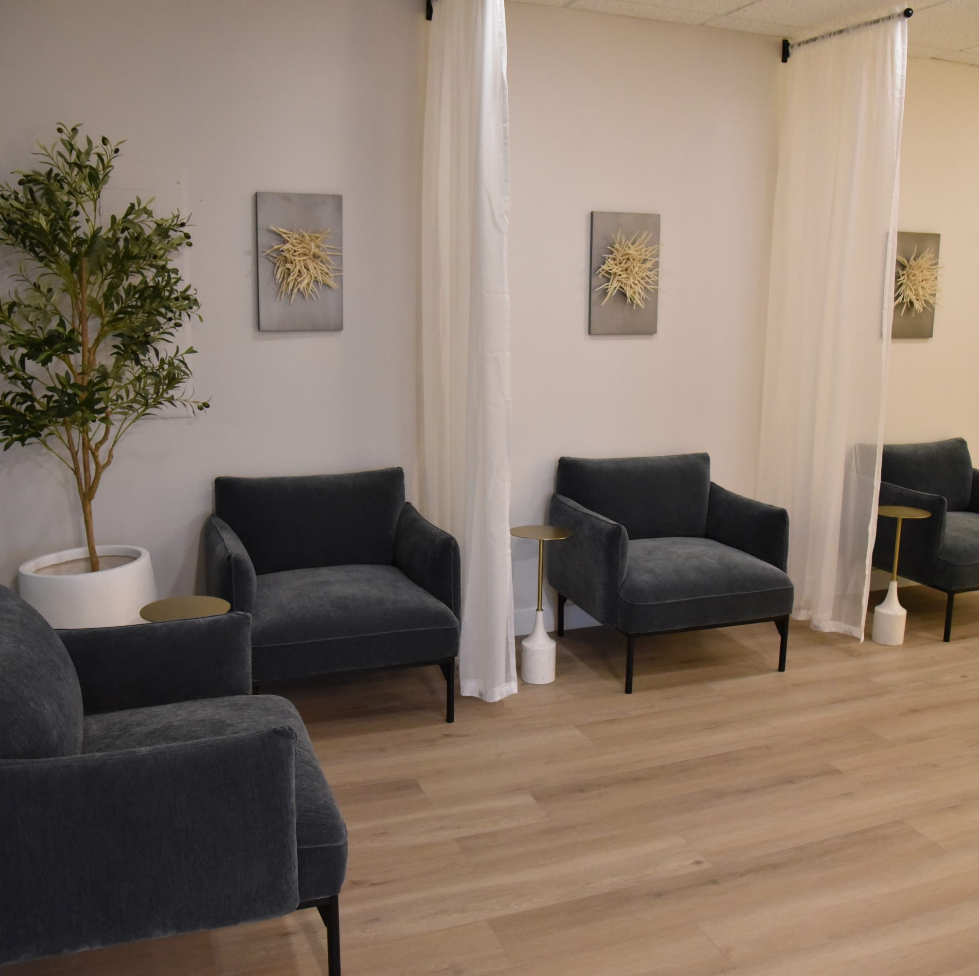
Who We Are?
Goals:
Accessibility
Underserved
Holistic Integrative Care
Evidence based
Team Based Approach
Certified Behavioral Health Center
Foster a positive and optimal healing environment.
Rooted in community

Slide 13

What We Do?
In-Person and Virtual Outpatient Therapy​
Pathways To Success Services (Ages 0-21)
Intensive Home Based, Therapeutic Mentor, Family Peer Support, Respite
Psychiatry Evaluation/Medications Management
Holistic Therapy

Slide 14



Pathways to Success
Value Children and Family
Importance of team based, care coordinated, wrap around model​
Significant gap for Pathways services

Slide 15
THANK YOU
for more details
https://bluekitewellness.com/
Ankur Singhal, Managing Partner
asinghal@bluekitewellness.com
(614) 607-1496
Candace Clark, LCSW, Director Pathways
cclark@bluekitewellness.com
(630) 339-2956

Slide 16
Housing Resource Guide Overview
Paige Clincy, Program Coordinator

Slide 17
Agenda
Demonstration of the Housing Resource Guide Document
The Chicago Furniture Bank
- Process
- Case Worker Guide
- Cancellation Policy
Contact Information
Questions

Slide 18
Housing Resource Guide

Slide 19
Housing Resource Guide – Key Points
This document provides an overview of housing resources throughout Cook County and should be used in addition to the UniteUs Portal
Housing Resource Guide can be found here: Care Coordination – CountyCare Health Plan

Slide 20
Housing Resource Guide Demonstration
Demo of Housing Resource Guide

Slide 21
Chicago Furniture Bank

Slide 22
Chicago Furniture Bank
New process has been implemented due to none payments of cancelled appointments by members.
New Process
Members will have to pay fees upfront (1 week prior to scheduled appointment)

Slide 23
Chicago Furniture Bank Member not able to pay for scheduled appointment
Care coordinator must cancel the scheduled appointment via appointment confirmation email.
Care coordinator must forward cancellation confirmation email to designated liaison.
*Please note: If appointment is canceled 1 week prior to scheduled appointment, member will not receive a cancellation fee.

Slide 24
Chicago Furniture Bank How to Request and Invoice (Information can be found on pg. 7 of the Caseworker Manual)
How to Request an Invoice To request an invoice, please send an email to appointments@chicagofurniturebank.org, including the following information before the appointment:
● Agency billing address
● Name and email of contact (to send invoice)
● Client’s name and appointment type (pick up, delivery, installation)
● Date of appointment
*Please note: Once invoice has been paid, please forward receipt of payment to designated liaison.

Slide 25
Chicago Furniture Bank: Payment Options
Accepted Payments
Cash
Cashier’s checks
Money orders
*Chicago Furniture Bank does not accept personal checks from clients.
For more information, please refer to the Caseworkers’ Guide to the Chicago Furniture Bank.

Slide 26
Contact Information
Paigeclincy@cookcountyhealth.org
Aaroneldridge@cookcountyhealth.org

Slide 27
Questions?

Slide 28
Announcements
Next webinar is June 18th, 2025!
Slides posted on CountyCare Care Coordination Webpage:
http://www.countycare.com/carecoordination
Have feedback? Ideas for future topics? Please share!
https://redcap.link/23k1fzzb
Please email questions/concerns: stephanie.nickles@cookcountyhealth.org

