Slide 1
New Care Management Webinar
March 15^{th,} 2023

Slide 2
Agenda
Introduction
BH Rewards (FUH, FUM & FUA overview) (25 Mins)
Emily Lupo, Director of Population Health & Performance Improvement
REDE Training (15 mins)
Peter Gustafson, Senior Manager of Enrollment
Heather Holberg, Director of Enrollment & Outreach
Covid 19 Updates (3 Mins)
Announcements (5 mins)
CC Spotlight (10 mins)
Wrap Up (2 mins)

Slide 3
Care Management Training on FUH,FUM, & FUA

Slide 4
Agenda
Welcome/Introductions
BH Rate Improvement Initiative
Follow-Up After Hospitalization for Mental Illness (FUH)
Follow-Up After ED Visit for Mental Illness (FUM)
Follow-Up After ED Visit for Substance use Disorder (FUA)
Member Rewards Program

Slide 5
Overview of BH Rate Improvement Initiative

Slide 6
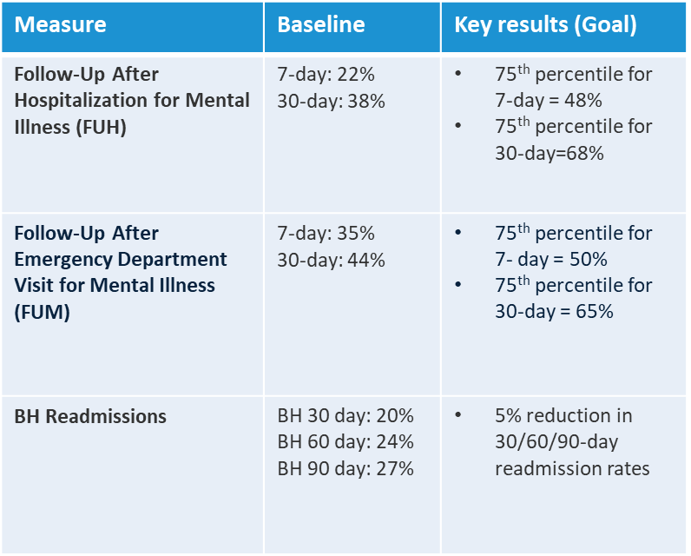
BH Rate Improvement Initiative
Cross departmental workgroup assembled within the Health Plan to develop robust initiative to improve BH rates for FUH, FUM, and readmissions.
SWOT Analysis completed to identify strengths, weaknesses, Opportunities and threats to BH rate improvements & related initiatives
Baseline and key results identified and set by the group.
Project charter developed.

Slide 7
BH Initiative Workgroups
Clinical
Ops/Education
Network Contracting
Technology/ Cohort development for FUH & FUM in Collective Medical.
Review & Assessment of CM and TOC workflows for BH measures.
Workflow enhancements for follow up appointments after Mental Health ED visits and Admissions.
Evaluation of high-volume facilities for FUM & FUH.
Co-location at high volume hospitals.
Member Incentive analysis for members receiving BH follow up visits for FUH & FUM.
Development of text workflows for BH.
Updated HEDIS coding booklet.
Training development.
BH Vendor Contracting (Expansion of providers in network).
Development of preferred BH provider list for Care Management & Patients

Slide 8
Follow-Up After Hospitalization for Mental Illness (FUH)

Slide 9
Follow-Up After Hospitalization for Mental Illness (FUH)
The percentage of discharges for members 6 years of age and older who were hospitalized for treatment of selected mental illness or intentional self-harm diagnoses and who had a follow-up visit with a mental health provider.
Two rates are reported for follow-up visit after a BH admission:
The percentage of discharges for which the member received follow-up within 30 days after discharge. (7 days; does not count on day of discharge)
The percentage of discharges for which the member received follow-up within 7 days after discharge. (30 days; does not count on day of discharge)

Slide 10
Mental Health Provider Follow-up after Hospitalization for Mental Illness (FUH)
An MD, DO, APN, or PA who specializes in Psychiatry for children or Adults. (Psychiatrist or Psychiatry provider)
An RN who is certified and credentialed as a Psychiatric Nurse or Mental Health Clinical Nurse Specialist
A Licensed Psychologist, Therapist, Counselor (Including LPCs & LCPCs) , or Social Worker (LCSW).
A Certified Community Behavioral Health Center Or Certified Community Behavioral Health Clinic

Slide 11

Visit Types
HEDIS MY 2022 | Telephone Visit (Telephone visits value set) | Telehealth Visit (Visit setting Unspecified Value set w/ Telehealth POS value set) | E-visit /Virtual Check in (Online Assessments Value set)
Follow Up After Hospitalization for Mental Illness (FUH)

Slide 12
Questions?

Slide 13
Follow-Up After ED Visit for Mental Illness (FUM)

Slide 14
Follow-Up After ED Visit for Mental Illness (FUM)
Assesses emergency department (ED) visits for adults and children 6 years of age and older with a diagnosis of mental illness and who received a follow-up visit with any practitioner.​
Two rates are reported for follow-up visit after ED visit:​
ED visits for which the member received follow-up within 7 days of the ED visit (8 total days; does count on day of discharge)​
ED visits for which the member received follow-up within 30 days of the ED visit. (31 total days; does count on day of discharge)​

Slide 15
Any Practitioner Follow-up after ED visit for Mental Illness (FUM)
FUM doesn’t require a follow up with a Mental health provider, a visit with any practitioner counts if Mental health Diagnosis or Self Harm diagnosis is Principal diagnosis for the ED visit.
Visit with a PCP can count! (MD, DO, PA, APN, etc. )

Slide 16
Visit Types
HEDIS MY 2022 | Telephone Visit (Telephone visits value set) | Telehealth Visit (Visit setting Unspecified Value set w/ Telehealth POS value set) | E-visit /Virtual Check in (Online Assessments Value set)
Follow Up After Hospitalization for Mental Illness (FUH)
Follow Up After ED visit for Mental Illness (FUM)

Slide 17
Questions??

Slide 18
Follow-Up After ED Visit for Substance Use (FUA)

Slide 19
Follow-Up After ED Visit for Substance Use (FUA)
An ED visit with a principal diagnosis of SUD or any diagnosis of drug overdose, where the member was 13 years or older on the date of visit.
Two rates are reported:
ED visits for which the member received follow-up within 30 days of the ED visit (31 total days).
ED visits for which the member received follow-up within 7 days of the ED visit (8 total days). Same day of ED Visit Follow up Counts!
* A follow up visit or pharmacotherapy dispensing event within 7 or 30 days will make member compliant

Slide 20
Visits that Count for FUA
Visit with a mental health provider (Counselor, psychiatrist, therapist, etc.) or Community Mental Health Center
Visit with a PCP or other non-mental health provider
Pharmacotherapy Dispensing Event or Medication Treatment Event (for AOD and/or OUD Medication Treatment Value sets)
Intensive Outpatient Treatment or PHP
Non-Residential Substance Abuse Treatment Facility Visits

Slide 21
Visit Types
HEDIS MY 2022 | Telephone Visit (Telephone visits value set) | Telehealth Visit (Visit setting Unspecified Value set w/ Telehealth POS value set) | E-visit /Virtual Check in (Online Assessments Value set)
Follow Up After Hospitalization for Mental Illness (FUH)
Follow Up After ED visit for Mental Illness (FUM)
Follow up After ED Visit for Substance Use (FUA)

Slide 22
Pharmacotherapy Dispensing and/or Medication Treatment Events for FUA
Pharmacotherapy Dispensing Events:
Medications on the Alcohol Use Treatment Medication List and/or the Opioid Use Disorder Medication List.
Medication Treatment Events (Dispensing and/or Administration)
Buprenorphine (implant, oral, injectable)
Subclade
Methadone
Naltrexone
Naloxone
Weekly MAT Bundles

Slide 23
Questions?? stions?

Slide 24
Supporting Members in the FUH, FUM, & FUA Measures

Slide 25
What Can CMs & CCs Do to Support These Measures?
Educate
Provide education about treatment plan. Use Motivational Interviewing to assess the member’s priorities and engage them in their care plan.
Appointments
Ensure members have the right follow up appointment type with the right provider.
Transportation
Ask about how the member will get to their appointment. Assist with transportation if needed.
Medication
Follow up with member to ensure they pick up medications after ED visits or hospitalizations. Assist in troubleshooting any issues with meds/pharmacy.
Barriers
Assess other barriers to member following up as recommended. Refer members to appropriate services and resources as applicable.
Provide Appointment Reminders.

Slide 26
Questions?
Questions??

Slide 27
Member Rewards

Slide 28
Enhanced Member Rewards Program
Member Rewards Program now includes colorectal and cervical cancer screenings, as well as flu shot incentives.
Enhanced Rewards:
PCP annual visit – $50 reward for DOS on or after 8/1/22
Annual health risk screening – $50 reward – for completion dates on or after 7/1/22
Colorectal cancer screening – $50 reward for DOS on or after 8/1/22
Cervical cancer screening – $50 reward for DOS on or after 8/1/22
Mammography program – $50 reward for DOS on or after 8/1/22
Flu shot – $10 reward for DOS on or after 9/1/22
Notification of Pregnancy - $50 reward for notifications on or after 10/1/22
COVID 19 Vaccinations - $50 for first vaccination, $10 for second vaccinations, and $10 for boosters for completion dates on or after 1/1/23

Slide 29
Rewards Program
Reward | Who Qualifies | Required Activity | Reward
Notification of Pregnancy | Members who are pregnant | Complete the Notification of Pregnancy form on our website under Member Resources. | $50 reward will be added to your card for completing the form. *Effective 10/01/22
Post Partum Visit | Moms who recently delivered babies | Visit your doctor for a follow-up exam 1-12 weeks after delivery. | $25 reward will be added to your card.
Prenatal Visit | Pregnant CountyCare members | Visit your doctor for prenatal visits. | $10 reward for up to 14 prenatal visits will be added to your card.
Childhood Immunizations | Members under 2 years old | See their doctor to have your child immunized. | $10 reward per shot will be added to your child's card, up to 10 total.
Well Child Visits | Members under 15 months old | See their doctor for well-child visits as recommended. | $50 reward will be added to your child's card for taking them to their doctor within 30 days of birth, $10 for each of the next 5 visits.
Flu Shot | CountyCare Members ages 6 months and older | Receive a flu shot from your PCP, Pediatrician, or an in-network pharmacy. | $10 reward will be added to your card for completing your flu shot once per year. *Effective 09/01/22
Cervical Cancer Screening | Female members ages 21 – 64 | Get a cervical cancer screening from a network provider. | $50 reward will be added to your card once per year. *Effective 08/01/22
Annual Mammogram | Female members 45-74 | Get a mammogram from a network provider. | $50 reward will be added to your card once per year. *Effective 08/01/22
Health Risk Screening | All CountyCare members | Contact your Care Coordinator to complete your annual screening. | $50 reward for completing annual Health Risk Screening will be added to your card once per year. *Effective 07/01/22
PCP Annual Check-Up | Members 16 months and older | Visit your assigned primary care doctor for an annual check-up. | $50 reward will be added to your card once per year. *Effective 08/01/22
Colorectal Cancer Screening | Members ages 45 to 75 | Get a colorectal cancer screening from a network provider. | $50 reward will be added to your card at most once per year. *Effective 08/01/22
Managing Diabetes | Diabetic members ages 18-75 | Visit your provider and get your blood tests and urine screens. | $25 reward will be added to your card once per year.
Behavioral Health Follow-up visits (FUM and FUH) | All members 6 and older | Follow up with your doctor after ER visits and inpatient hospital stays for behavioral health. | $20 reward for seeing your doctor within 7 days; or $10 if it is between 8-30 days after an ER visit for behavioral health. $20 reward for seeing your doctor within 7 days; or $10 if it is between 8-30 days after an inpatient behavioral health stay.
Follow-up after Hospital Admission | All members 6 and older | See your doctor within 14 days after an inpatient hospital stay. | $20 reward will be added to your card.
COVID Vaccine | All member 6 months and older | Receive your first, second, or booster COVID vaccinations | $50 for the first vaccine, $10 for the second vaccine, and $10 for all boosters *Effective 1/1/23

Slide 30

FUH and FUM Rewards
Members who follow up with their doctors after ER visits or inpatient stays will receive the following rewards:
$20 for seeing your doctor within 7 days after an emergency room visit for behavioral health; or
$10 if it is more than 7 days but within 30 days after an emergency room visit for behavioral health.
$20 for seeing your doctor within 7 days after an inpatient behavioral health stay; or
$10 if it is more than 7 days but within 30 days after an inpatient behavioral health stay.

Slide 31
Rewards Card Enhancements
Effective: 1/1/23
 | NEW Visa Rewards Card
Card Type | Visa card
Store Restrictions | Can use funds to buy/pay for/purchase from almost any type of merchant category.
Purchase Restrictions | Can use their funds to pay for almost anything (online and in-store), including: Gas Utilities Internet Clothes Groceries Transportation See next slide for more categories
Member portal | www.mybenefitscenter.com
Confidential and not for distribution

Slide 32
Merchant Categories Members Can Purchase From:
Utilities – electric, gas, water, phone bills, and more
Transportation (CTA, Uber, Lyft, Taxi, and more)
Child Care Services
Hardware stores
Dental and vision services
Clothing
Drug stores and pharmacies
Gas
Discount stores
Department stores
Grocery stores, convenience stores, and supermarkets
Automotive parts and repairs
Furniture
Household appliances
Electronics
Court Costs
Restaurants and fast food
Footwear
Used merchandise and secondhand stores
Books
Cosmetics
Pet supplies
Veterinary services
Lodging
Laundry, cleaning, and garment services
Beauty and barber shops
Repair shops
Recreation activities
And much more!

Slide 33
What Remains the Same
Members can earn the same exact rewards as before; it will be loaded to their new cards.
Rewards earned expire 6 months after the reward is put onto the member’s card.
Members will still be able to call our call center for questions regarding the benefit, card replacements, card issues, etc.
Members can still use the OTC Network App or call our call center to see their balance.
Cards must be activated before they can be used.
Members cannot purchase tobacco, alcohol, or firearms
Confidential and not for distribution

Slide 34

Other Future Enhancements
Redetermination Reward
Current: None
Future: $40 for completing redetermination
Date: 7/1/23

Slide 35
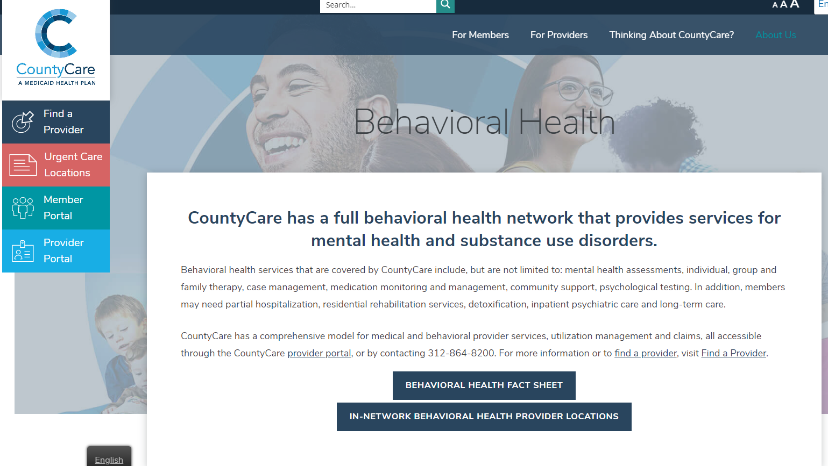
Behavioral Health Provider List

Slide 36
Thank You!

Slide 37
Medicaid Redetermination
Medicaid Redetermination
Care Coordination Training
March 2023
March 2023
Notes:
Peter

Slide 38
Agenda
Purpose
Redetermination Overview
Timelines
What Can Care Coordination Teams Do?
Manage My Case Overview

Slide 39
Purpose
We have designed these materials to organize and simplify important information that can help our members retain their CountyCare coverage.
We want to ensure all staff has the training and information necessary to assist in the following:
Minimize the number of eligible members who lose coverage.
Provide all members with access to multiple customer-centered redetermination completion and submission opportunities.
Notes:
On January 5, 2023, the federal Centers for Medicare and Medicaid Services (CMS) announced the Medicaid continuous enrollment condition provisions will no longer be tied to the public health emergency (PHE). The Illinois Department of Healthcare and Family Services (HFS) and the Illinois Department of Human Services (IDHS) Division of Family and Community Services (FCS) are developing a plan to systematically review and complete annual redeterminations for all Medicaid beneficiaries. The plan is to complete annual redeterminations based on the month the beneficiary's redetermination is due.

Slide 40
Redetermination Overview

Slide 41
Redetermination Overview
Redetermination (REDE) or Medicaid Renewal
Medicaid redetermination is the process Medicaid enrollees must complete annually* to determine their eligibility for Medicaid. If Medicaid enrollees do not complete the renewal process and provide the required eligibility documents, their Medicaid benefits may be terminated.
Why is Medicaid Redetermination Restarting?
Medicaid redetermination was on hold due to the COVID-19 public health emergency (PHE). Many Medicaid enrollees may be unfamiliar with the redetermination process because it was on hold for over two years or joined CountyCare during the PHE and have not gone through this process.
* Every six months if they also receive SNAP benefits
Notes:
Continuous Enrollment is no longer tied to PHE end date.
Medicaid continuous enrollment condition will end March 31, 2023.
Redeterminations will begin for Illinois in April 2023.
First group of redetermination letters will be mailed in late April 2023.
First date Medicaid customers could lose coverage is July 1, 2023.

Slide 42
Redetermination Timeline
HFS will begin mailing redetermination/renewal forms at the end of April 2023 for enrollees with a June 1, 2023 due date.
Rede paperwork will be sent out at least 30 days prior to the due date that is printed on the form.
Members are instructed to complete their rede by the due date or they could lose their Medicaid coverage. HFS has built in a grace period of 15 days for members who submit late. If the information is not received by the end of the grace period, the enrollee’s coverage will be cancelled.
Renewal forms will continue to be sent out monthly to different cohorts of our membership over the next 12 months.
Month of Redetermination | Date HFS Mails REDE Forms | REDE Due Date Printed on Forms | Date 15 Day Grace Period Ends | First Day/Month of Coverage Loss
June | 04/27/2023 | 06/01/2023 | 06/15/2023 | 07/01/2023 - July
July | 05/30/2023 | 07/01/2023 | 07/17/2023 | 08/01/2023 - August
August | 06/28/2023 | 08/01/2023 | 08/15/2023 | 09/01/2023 - September
Notes:
HFS will mail the redetermination paperwork out at least 30 days prior to the due date that is printed on the forms. Enrollees are instructed to complete the rede by the due date. HFS has built in a grace period of 15 days for enrollees who submit late. If the information is not received by the end of the grace period, the enrollee’s coverage will be cancelled.
Below is an example of the state REDE timeline:

Slide 43
Ex-Parte (Form A & B) Renewals
Form A vs. Form B Renewals
Form A – No response required.
This is a pre-populated form that notifies enrollees they are up for renewal and that they must complete their redetermination in order to be assessed for renewed coverage. If the enrollee does not respond to Form B by the due date, their Medicaid coverage will be cancelled.
Form B – Response is required.
This is referred to as an Ex-Parte renewal. Enrollees who receive Form A notice do not need to do anything to keep their coverage. Form A notifies the enrollee that their coverage has been renewed using electronic verification. It also includes the information (family size, income amount, etc.) that was used to renew coverage.
Notes:
Redetermination Forms
The Head of Case will get one of the following forms:
Form A
Form A – No Response Required. This is referred to as an Ex-Parte renewal. Enrollees who receive Form A notice do not need to do anything to keep their coverage. Form A notifies the enrollee that their coverage has been renewed using electronic verification. It also includes the information (family size, income amount, etc.) that was used to renew coverage.
HFS estimates that approximately 35% to 40% of the population is renewed through ex-parte.
Form B
Form B – Response is Required. This is a pre-populated form that notifies enrollees they are up for renewal and that they must complete their redetermination in order to be assessed for renewed coverage. If the enrollee does not respond to Form B by the due date, their Medicaid coverage will be cancelled.

Slide 44
What Can Care Coordination Teams Do?

Slide 45
What Can Care Coordinators Do?
Supporting Members – Address Updates
Make sure members update their address
They can do that in one of two ways:
You can help members by encouraging them to make sure their information (mailing address, phone number, and email) is up-to-date with HFS.
Calling the HFS hotline
(877)-805-5312
(TTY) (877)-204-1012
Updating information on the HFS web form www2.illinois.gov/hfs/address
Notes:
Helping members complete their Redetermination paperwork ensures members can continue to get the care and services they need through Medicaid and reduce claim denials due to eligibility. To help as many patients as possible keep their Medicaid coverage, HFS needs updated mailing addresses to send patients their renewal forms for redetermination.
Medicaid Enrollees can update their mailing address in two ways:
Calling the HFS hotline (877-805-5312)
Through an HFS web form (www2.illinois.gov/hfs/address)

Slide 46
What Can Care Coordination Teams Do?
Sample Messaging
Don’t risk losing your CountyCare coverage. Illinois Medicaid needs to be able to send you renewal paperwork. Make sure you give them an address where mail can always reach you. If you need help, we can call HFS together.
Update Your Mailing Address By:
Calling the HFS hotline at
(877)-805-5312, TTY (877)204-1012
From 7:45 a.m. – 4:30 p.m.
Completing an online form
Notes:
Helping enrollees complete their Redetermination paperwork ensures they can continue to get the care and services they need through Medicaid and reduce claim denials due to eligibility. To help as many enrollees as possible keep their Medicaid coverage, HFS needs updated mailing addresses to send enrollees their renewal forms for redetermination.
Medicaid Enrollees can update their mailing address in two ways:
Calling the HFS hotline (877-805-5312)
Through an HFS web form (www2.illinois.gov/hfs/address)

Slide 47
What Can Care Coordination Teams Do?
Redetermination Action Plan
Ensure enrollee address is up to date.
Help enrollees set up Manage My Case (MMC). enrollees must create the account, but you can guide them through the process.
Direct and transfer enrollees to the DHS or Cook County Health Application Assistance call center to answer specific questions and help with the submission process.
Encourage enrollees to complete their redetermination through the 4 ways shown on the next slide.
Illinois Department of Human Services (DHS)
800-843-6154
Monday thru Friday
8 a.m. to 5 p.m .
Cook County Health Application Assistance Call Center
312-864-8200, option #1
Monday thru Friday
8 a.m. to 7 p.m.
Saturdays from 8 a.m. to 4 p.m.

Slide 48






What Can Care Coordination Teams Do?
Four Ways to Complete Renewal Paperwork
Online: Visit ABE.Illinois.gov and click on Manage My Case
By Phone: Call the DHS Call Center at 1-800-843-6154 / 1-866-324-5553 (TTY) or Cook County Health Application Assistance 1-312-864-REDE (7333)
By mail (return envelope included) or fax to:
Central Scanning Office
P.O. Box 19138
Springfield, IL 62763
Fax: 1-844-736-3563
In person to a Department of Human Services (DHS) office. Visit dhs.state.il.us/p for a list of Family Community Resource centers.
Notes:
https://www.dhs.state.il.us/p
If you need help accessing your ABE Manage My Case account or have other questions, CountyCare is here to help! Call us at 312-864-8200, and select option 1.
You can also call HFS at 800-843-6154.

Slide 49
Thank you!
Notes:
All will close, field questions

Slide 50
Appendix
Appendix
Notes:
Peter

Slide 51
Manage My Case (MMC) Overview
How to Complete Renewal Paperwork
MMC is one of the easiest ways for enrollees to submit redeterminations. MMC allows enrollees to make fewer visits to their local DHS office, stay informed on the status of their benefits, and manage their case information.
Help enrollees set up their MMC accounts so they can:
Check the status of an application
Renew benefits
Report changes – income, household enrollees, expenses or new address
Upload documents
View notices
View and reschedule upcoming appointments
File and manage appeals

Slide 52
Manage My Case Overview
Setting Up Manage My Case
What you need to set-up MMC
Social security number
Established credit history
How to set-up MMC
Step 1
Go to http://ABE.Illinois.gov
Click on the Green “Manage My Case” button. Enter ABE User ID and Password. If the patient does not have an ABE account, click “Create an ABE account” to register.
Step 3
When you link the case to the patient’s ABE Account, they will be asked to answer a few questions to confirm their identity. If successful, the patient will be able to go right into MMC
Step 4
After logging in, select ”Link your account”. Enter date of birth, social security number or individual ID number.
Step 2
Notes:
Step 1: Go to http://ABE.Illinois.gov
Step 2: Click on the Green “Manage My Case” button. Enter ABE User ID and Password. If the patient does not have an ABE account, click “Create an ABE account” to register.
Step 3: After logging in, select ”Link your account”. Enter date of birth, social security number or individual ID number.
Step 4: When you link the case to the patient’s ABE Account, they will be asked to answer a few questions to confirm their identity. If successful, the patient will be able to go right into MMC.

Slide 53
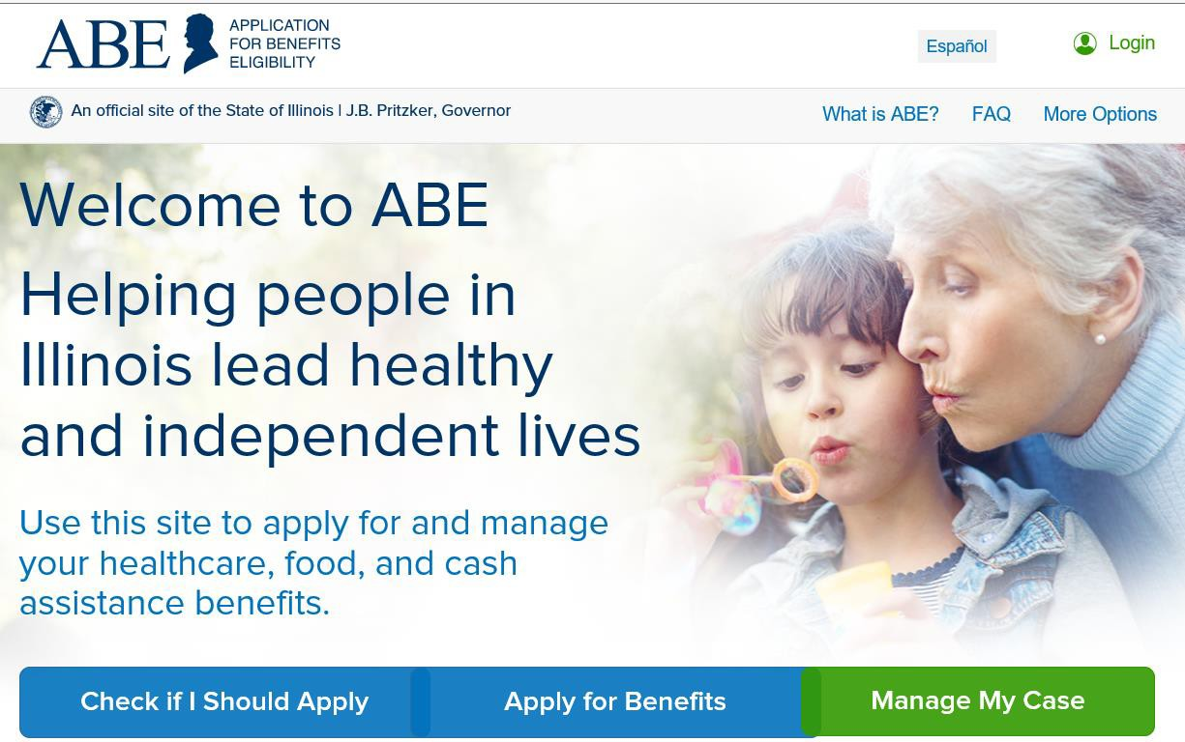
Manage My Case Overview
Setting Up Manage My Case
Notes:
enrollees will need to create an ABE User ID and password to access Manage My Case. If they have already created an ABE Account for an Application, then they should use that login information.

Slide 54
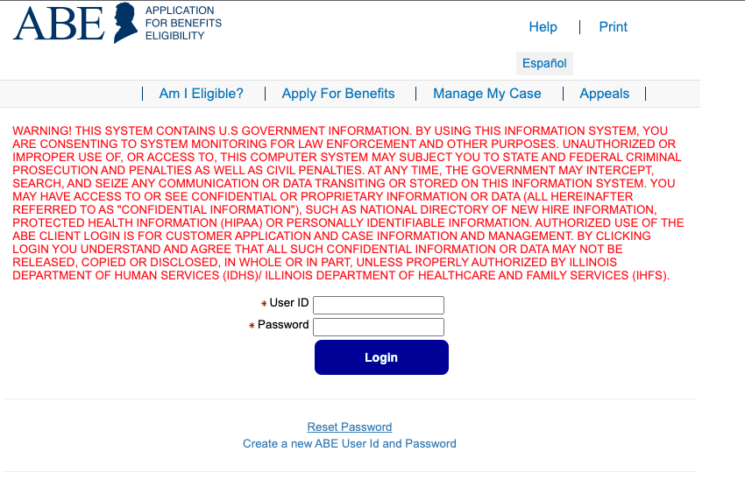
Manage My Case Overview
Setting Up Manage My Case
Password must be a minimum of 8 characters. It must contain a minimum of three of the following:
one capital letter,
one lower case,
one special character (! @ # $ % & *), and
one numeral
Passwords cannot be used consecutively. The same password cannot be used for 24 change cycles. Do not use the User ID or name as the password.
Notes:
If this is the enrollees first visit to ABE, they will need to create an ABE User Account. The Head of Household’s (HoH) information is the information that must be used to create an ABE Manage My Case (MMC) Account.
The HoH is the person that receives mail and Notices from DHS/HFS and is the first person listed on an application for benefits. If the enrollee has an Approved Representative they may create a MMC Account using the HoH information.
Enrollees need to enter their name, then choose an ABE user ID and password. THE STATE will not be able to recover the user ID if the enrollee forgets it.
Ensure the enrollee picks a user ID they will remember. Enrollees will then be prompted to select and answer security questions.
Then the enrollees will click create account. And log into the system.

Slide 55
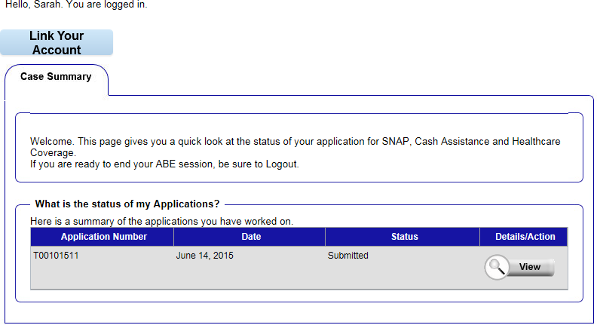
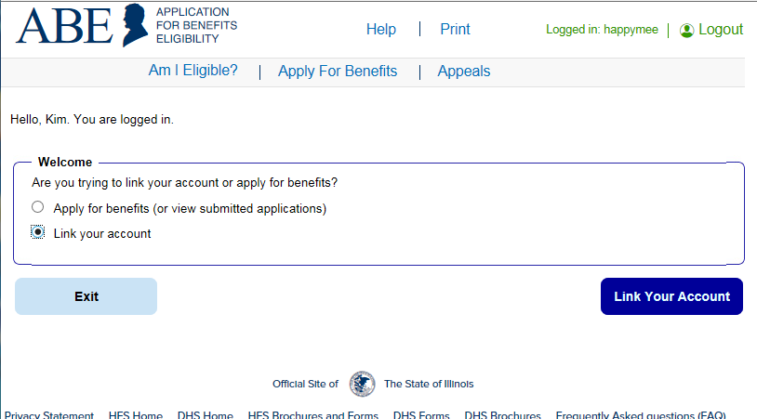
Manage My Case Overview
Linking a Case in Manage My Case
Notes:
If this is the first time an enrollee has visited MMC, they will need to link their ABE account to their case benefits.
1.) Once the enrollee is logged in and have already submitted an application through ABE, they will see the case summary page.
If they have an existing account but have not used ABE they will see a welcome screen. Both screens give enrollees the option to click on LINK YOUR ACCOUNT.

Slide 56
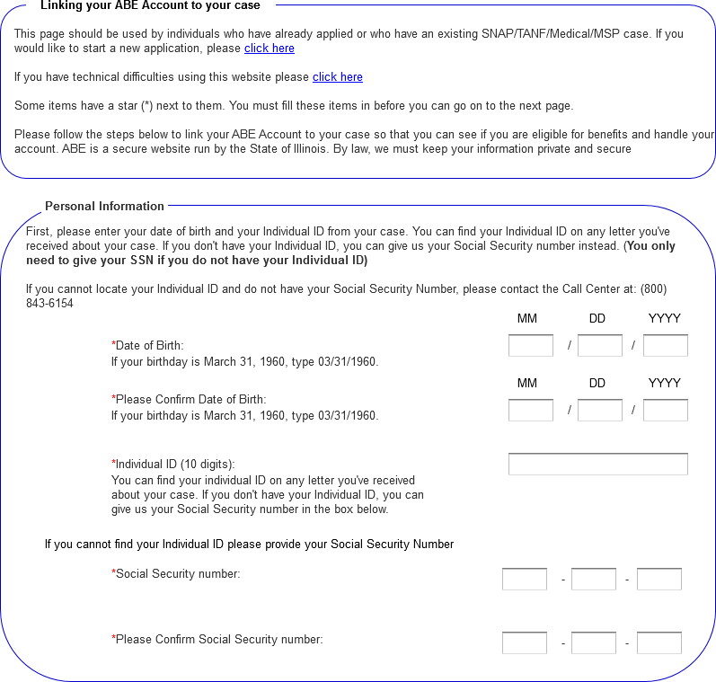
Manage My Case Overview
Linking a Case in Manage My Case
Notes:
2. ) On the Linking your ABE Account to your case screen, the enrollee will enter their Date of Birth and their Individual ID or Social Security Number. Do not enter both numbers. Click [Next]. The enrollee Individual ID is a 10-digit number listed in the top right corner of their Notice of Decision Letter. This is not the same as their Recipient ID (RIN). This number will not be available until they receive a notice from the state.

Slide 57
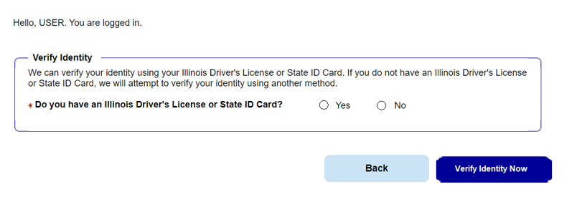
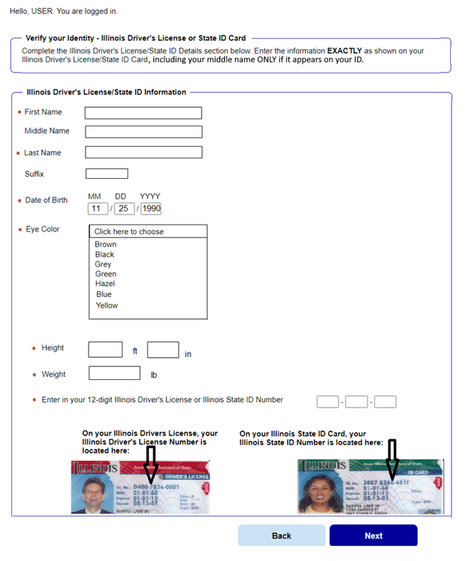
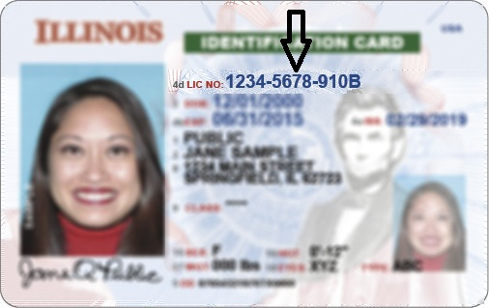
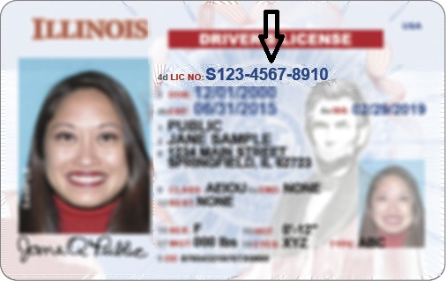
Manage My Case Overview
Identity Proofing
Notes:
After the enrollee has linked their case, and if they did not already complete the ID proofing in ABE, they will need to do that before proceeding in MMC. Enrollees only need to complete this process if it’s the first time they visit MMC.
First, the system will attempt to verify the Head of Household identity through the Illinois Secretary of State using the Illinois State Driver’s License or State ID card (beginning 2023).
The enrollee will be asked to enter multiple fields EXACTLY as they appear on their ID, including the License or ID Number. If the Secretary of State can use the enrollee's answers to verify identity, they will be taken directly to the MMC Landing Page.

Slide 58
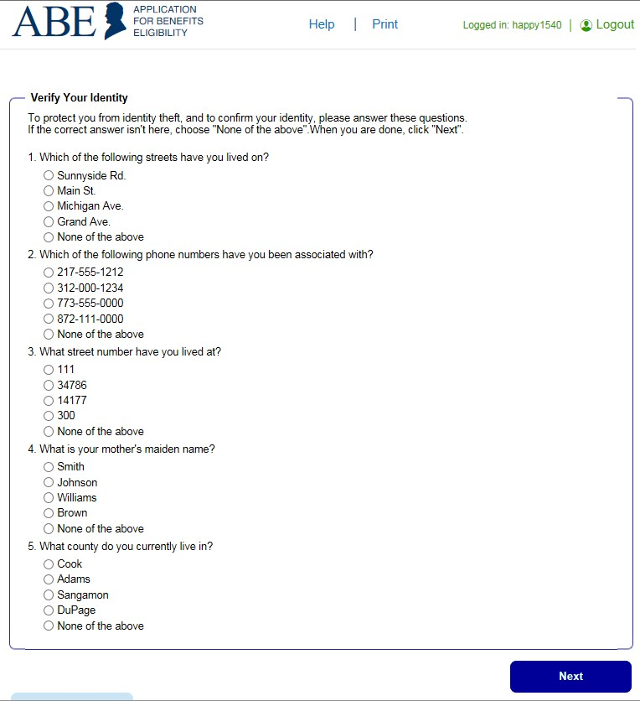
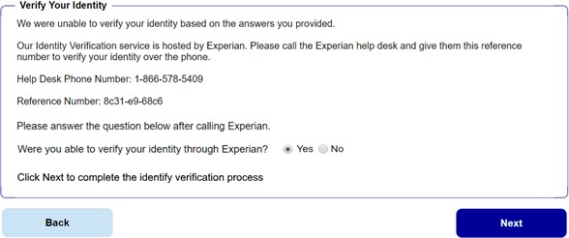
Manage My Case Overview
Identity Proofing
Notes:
If Identity Verification fails through SOS or the enrollee does not have State of Illinois identification, ABE will access Experian, a third-party identity proofing service.
A set of multiple-choice questions will be displayed that only the enrollee would know the answer to, thus “proving” the customer identity.
Enrollees must answer questions and click next.
If the Identity Proofing service is able to use the enrollees answers to verify their identity, then they will return to the Case Summary page.
If the enrollee is NOT able to answer the questions correctly or if the service does not have enough information to offer questions, they will be asked to contact the Identity Verification Help Desk at Experian.
If enrollees can be verified they will click yes. If they were not able to be verified, they will click NO and cannot access MMC until their identity has been verified manually.

Slide 59
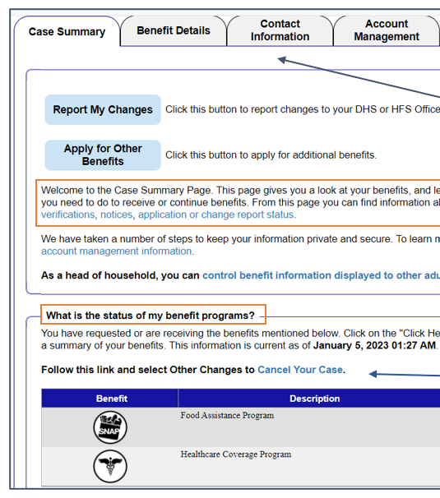
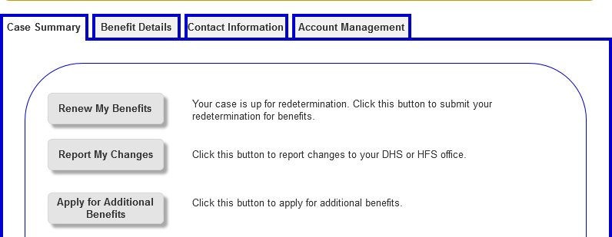
Manage My Case Overview
Manage My Case Summary
Notes:
If it is time for the enrollee to renew their benefits, a [Renew My Benefits] button displays on the Case Summary page.
This button only displays 60 days prior to the end of the enrollees current approval period. The enrollee will click on the Renew my benefits button.

Slide 60
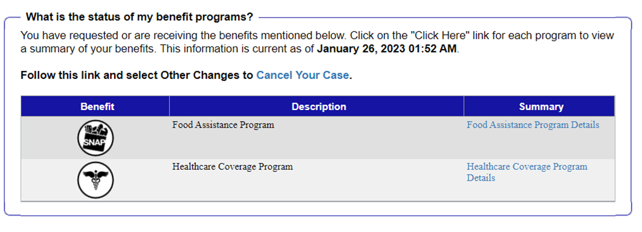
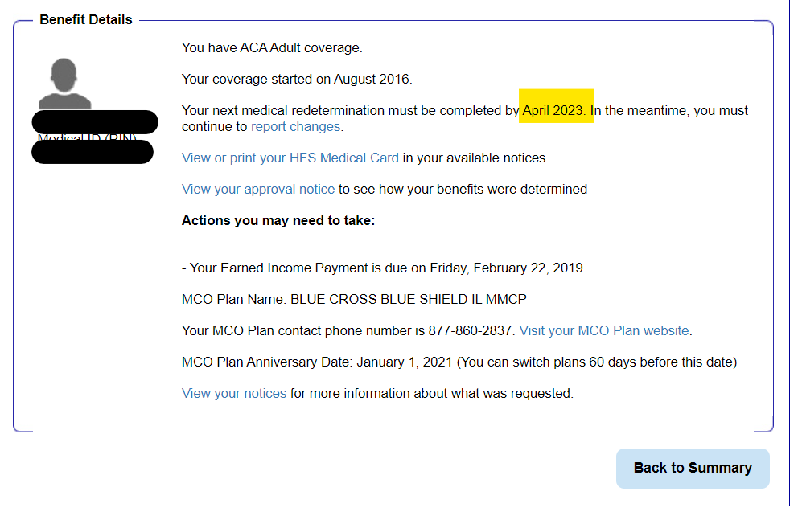
Manage My Case Overview
Manage My Case Summary
Notes:
If a enrollee does not have a renew my benefits button on the MMC home page, they do not need to renew right away. Their renewal/rede date may be later. If the enrollee wants to find out when that date is, they can click the summary of their healthcare coverage program and see the date highlighted.

Slide 61
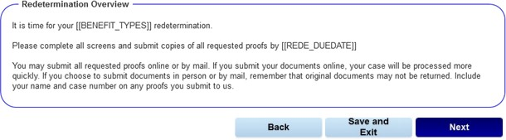
Manage My Case Overview
Redetermination Overview Page
Notes:
If the enrollee has the renew my benefits button then they will click renew my benefit.
The redetermination overview page will display which benefits are up for redetermination. Enrollees should click next

Slide 62
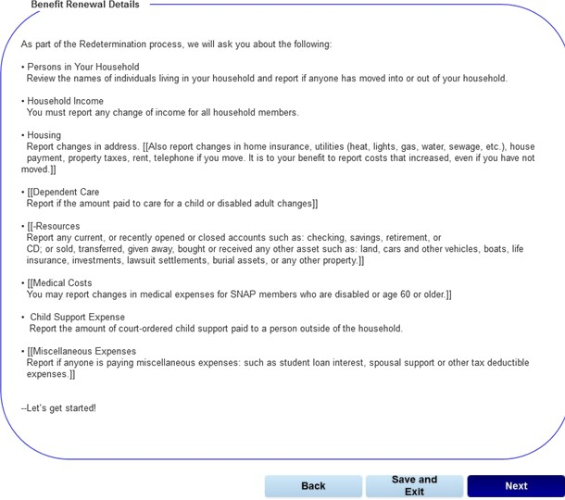
Manage My Case Overview
Redetermination Overview Page
Notes:
The benefits renewal details page displays what type of information enrollees will be asked to provide for their redetermination.
Once enrollees click next, they will need to complete all questions, upload any supporting document, and enter any changes and comments.

Slide 63
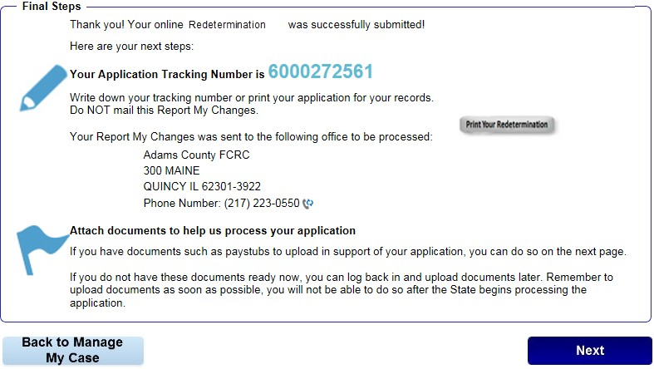
Manage My Case Overview
Redetermination Overview Page
Notes:
After the enrollee has completed all questions and entered any other changes and comments, have them click [Next] and the Final Steps page displays. Make sure the enrollee keeps this tracking number in case they need to speak with a Caseworker!

Slide 64
Where to Find REDE Dates
MEDI Portal -> Eligibility Results by Enrollee
REDE date is “renewal due date”
Type of renewal form is noted too

Slide 65
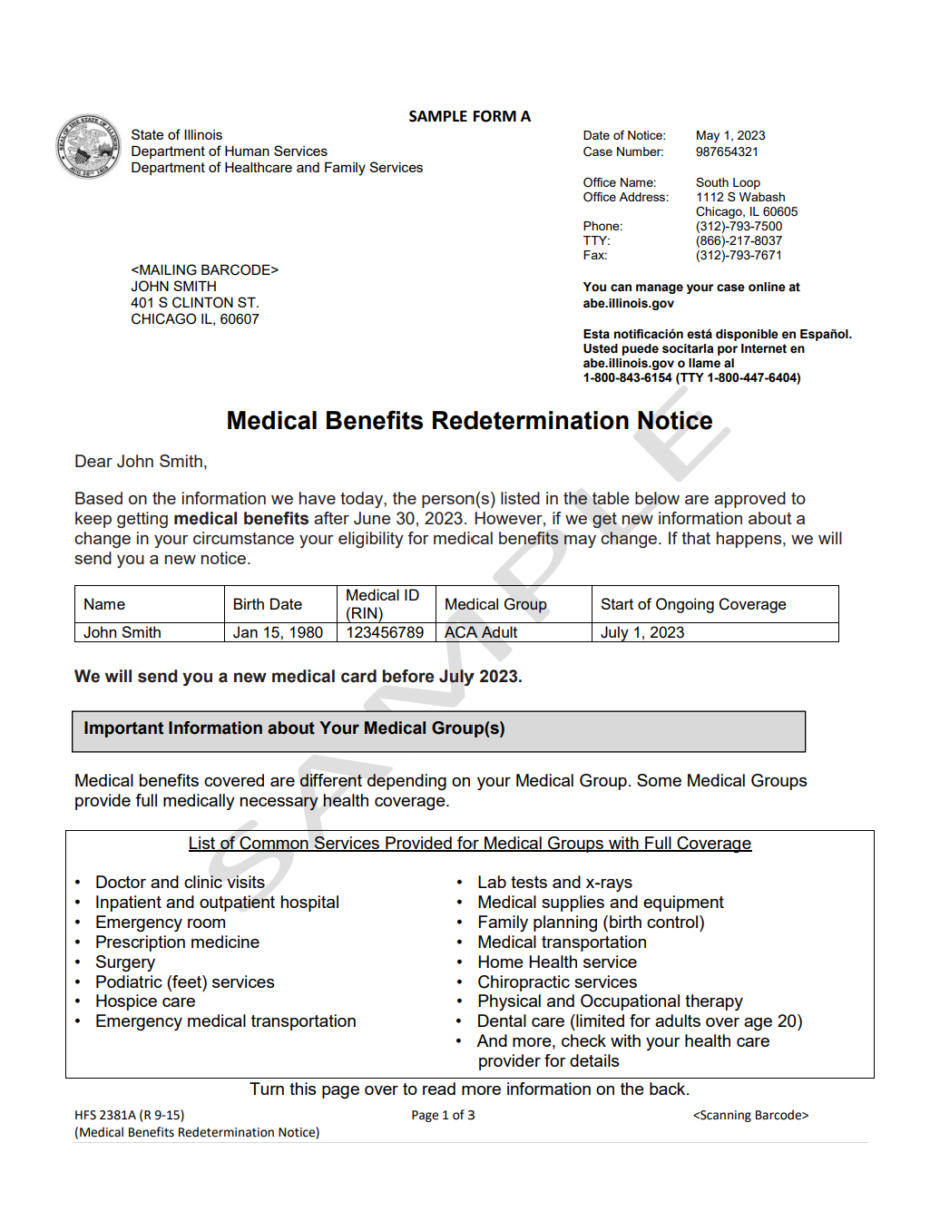
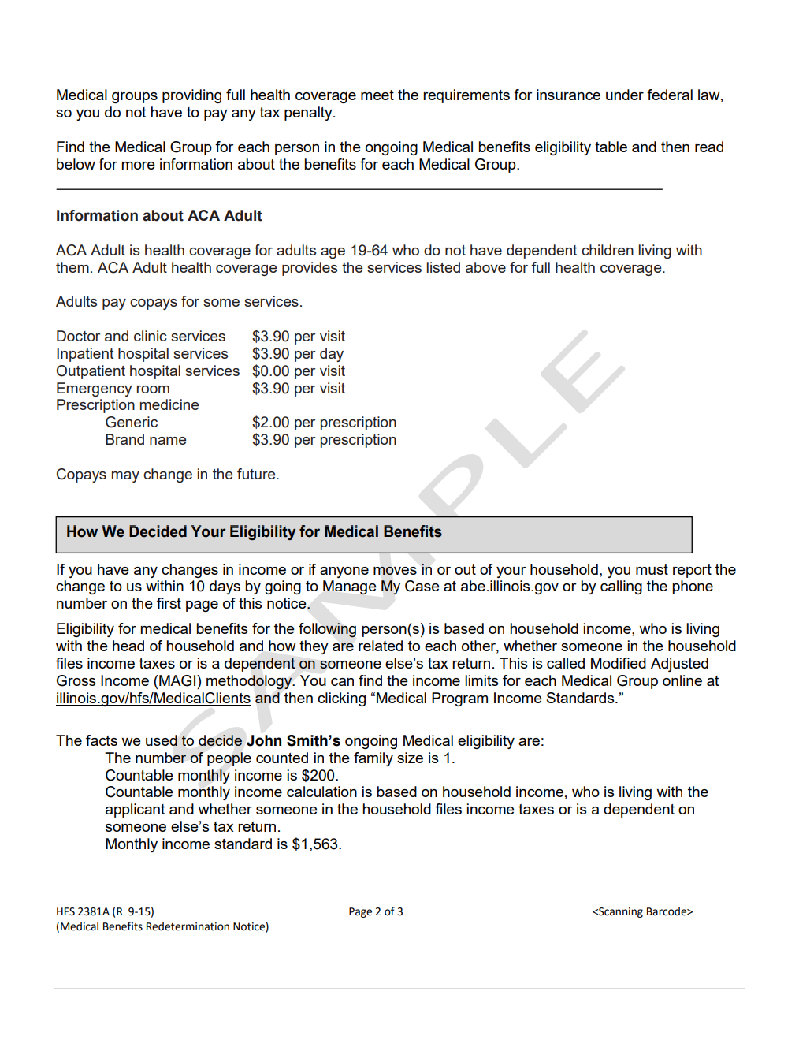
REDE Sample Form A

Slide 66
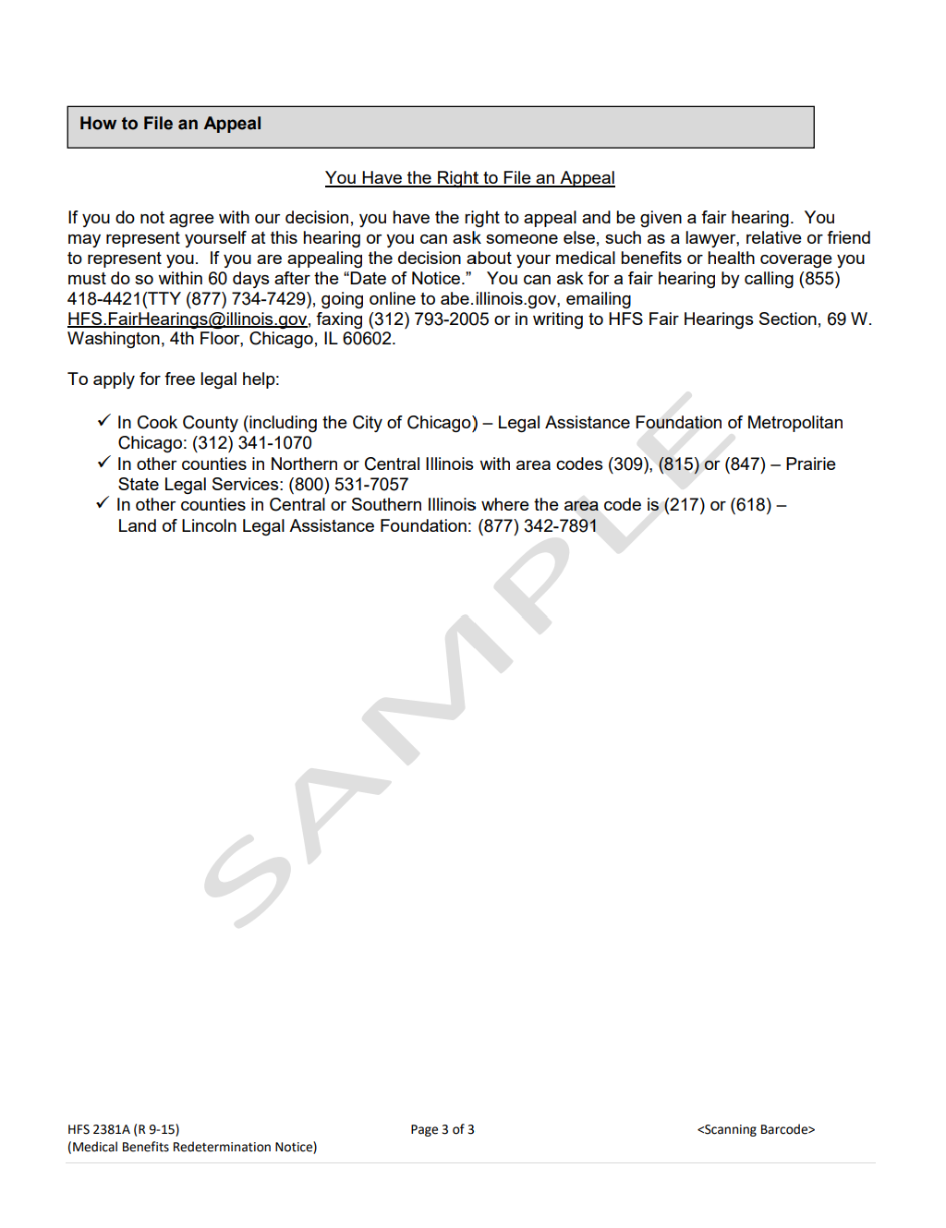
Sample Form A Cont.

Slide 67
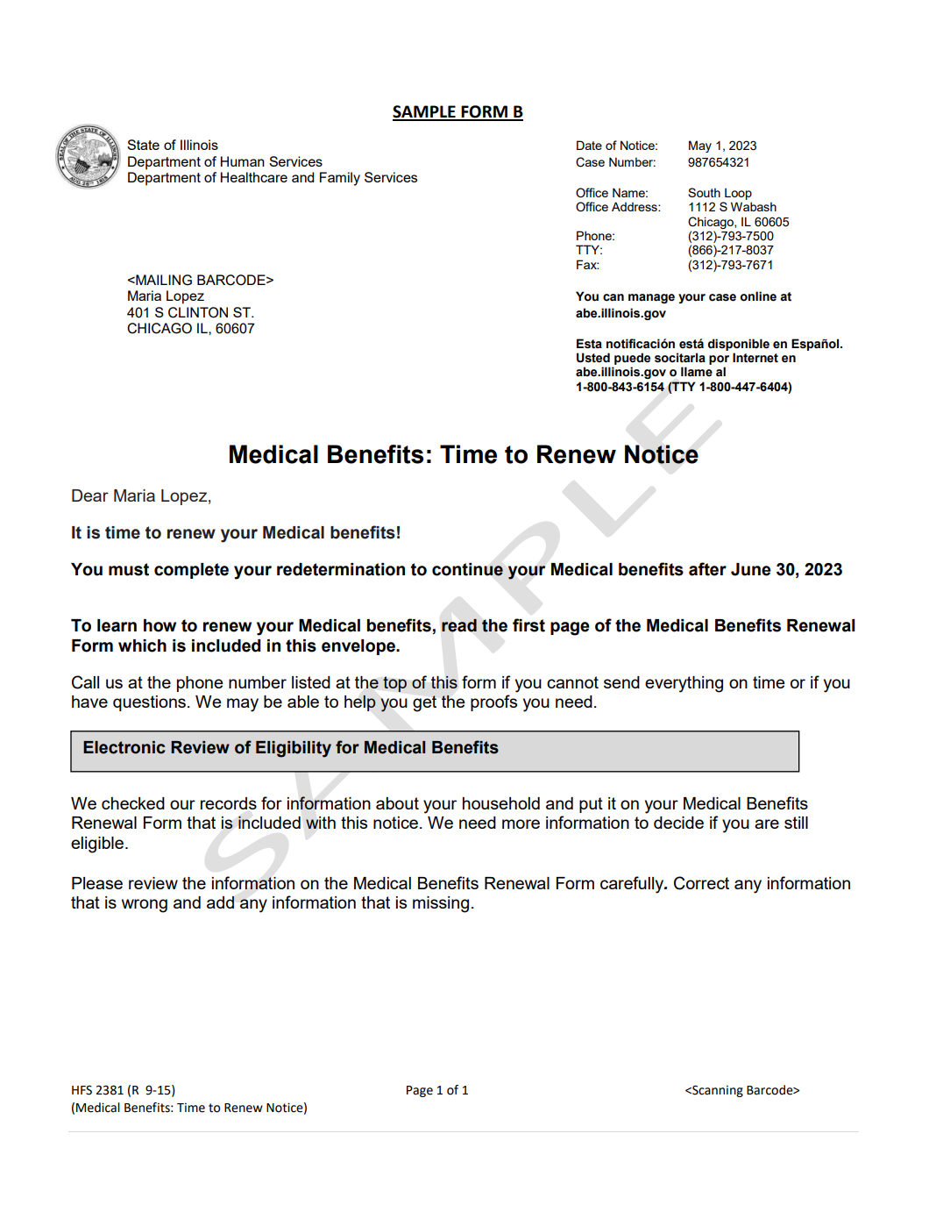
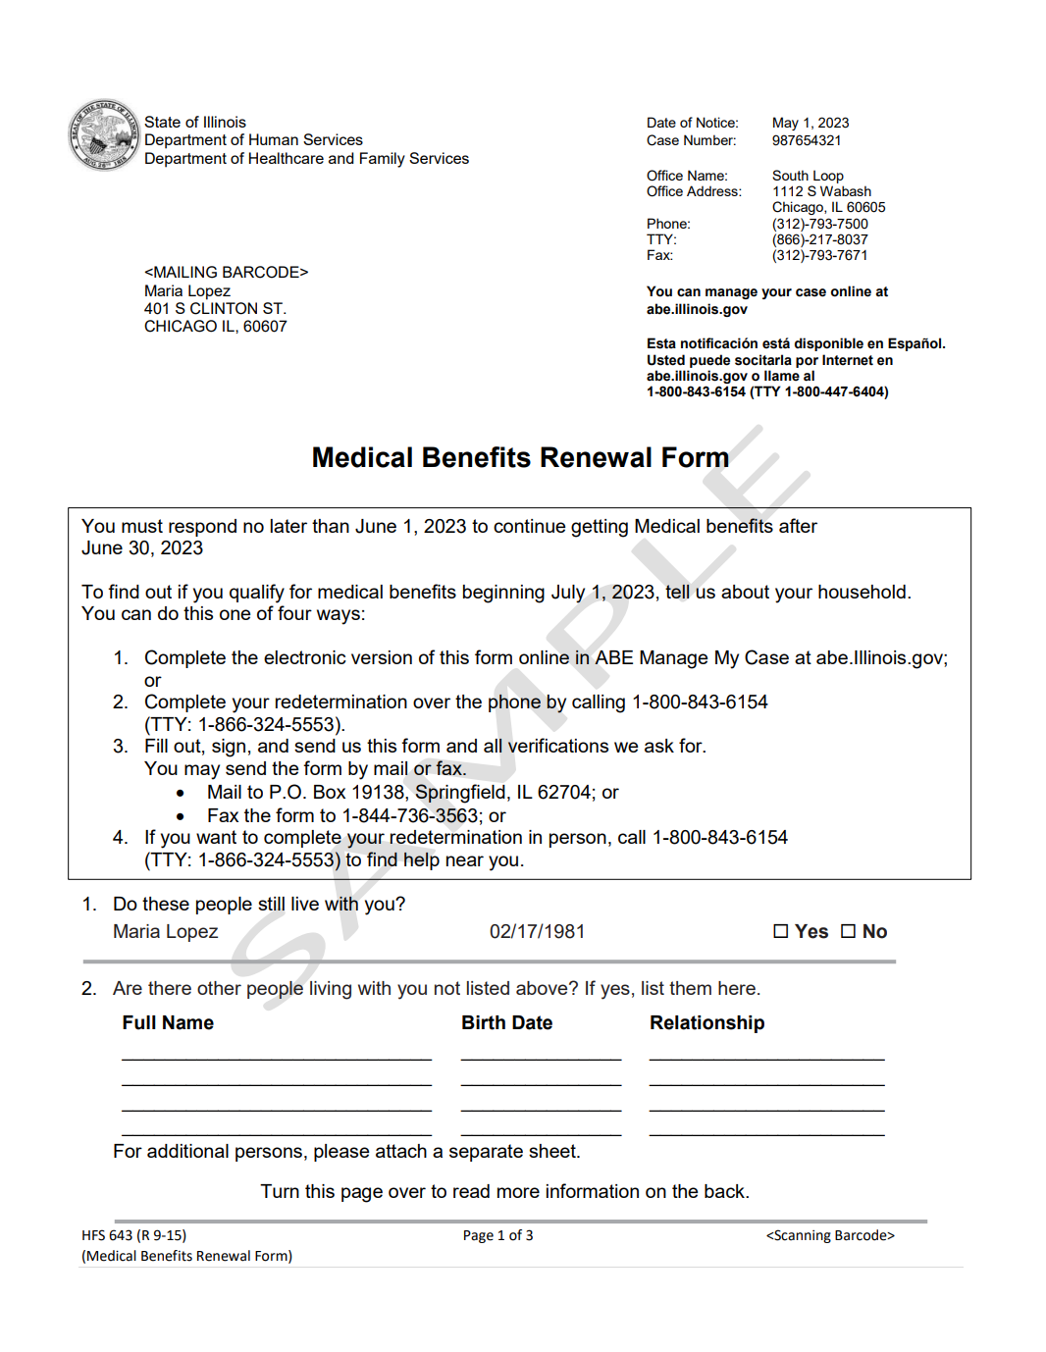
REDE Sample Form B

Slide 68
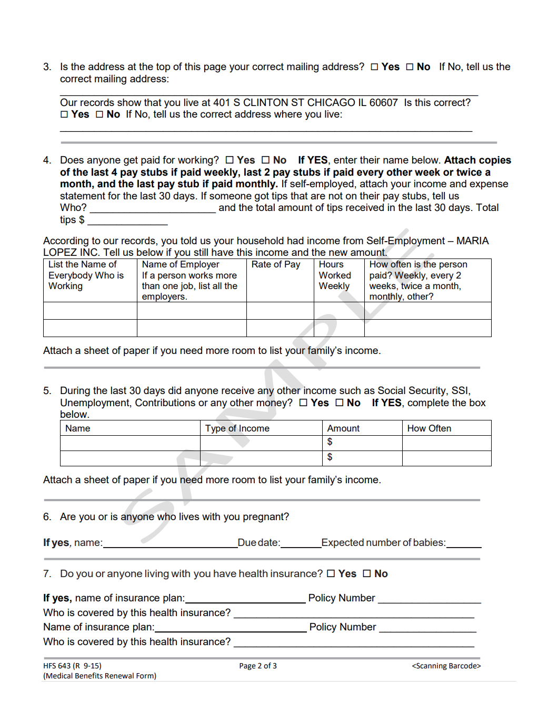
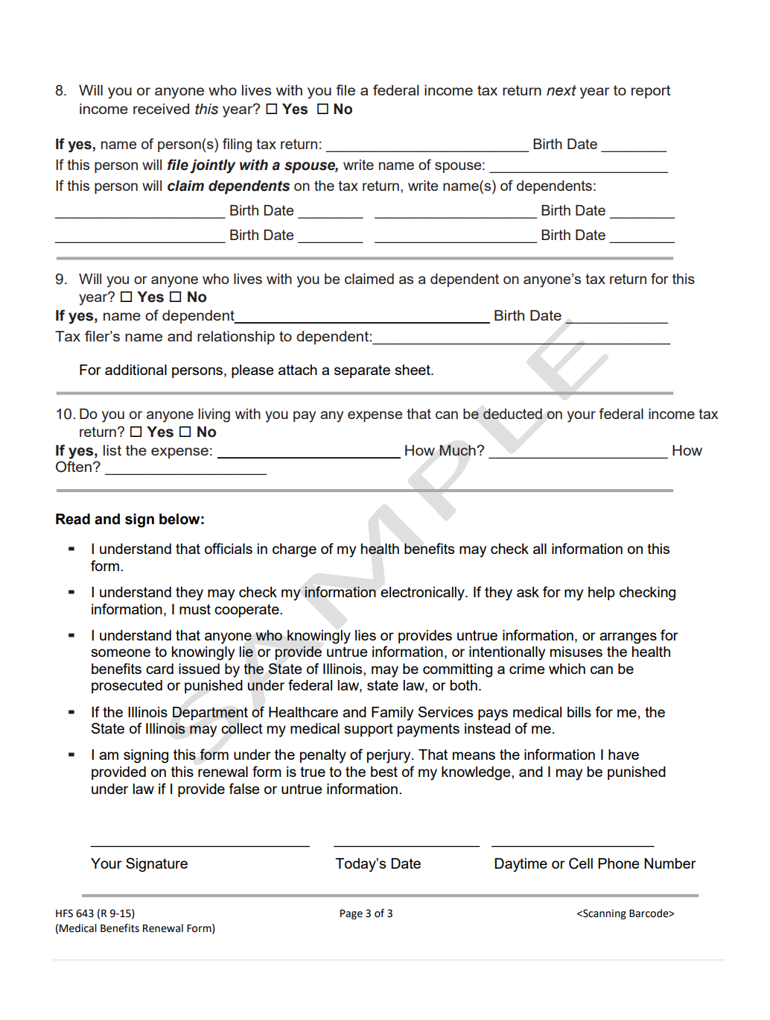
REDE Sample Form B Cont.

Slide 69
COVID-19 Updates
COVID-19 Case Overview (Year to Date) |  | Vaccination Overview As of March 2023
# Cases | 56052 | # only 1 dose* | 22,367 (5.10%)
# Deaths | 295 | # fully vaccinated #3rd doses/Booster | 197,902 (45.15%) 78,228 (17.85%)
CountyCare CM Webinar | For CountyCare Care Coordination Staff – Not for Distribution

Slide 70
Announcements
Chicago Furniture Bank
The mission of the Chicago Furniture Bank is to provide dignity, stability and comfort to Chicagoans that face poverty by allowing clients to handpick an entire home's worth of furnishings for free.
We believe everyone should be able to sleep in a bed, share a family meal at a kitchen table, and enjoy the comfort of a furnished home.
“Transforming houses into homes!”

Slide 71
All caseworkers must understand and follow this packet to make this the best experience for you and your client at the Chicago Furniture Bank (CFB). Anyone can make an appointment with the CFB. Liaisons are responsible for distributing the scheduling link, all materials guides, and forwarding all updates to the organization.
The Chicago Furniture Bank uses Calendly for scheduling all appointments, which allows appointments to be made without having to discuss availability with our staff. Caseworkers are required to provide their email address.
There are 5 appointment types; please choose the appropriate one when signing up! Self-Haul, Curbside Delivery, Installation Delivery, 2-client Appointment or Virtual (via Facetime, Zoom or Google Duo) Guidelines for Appointments.
Caseworkers must be present for the client’s entire in-person appointment. Your presence assures the client is comfortable and makes the appointment run smoothly. Caseworkers should relay our procedures to their clients before the appointment. It is better for everyone if the clients understand how our service works and what to expect.
It is important that the client understands their furniture needs before the appointment. Please have them think about their space, specifically hallway and doorway width. The same rules and procedures apply for virtual appointments; caseworkers will be responsible if clients were not informed of CFB

Slide 72
Chicago Furniture Bank Price Change
Over the last two years, the CFB has seen a massive increase in prices and costs. To ensure we can continue to operate and provide furnishing services the appointment, delivery, and new bedding fees will increase in 2023. This is our first pricing increase since we started CFB in 2018 and are making efforts to continue to scale our social enterprise,
The Honest Junk Company, to prevent future increases.
Please see below for our 2023 price increase, which will go into effect March 1, 2023:
• Appointment Fee: $50 to $100
• Curbside Pickup: $150 to $225
• In-Home Delivery: $250 to $325
• Bed Price Break Down
• New Queen set: $180
• New Full set: $155
• New Twin set: $130
Moving forward your senior contact at Chicago Furniture Bank will be Ms. Amena Wallace on Wednesday 3/1/23. amena@chicagofurniturebank.org

Slide 73

Care Coordinator Spotlight
I.C.A.R.E stands for our five qualities of an amazing employee: Integrity, Collaboration, Accountability, Respect, and Excellence.
CountyCare CM Webinar | For CountyCare Care Coordination Staff – Not for Distribution

Slide 74
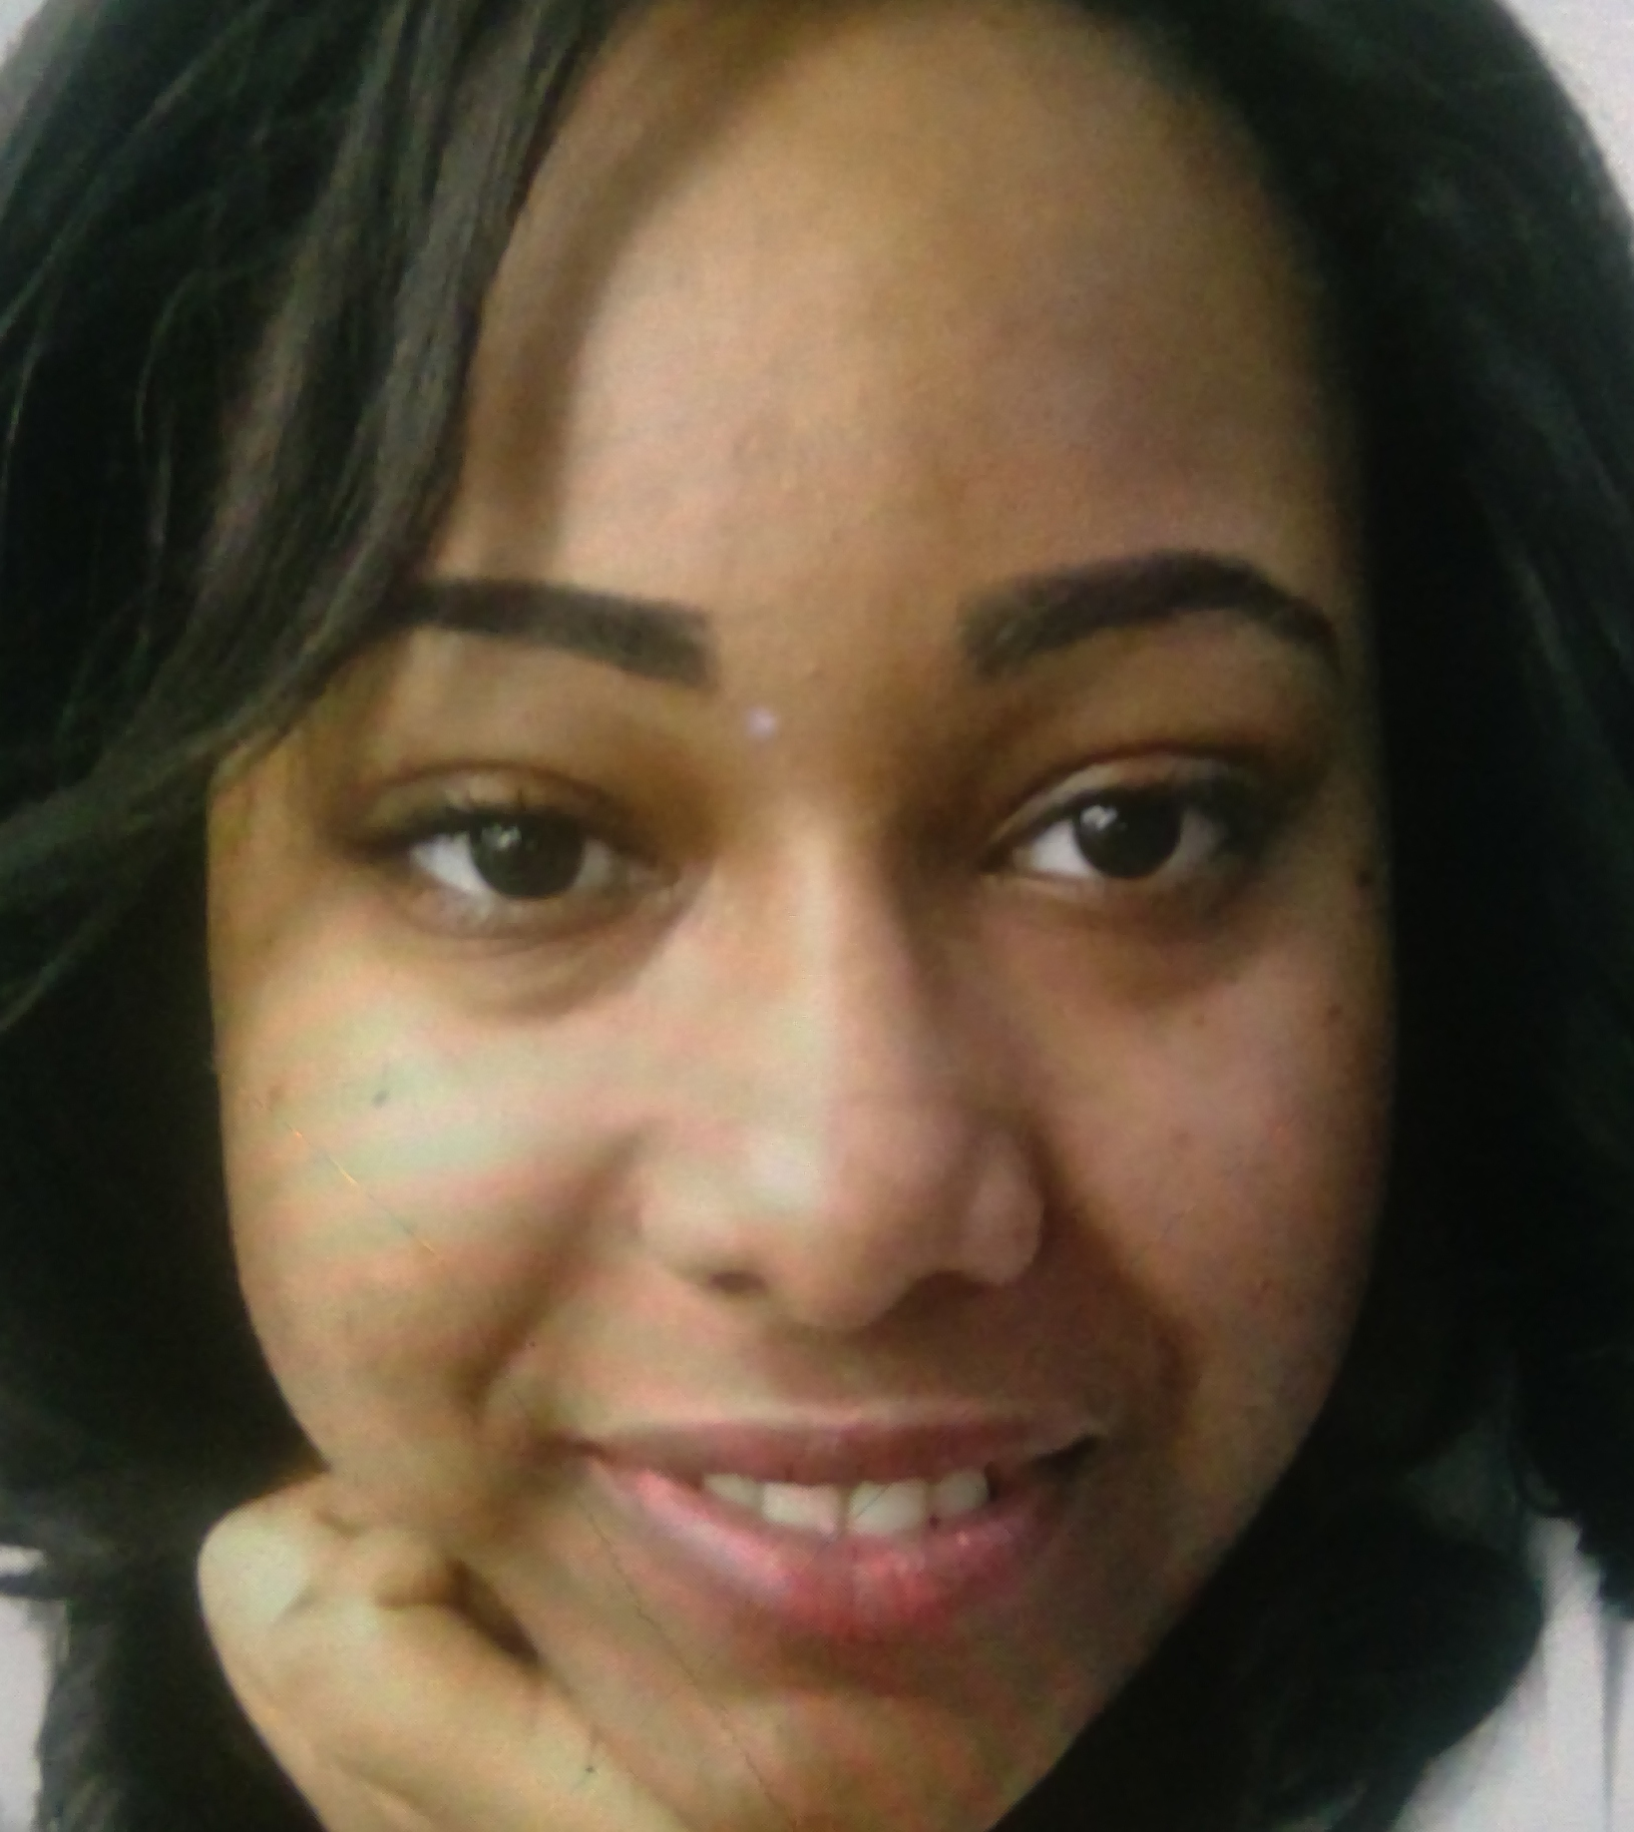
Jasmine Barnes - Aging
I.C.A.R.E. Standard displayed
= Integrity
“Jasmines knows everything about her members. She is really invested in getting to know them and it shows with the work she does for her critical incidents.”
Fun Fact: My very first airplane ride was out of the country to Guatemala!

Slide 75
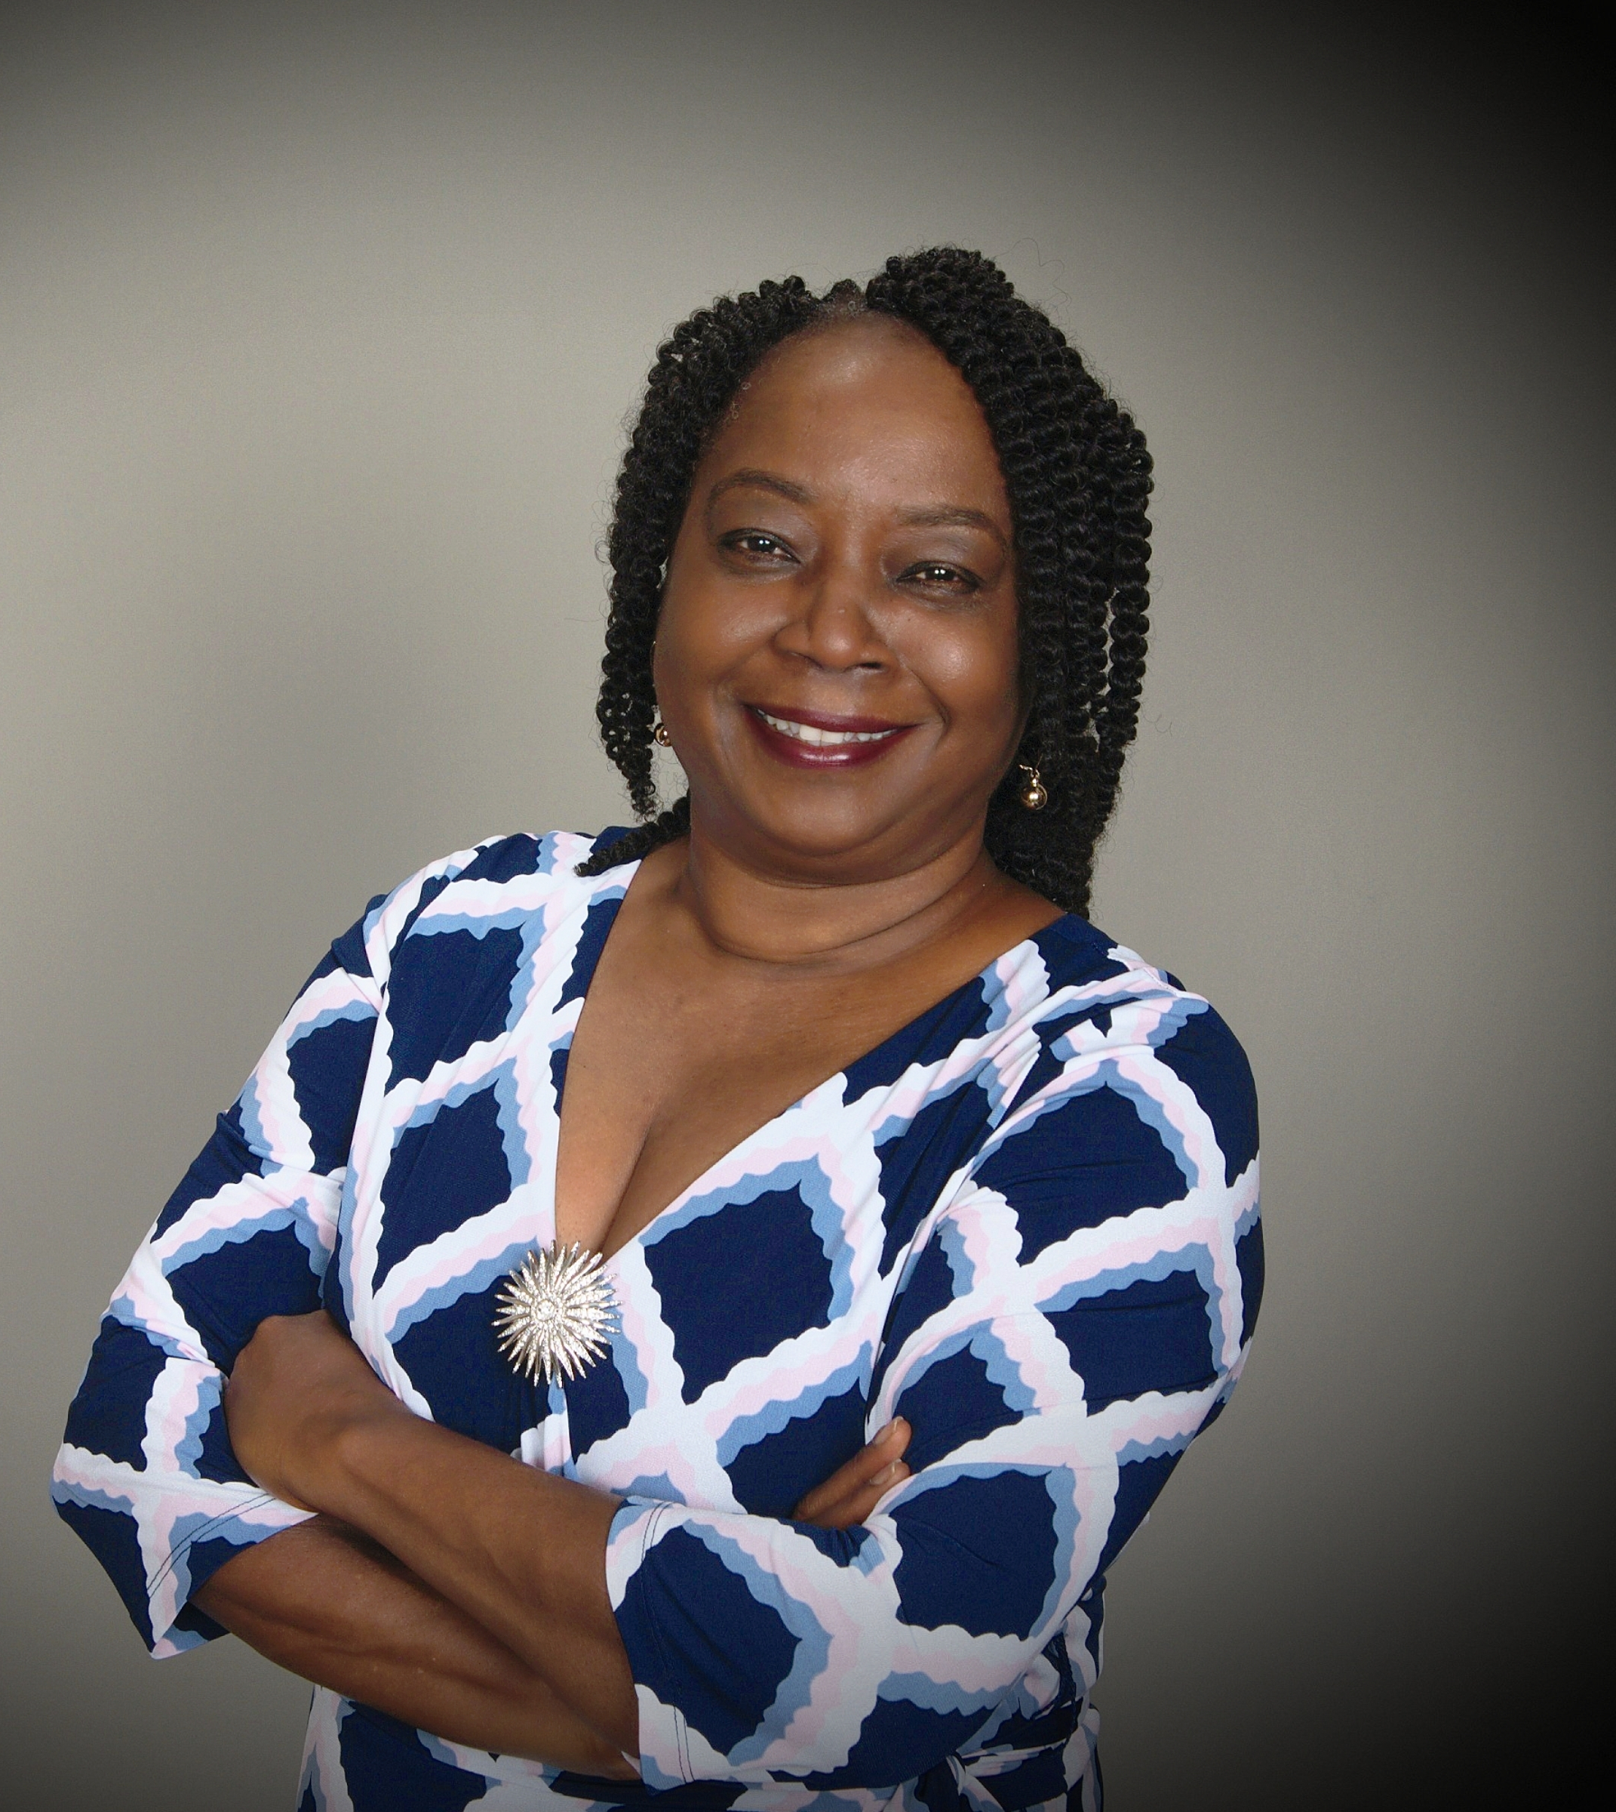
Adaku MaduBuko - Aging
I.C.A.R.E. Standard displayed
= Accountability
“Adaku is really doing a great job with her cases. She stays on top of her follow-ups!”
Fun Fact: I love to sing and in the choir of my church. My greatest passion is in education and building of young lives.

Slide 76
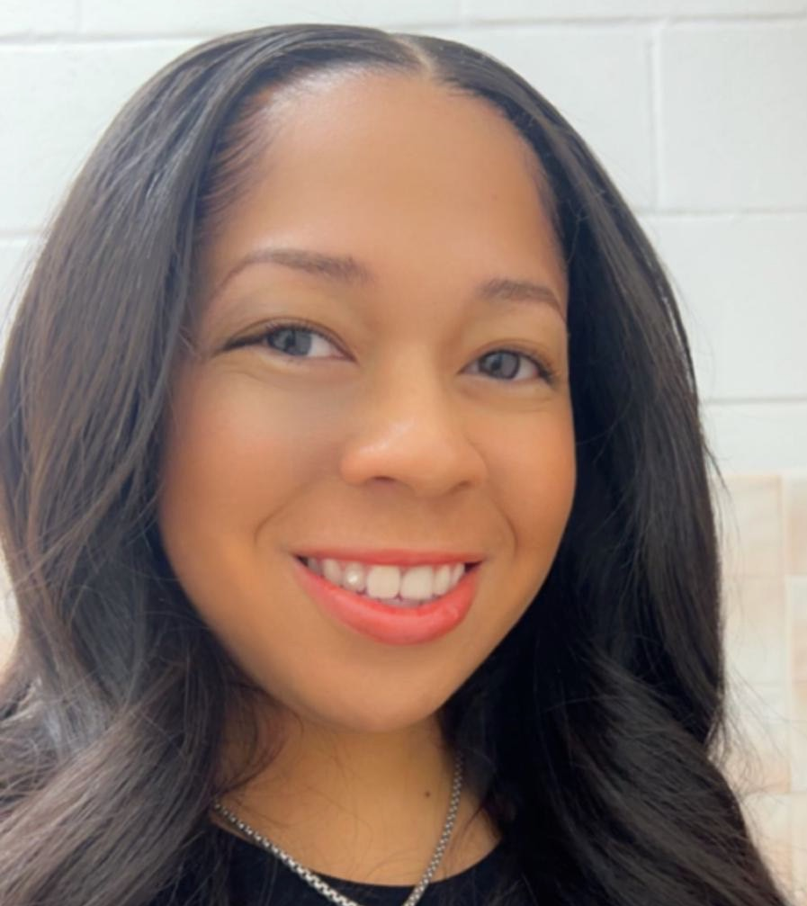
Zantra Madkins – Non Waiver
I.C.A.R.E. Standard displayed
= Integrity
“Zantra gets the job done. From her bi-weekly follow-ups to her 90 day follow ups, everything is on time. She models compliance.”
Fun Fact: People think I am outgoing and fun but I'm really a huge nerd. I'd take a museum and a book over partying any day.

Slide 77

Rachel Earl - TOC
I.C.A.R.E. Standard displayed
= Collaboration
“Rachel provides great energy through her emails that helps you give great energy back. Her energy lets you know she is a great team player.”
Fun Fact: is I am extremely quick to laugh! Smiling and silliness is my baseline. I am always a comedian’s best audience member!

Slide 78
Shirece Roberts – LTF/SLF
I.C.A.R.E. Standard displayed = Integrity
“Shirece has inherited CI cases with major compliance issues, some with gaps in information and some with no information at all. She has taken the challenge of each case and help the HSW team come to resolutions with each case.”

Slide 79
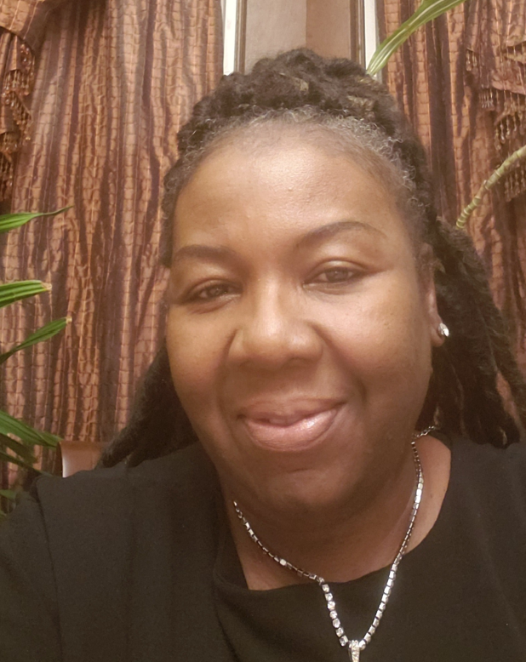
Donna Bakare - PWD
I.C.A.R.E. Standard displayed
= Excellence
“Working with Donna through CIs she has demonstrated a very caring spirit for her members. Many times, her CI cases were not quick fixes and she never showed frustration. She continued to generate ideas to support her members through their circumstances until she found a resolution.”
“In addition to being compassionate, Donna is very patient with her members. Kim’s remarks are spot on!!... she works through complex issues with her members with great patience until the issues are resolved.”

Slide 80
Donna Cont.
Fun Fact: that I still love early hip-hop music, we own 2 Dobermans and a Shitzu as pets and I love traveling to different countries. I love working with the members at County care , I am grateful to have the opportunity to meet the person behind the name, each person is unique. I have an affirmation in my wallet that reads “Ability is what you are capable of doing, Motivation determines what you do, Attitude determines how well you do it! I try to approach each day knowing that kindness doesn’t cost you anything, why not give it freely.

Slide 81
Linda Clay - PWD
I.C.A.R.E. Standard displayed = Integrity
“Linda has shown a spirit of openness for feedback on cases and has shown an interest in developing more understanding for critical incidents.”

Slide 82

Care Coordinator Spotlight Reminder
Please email nominations to: iva.elliott@cookcountyhealth.org
If you have been nominated, I will reach out to you prior to the webinar
CountyCare CM Webinar | For CountyCare Care Coordination Staff – Not for Distribution

Slide 83
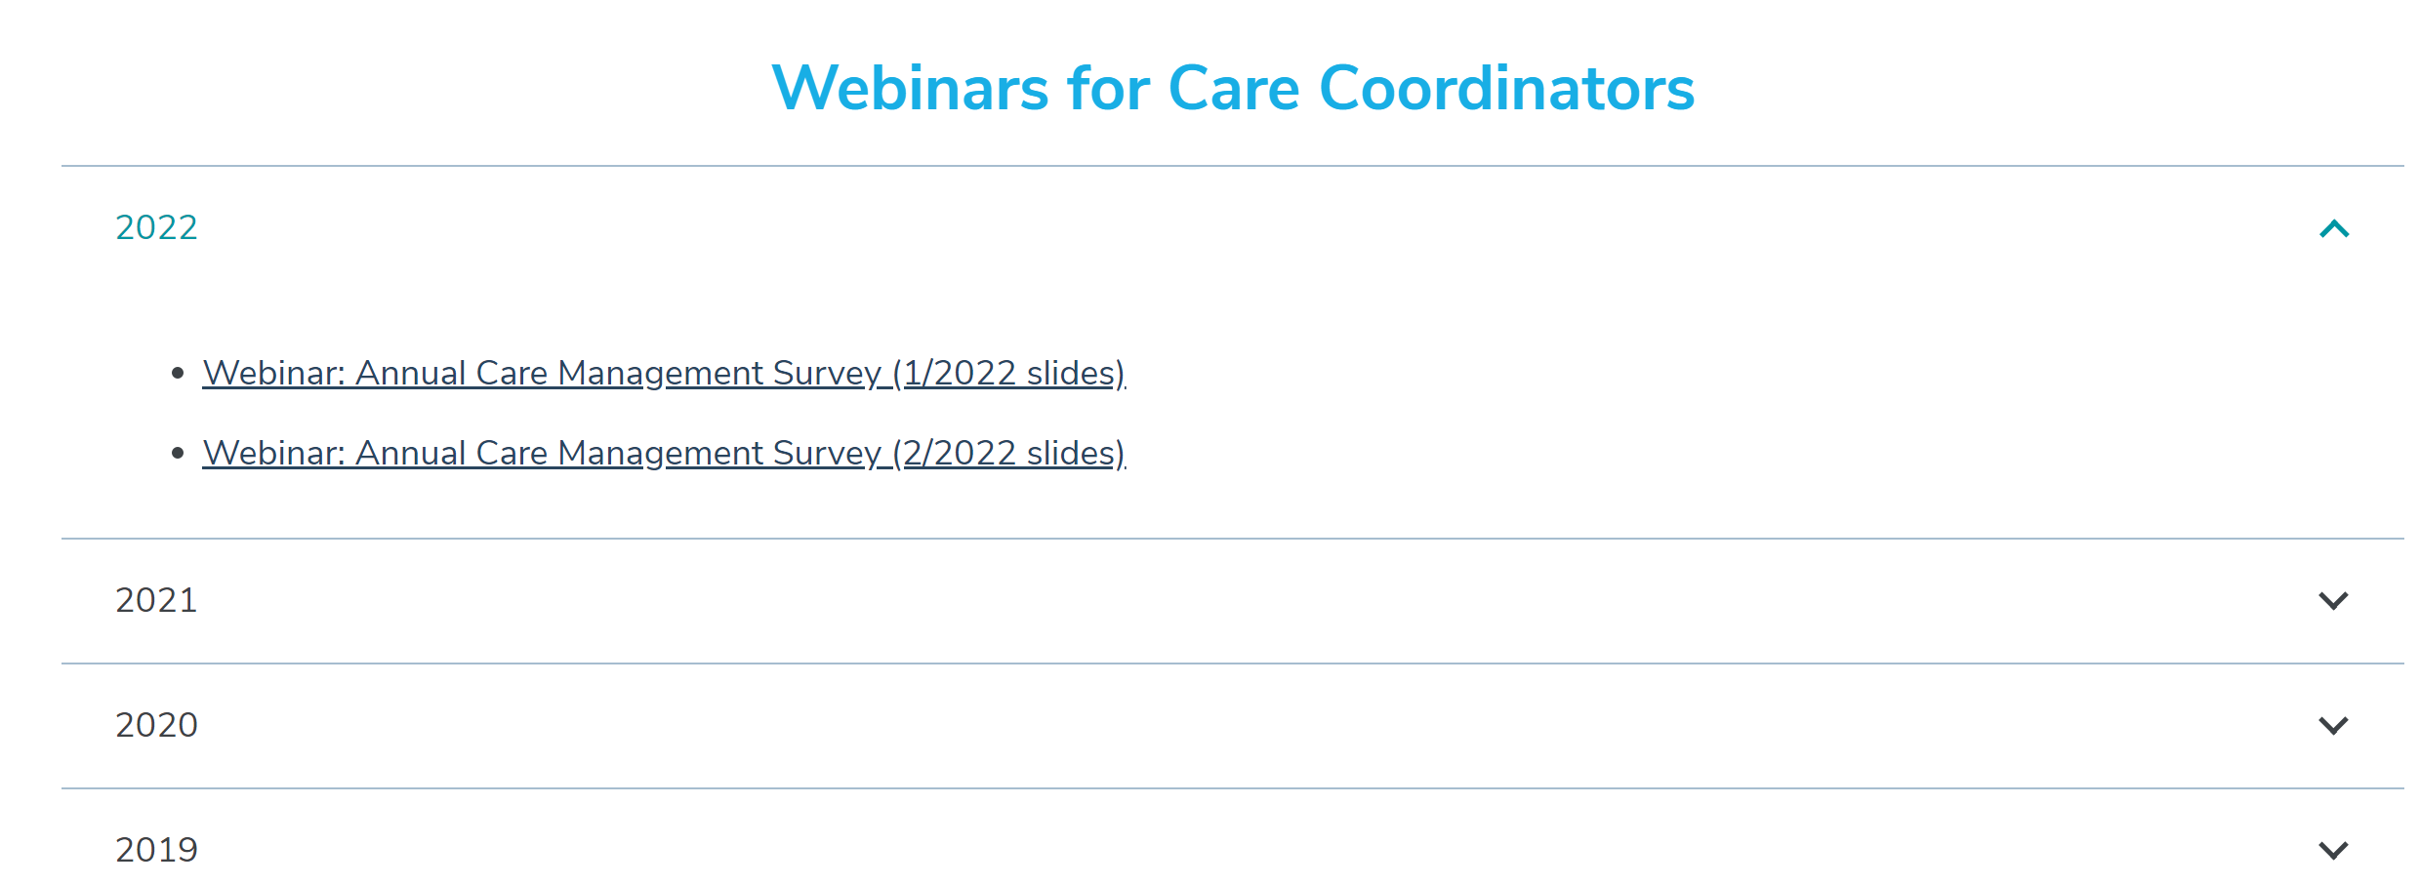
Reminders
The next webinar is scheduled for April 19th 2023!
Webinar feedback: https://redcap.link/23k1fzzb
Slides will be posted to the CountyCare Care Coordination Webpage: http://www.countycare.com/carecoordination
CountyCare CM Webinar | For CountyCare Care Coordination Staff – Not for Distribution

Slide 84
Open Forum
Please share any needs or questions you have by typing in the chat box
CountyCare CM Webinar | For CountyCare Care Coordination Staff – Not for Distribution

