Slide 1
November Care Management Webinar
Wednesday, September 15, 2023

Slide 2

Trauma-Informed Care
11/15/2023
Catharine Thomann, Ph.D.
Theresa Valach, LCSW

Slide 3
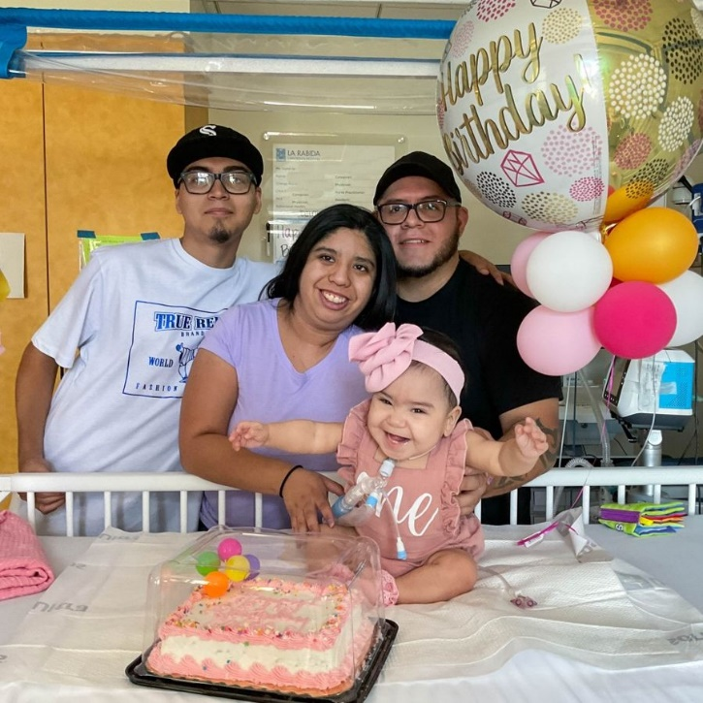
About La Rabida
Acute care hospital focused on children with complex medical needs, technology dependence and rehabilitation
39 bed inpatient unit
Outpatient clinic with a NCQA certified primary care medical home and multiple specialty clinics
Interdisciplinary care team, that includes: physicians, nursing, respiratory therapy, physical therapists, occupational therapists, speech therapists, child life, behavioral health, infant development, social workers and case managers
Notes:
Amy

Slide 4
How We Work with MCOs
90% Medicaid (including MMC); contracted with all MCOs
Provided trauma-informed care training to Aetna High Needs Children and Community Health Worker care management teams
NCQA certified patient-centered medical home; provide care coordination to over 1,500 County Care enrollees
If you have questions, opportunities to partner with us, or would like to visit, please contact Amy Lulich, Director of Outreach and Business Development, alulich@larabida.org or 773-753-8643.

Slide 5
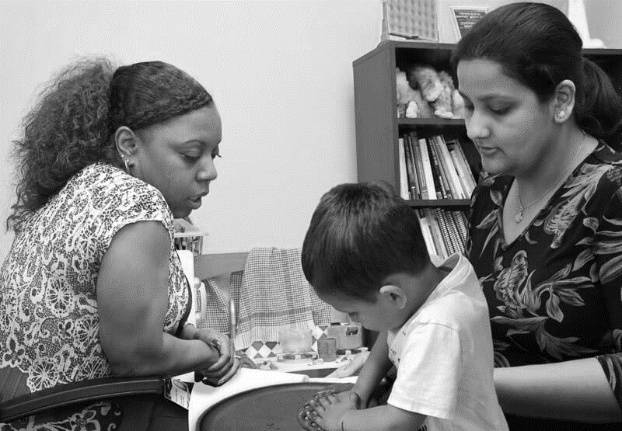
The Chicago Child Trauma Center
(CCTC)
The CCTC is a community treatment site of the National Child Traumatic Stress Network
Located in one of the most racially and economically segregated areas in the United States
Primary mission:
  Ensure that expert trauma-focused psychological services are available to children on Chicago's south side and south suburban Cook County where their risk of exposure to traumatic stress is great.
Aprox. 80% of the population that we serve at the CCTC identifies as Black or African American and 13% as Latinx
Notes:
Theresa
La Rabida’s mission has always been to assure there is access of high quality care to anyone who is in need.
We are an affiliate of the National Child Traumatic Stress Network and it is our goal to contribute to raising the standard of care and improve access to care for families who have been exposed to trauma.
We believe everyone should have access to high quality services at no cost to families. No one chooses to experience a trauma and no one should have to pay to heal from it. About 80% of the population that we serve at the CCTC identifies as Black and about 13% identifies and Latino or Hispanic. So the large majority of our patients identify as People of Color.
*Disclaimer. We will be discussing trauma today from multiple perspectives. We want to give people permission up front to step away, pause, do what they need to care for themselves if the information feels triggering or overwhelming. We also plan to discuss topics today related to racism, oppression, white supremacy as it relates to racial, intergenerational, and historical trauma. We acknowledge that as two white women we do not have the lived experience of facing oppression and discrimination that many BIPOC people in this group may have experienced. We do feel we still need to speak to these topics as it is extremely important to understand that the root of so much trauma lies within systems of oppression and we will be touching on these subjects today.
Questions in Chat, do our best to address as we go and will also have time at the end for questions were we can go more into more depth with some aspects.

Slide 6
Goals
Trauma Informed Care
REALIZE:
WHAT IS TRAUMA, COMPLEX TRAUMA, RACIAL TRAUMA? HOW DO THESE INTERACT?
RESPOND:
CARING for OURSELVES (Secondary Traumatic Stress)
CARING for STAFF
CARING for the INSTITUTION
RECOGNIZE:
WHAT IS THE POTENTIAL IMPACT OF TRAUMA ON PROVIDERS and ORGANIZATIONS?
RESPOND:
STRATEGIES TO SUPPORT ORGANIZATIONS WORKING WITH PARTICIPANTS EXPERIENCING TRAUMA
Notes:
Theresa
We want to briefly give an overview of what we hope you will take away from today and our next training in two weeks. Today we are going to focus on better defining What is trauma. This includes not only gaining more awareness about what may be considered trauma, but also what is complex trauma, racial trauma, and stressors that may impact participants functioning.
After we learn to realize with is trauma we want to also learn to recognize what the impact of trauma is including symptoms of trauma and what trauma reactions may look like.
So today is going to be a little broader goal of better understand trauma.
Then next time we come together we will focus more on specific trauma-informed care principals and how to respond to participants in a trauma informed way and how to make sure we are thinking about trauma informed care principals as it applies to an organization and caring for the staff within an organization.

Slide 7
DEFINITION OF TRAUMA
3 E model from SAMHSA
Event
Experience
Effects
Notes:
Theresa
An easy way to better understand trauma is by breaking trauma down to the 3 E’s.
An Event occurs, we experience the event, and then the event has an effect on us. That effect may or may not be significant. So two people may experience the same EVENT but one may walk away feeling a bit off/stressed while another person may be traumatized and start presenting trauma symptoms. For example if I you get into a car accident on your way to work. One person may experience stress when it happens and even think about it for the next few days, but they go on with their life and return to daily functioning. Another person could develop a fear of driving or avoid taking that route to work. They may experience flashbacks, nightmares, or a number of other reactions from the same experience.
We all experience some level of stress on a regular basis, whether at work or at home. Daily stressors such as deadlines, meetings, traffic, and juggling family needs are common for most of us. We also face more intense experiences like illness, caring for an aging parent, ongoing stress at work, financial pressures, or dealing with a major loss. Even positive experiences like getting married, moving, or starting a new job can cause some level of strain. In many cases, we have the capacity to cope with a range of life experiences, expected or unexpected, mild or intense.

Slide 8

CULTURE AND TRAUMA: The 3 Es
All influenced by cultural factors:
  Events: risk and type of exposure to potentially traumatic events
  Experience: how a person describes their experience, how distress is expressed
  Effects: which topics are acceptable to share and discuss, how a person makes meaning of experiences and heals from trauma
Notes:
Theresa
Culture may also influence how someone responds based on what is normative or acceptable in one’s culture to express, discuss, share. How we make meaning of our experience impacts how we heal from the trauma so their may be cultural factors that are protective and some that increase the risk of trauma.

Slide 9
DEFINITION OF TRAUMA: 3Es
Event
Experience
Effects
Natural disasters
Family violence
Refugee and Immigrant trauma
Medical trauma
Sudden, unexpected, or violent death or separation from a loved one
Abuse or neglect
School violence: Threats, fights, school shootings, bullying, loss of a student or staff member
Community violence
Human-caused disasters
Historical trauma
Racial trauma
aka Potentially Traumatic Events (PTEs)
Notes:
Theresa
Traumatic events that some participants that you work with may face in their families and communities come in many forms, and range from one-time incidents, such as an accident, a natural disaster, a surgery or scary medical procedure, the loss of a parent or peer, or a single experience of violence, to experiences that are chronic or even generational, such as abuse, neglect, enduring chronic painful ongoing medical procedures or care, chronic bullying, exposure to family or community violence, or the cumulative and historical impact of poverty, racism, or discrimination.

Slide 10
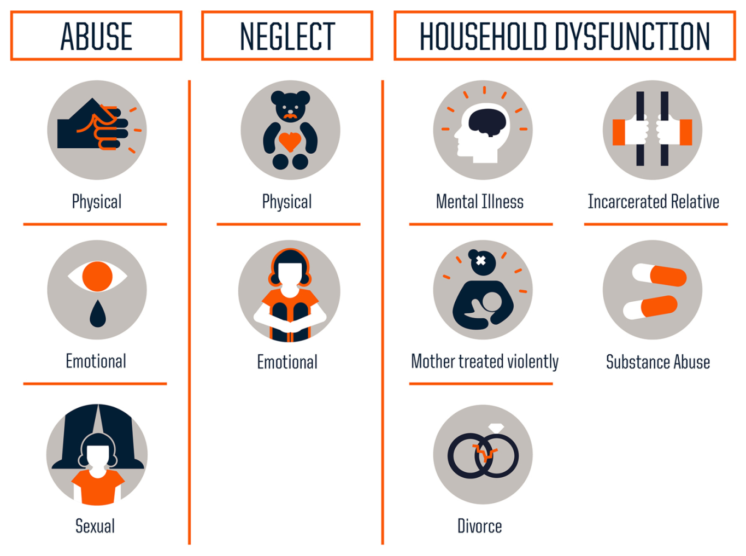
Adverse Childhood Experiences (ACES)
*Loss of primary caregiver
Source: Centers for Disease Control and Prevention
Credit: Robert Wood Johnson Foundation
Notes:
Theresa ACES section
Now that we’ve talked about how specific events we also want to take a closer looks at how these events or some other ongoing stressors can impact people throughout their lifetime, especially as it relates to ones health.
The idea for the ACES study was developed after a research team that was studying obesity started to notice a link between trauma and obesity. In the study participants were asked to keep a food diary. They began noticing that a large number of patients who appear to be following diet plans weren’t losing weight. They began trying to make sense of it and put camera’s around the homes and realized some participants were actually eating at night and didn’t recall in the morning that they’d eaten. They realized they were dissociating which made them look to trauma. They began asking about trauma (Prior to age 18…) and realized there was a huge connection between trauma and obesity. They decided to look at this further.
CDC-Kaiser ACE Study from 1995 to 1997 with two waves of data collection. Over 17,000 Health Maintenance Organization members from Southern California receiving physical exams completed confidential surveys regarding their childhood experiences and current health status and behaviors.
2/3 reported at least one ACES. 1 in 5 people reported 3 or more ACES

Slide 11
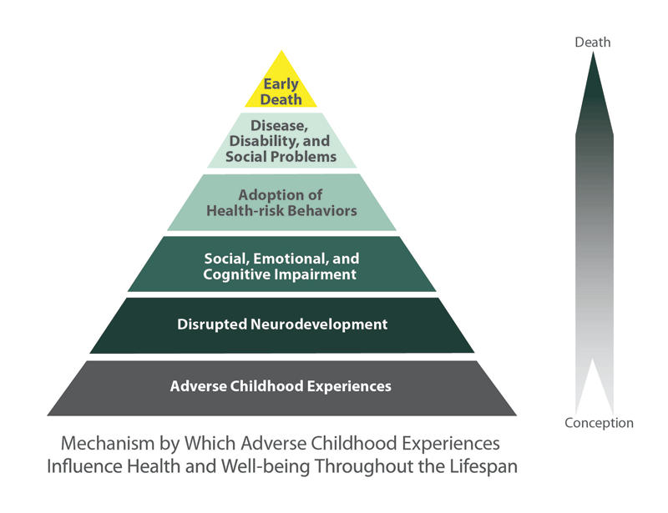
* https://www.cdc.gov/violenceprevention/acestudy
Notes:
Theresa
As the number of ACES increases so do the risk of experiencing these negative outcomes
We know that increased stress can actually change the way your brain develops, underdeveloped neuropathways. How do you build upon that?
This in turn impacts your social, emotional, cognitive development (we need healthy thriving neuropathways to build these skills).
Young children face a 76% likelihood of having one or more delays in their language, emotional, or brain development if exposed to 5 or more significant adverse experiences in the first 3 years
When you are struggling to keep up with peers/ the general population people sometimes adopt risky health behaviors – over-eating for comfort, smoking, alcoholism, drugs
This can lead to chronic health conditions- obesity, diabetes, depression, heart disease
low life potential- academic achievement and graduation rates, lost time at work
and early death.
75% of the ACES participants in the Kaiser study were white. 75% had at least some college experiences.
So what does that mean for children and families who also experience oppression, discrimination, racism

Slide 12
ACEs Exposure:
Racial & Socioeconomic Disparities
ACEs included:
  Physical and psychological abuse; neglect
  Parental domestic violence, depression, substance use, divorce/separation and incarceration
  Economic hardship and maternal education (used to capture socioeconomic adversity)
ACE prevalence: Higher among adolescents identifying as Black and Hispanic (compared to White adolescents)
Economic adversity significantly more likely for Black and Hispanic adolescents (compared to White adolescents)
(Zhang & Monnat, 2021)
.
  Included 11 ACEs (physical, sexual, & emotional abuse, household mental illness, intimate partner violence, household substance use, parental divorce/separation, incarcerated household member)
  Did not include exposure to racism/discrimination or CVE
(Giano, et al., 2020)
Notes:
ix indicators were based on Felitti et al.’s (1998) landmark study: physical and psychological abuse and parental domestic violence, depression, substance use, and incarceration. Two indicators were from Anda et al.’s (2006) subsequent data collection: neglect and parental divorce/separation. Among our contributions to the literature is to include two additional indicators—economic hardship and maternal education—which have been found to have strong influences on children's mental health and which we use to capture socioeconomic adversity (Hughes et al., 2017). The FFCWS does not include sexual abuse by a household member.
The ACES studies also revealed some striking disparities
Further research revealed that Adverse childhood experiences, including experiences of potentially traumatic events, disproportionately affect children in racial minority groups and families with lower incomes.
The families we strive to serve at the CCTC often fall into one or both of those groups – and thus are more likely to be disproportionately exposed to ACES
financial hardship;
2. parental divorce/separation;
3. parental death;
4. parental imprisonment;
5. witness to domestic violence;
6. victim or witness of neighborhood violence;
7. lived with mentally ill/suicidal person;
8. lived with someone with alcohol/drug problem; and
9. treated unfairly because of race/ethnicity

Slide 13
ACEs Exposure:
Racial & Socioeconomic Disparities
Racial Disparities SES Disparities
.
  Included 11 ACEs (physical, sexual, & emotional abuse, household mental illness, intimate partner violence, household substance use, parental divorce/separation, incarcerated household member)
  Did not include exposure to racism/discrimination or CVE
(Giano, et al., 2020)
Individuals identifying as: | ACEs exposure
Multiracial | Significantly higher ACE mean score compared to all other races/ethnicities
Black & Hispanic | Significantly higher ACE mean score compared to individuals identifying as White; frequencies in some ACE categories reflected frequencies for individuals identifying as Multiracial
Income | ACEs exposure
Less than $15,000 per year | Significantly higher ACE mean score compared to all other categories
$15,000-$24,000 per year | Significantly higher ACE mean score compared to all higher earning groups
Notes:
The ACES studies also revealed some striking disparities
Further research revealed that Adverse childhood experiences, including experiences of potentially traumatic events, disproportionately affect children in racial minority groups and families with lower incomes.
The families we strive to serve at the CCTC often fall into one or both of those groups – and thus are more likely to be disproportionately exposed to ACES
financial hardship;
2. parental divorce/separation;
3. parental death;
4. parental imprisonment;
5. witness to domestic violence;
6. victim or witness of neighborhood violence;
7. lived with mentally ill/suicidal person;
8. lived with someone with alcohol/drug problem; and
9. treated unfairly because of race/ethnicity

Slide 14
ACEs Exposure:
Racial & Socioeconomic Disparities
Racial Disparities SES Disparities
.
Included some original and updated ACEs (CVE exposure, racial/ethnic discrimination)
Did not include abuse/neglect
Findings come from data in the Health Resources and Services Administration’s (HRSA’s) 2016 National Survey of Children’s Health and an analysis conducted by the Child & Adolescent Health Measurement Initiative (CAHMI) at the Johns Hopkins Bloomberg School of Public Health
Racial Group | % Exposed to one or more ACEs
Black | 64%
Hispanic/Latinx | 51%
White | 40%
Income Level | % Exposed to one or more ACEs
Children with family incomes under 200% of the federal poverty level | 62%
Children with incomes higher than 400% of the federal poverty level | 26%
Notes:
ACE scores were significantly higher among Blacks, Hispanics, and American Indians than Whites ( p < .01). ACE scores were also significantly higher among poor than non-poor participants ( p < .01).Catharine
The ACES studies also revealed some striking disparities
Further research revealed that Adverse childhood experiences, including experiences of potentially traumatic events, disproportionately affect children in racial minority groups and families with lower incomes.
The families we strive to serve at the CCTC often fall into one or both of those groups – and thus are more likely to be disproportionately exposed to ACES
financial hardship;
2. parental divorce/separation;
3. parental death;
4. parental imprisonment;
5. witness to domestic violence;
6. victim or witness of neighborhood violence;
7. lived with mentally ill/suicidal person;
8. lived with someone with alcohol/drug problem; and
9. treated unfairly because of race/ethnicity

Slide 15
La Rabida Chicago Child Trauma Center
Notes:
Catharine
And then – again – seeing this play our for our CCTC families – with 92% of participants coming in with two or more identified trauma experiences –
we are seeing this Higher risk for multiple trauma exposures and disparities in core resources

Slide 16
Structural Racism
“The macrolevel systems, social forces, institutions, ideologies, and processes that interact with one another to generate and reinforce inequities among racial and ethnic groups.”
(Gee & Ford, 2011, p. 3)
Notes:
Catharine
How do we understand these disparities?? For us – it is about structural or systemic racism.
This is of course, a huge and complex topic, and we are only going to skim the surface – but we wanted to establish this as a foundation for now, as the way that we are understanding these disparities, the unfair and disproportionate exposure to trauma and ACES for our participants, and how to think about being the most helpful within this context
Again – such a huge topic. We are using this definition on the slide – trying to get at this concept of Structural racism as all of the different ways in which societies foster [racial] discrimination, through all of these inequitable systems, beliefs, values, ideologies – in housing, health care, the criminal justice system, media, credit, education – on and on -- that are interconnected, that interact – and reinforce each other and keep producing disparities --
In the words of a former American Public Health Association president, Dr. Camara Jones,[2] “racism saps the strength of our entire society through the waste of human resources” as the full potential of those it marginalizes goes unrealized.[3]

Slide 17
Systemic or Structural Racism:
“The cumulative and compounded effects of an array of factors that systematically privilege white people and disadvantage people of color”
Systemic/
Structural Racism
Healthcare
Laws/ Government/Criminal Justice System
Education
Economy/ Jobs
Housing
Notes:
Theresa
We see White supremacy and privilege and as well as discrimination and oppression within every system in the US.
It contributes housing inequities where
Redlining still occurs – Banks refuse loans to Black residents who attempt to move to “White” neighborhoods. Today in Chicago 68.1% of dollars loaned for housing purchases went to majority-white neighborhoods, while just 8.1% went to majority-black neighborhoods, and 8.7 went to majority Latino Neighborhoods.
If housing is segregated so are schools which impacts taxes and money that is invested into schools. In the 2018-2019 school year, 10% of CPS is White, 38% African American, 47% Hispanic despite the city being evenly split
Structural racism is a fundamental cause of racial health inequities which not only includes unequal access to quality healthcare but Racism within patient care and treatment. The way COVID-19 has disproportionally impacted people of color is one example of this.
This countries legal system was developed during the Jim Crow era assuring that laws, policies, and practices produced inequal opportunities for BIPOC people and privileged white’s. To this day there is a failure to correct previous laws and practices that were explicitly racist. Our Crimincal Justics system today has been referred to the New Jim Crow due to the disproportionate incarceration of Black males
Structural racism also assures that differential distribution of goods, services, opportunities in employment opportunities, and opportunities to building adequate income.

Slide 18

RACISM IN HEALTHCARE
History of medical racism leading to well-founded Black community mistrust of the medical system (Prograis & Pellegrino, 2007)
Scientific racism in medicine – perpetuating myths of racial inferiority, racial differences in pain tolerance, lung capacity, etc. (Institute of Medicine, 2003)
History of medical atrocities against Black communities (Krieger, 2014; James, 2003).
Effects of racial trauma (experiences of discrimination → structural racism) leading to racial disparities in health outcomes (Jones, 2000; Jones, 2018)
Environmental racism (structural racism → residential segregation and less access to safe housing, water, air, green space)
Bedside racism (Racial microaggressions, implicit racism, cultural racism)
Racism in mental healthcare (Cummings Center, 2021; Helms, 2003)
Notes:
Healthcare
History of atrocities against Black communities:
Surgical experimentation on enslaved Black women (Krieger, 2014)
Eugenics Board of North Carolina’s forced sterilization program (1929-1974), disproportionately targeted Black women (James, 2003)
Use of Henrietta Lacks’ cancer cells for ongoing medical research, without knowledge, consent, or compensation for her family or her family’s knowledge or consent (Phelan & Link,
US Public Health Service Syphilis Study at Tuskegee, in which hundreds of Black men infected with syphilis were left untreated, even after penicillin became the standard of care
Racial disparities in access to resources (healthcare facilities, health insurance, etc.)
From American Public Health Association:
Structural racism as a fundamental cause of racial health inequities: Racism, particularly at the institutional/structural level, is a fundamental social determinant of long-standing, widespread racial disparities in population health.[5,6] Racism has been woven tightly into the fabric of American society to establish and reinforce the racial hierarchy.[7] From 1619, when the first enslaved Africans arrived to the land of America, to the deliberate failures of Reconstruction to Jim Crow and the Civil Rights Movement and beyond, racist beliefs about Black people have been codified into law and the policies and practices of social institutions.[5,8] Structural racism differentially distributes the goods, services, opportunities, and protections of society by race, including safe and affordable housing, quality education, adequate income and wealth building, employment, accessible quality health care, and healthy neighborhoods.[1,2] This legacy of racial oppression has resulted in pervasive social inequalities and health inequities across the life course.
Structural racism is pervasive in our environment, evident in the persistent residential segregation and restricted access to safe housing, water, air, and green space as well as healthy foods that disproportionately affect people of color in the United States.[23,31,35] Black individuals have experienced and continue to experience a particularly heavy burden from discriminatory environmental policies and practices.[23,31,35] Exposure to deleterious environmental conditions is linked to infectious and chronic disease and premature mortality.[23,31]
Racism in mental health care – from APA apology, 2021 – acknowledging history of racism in mental health system
WHEREAS APA was established by White male leadership, many of whom contributed to scientific inquiry and methods that perpetuated systemic racial oppression, including promoting the ideas of early 20th century eugenics; Eugenics is defined as the idea that racial differences and hierarchies are biologically based and fixed, and was used to support segregation, sterilization, and antimarriage laws (Cummings Center, 2021).
WHEREAS eugenicists focused on the measurement of intelligence, health, and capability, concepts which were adopted by the field of psychology and used systemically to create the ideology of White supremacy and harm communities of color (Cummings Center, 2021; Gillham, 2001).
WHEREAS psychologists created, sustained, and promulgated ideas of human hierarchy through the construction, study, and interpretation of racial difference, and therefore contributed to the financial wealth gap and social class disparities experienced by many communities of color (Cummings Center, 2021).
Now – apology/ commitment to anti racism --
WHEREAS APA has recently adopted a framework that affirms that human rights are universal and inalienable, that racism is a violation of human rights, and that APA must oppose racism in all its forms (APA, 2021e) and implemented an equity, diversity, and inclusion (EDI) framework (APA, 2021d) to be infused throughout the association that holds APA accountable for promoting psychological safety, emotional intelligence, and belongingness throughout APA.
More likely to get ADHD or ODD diagnosis

Slide 19

Systemic or Structural Racism
Notes:
Theresa
Here we have a video where Laid Bare helps show more clearly on how racism is lying within all of these structures. (aprox 6-7 min)

Slide 20

History → Structural Racism → Inequities/Risk for Aces
Inspired by the work of Professor Tricia Rose, Brown University
Structural Racism Machine
"Systemic racism is a machine that runs whether we pull the levers or not, and by just letting it be, we are responsible for what it produces"
- Ijeoma Oluo
Notes:
Catharine
This image has helped us to conceptualize these ideas – it is inspired by the work of Tricia Rose, Professor at Brown University
History ---> Structural Racism Machine ---> producing inequities and risk for higher exposure to Aces/trauma
Here we are seeing how -- All of these polices and events from the past – from creating the concept of race and white supremacy to justify forced removal and genocide of Indigenous peoples and enslavement of Africans – to redlining, Jim Crow, colorblind racism, etc… --have created a structural racism machine, with all of these interlocking and connected gears and levers that continue to produce racial inequities (including increasing the risk for more exposure to ACES).
This machine keeps operating and producing these inequities, whether or not individuals carry explicitly racist beliefs
Video –Start at 10 minutes -- Stop at 12:47
This machine keeps operating and producing these inequities, whether or not individuals carry explicitly racist beliefs
quote from Ijeoma Oluo:
"Systemic racism is a machine that runs whether we pull the levers or not, and by just letting it be, we are responsible for what it produces"

Slide 21
Racial Trauma
The trauma is RACISM
Racism operates at multiple levels: Individual → Structural
Negative effects on physical and mental health at all these different levels
Racial trauma: Describes the stressful impact (both physical and psychological) of experiencing racism (Jernigan, et. l, 2015).
Race-based traumatic stress
  Increased vigilance
  Hypersensitivity to threat
  Sense of a foreshortened future
  Headaches, insomnia, body aches, memory difficulty
  Self-blame, confusion, shame, and guilt
  Cumulative effects
    (Jernigan et al., 2015; Comas-Díaz, 2016)
Notes:
Catharine
In addition to considering how structural racism is creating this disproportionate risk for ACES and trauma exposure – we also want to consider the way in which racism operates at all of these different levels – from individual experiences, interpersonal experiences, cultural racism – to structural
And there can be negative effects on health at all these different levels – in some research, this is subsumed under this umbrella term of racial trauma – where we are tying to capture the stressful impact or emotional pain – both physical and psychological of experiencing racism.
Common traumatic stress reactions reflecting racial trauma include understandable increased vigilance and suspicion, increased sensitivity to threat, sense of a foreshortened future, and physiological reactions like headaches and insomnia.
And then we can also see health effects because of implicit racial bias affecting decision making by providers.
And these traumatic stress reactions are worsened by a build of multiple experiences of trauma – both racial trauma and otherwise – this can have cumulative, wear and tear effect.
So, we are thinking that there is a -- Missing category from typical ACES – more layers as we consider the effects of racism – from individual

Slide 22
Historical Trauma
“History is not about the past. It’s about the present!” – Dr. El-Kati
Historical Trauma is defined by Maria Yellow Horse Brave Heart, PhD as “cumulative emotional and psychological wounding across generations, including the lifespan, which emanates from massive group trauma.”
When a community has a universal experience of trauma that continues over an extended period of time.
Historical Trauma is an example of intergenerational trauma. Even family members who have not directly experienced the trauma can feel the effects of the event generations later.
Notes:
Theresa
Historical trauma is defined as the “cumulative emotional and psychological wounding across generations, including the lifespan, which emanates from massive group trauma.” – Maria Yellow Horse Brave Heart
For example, the negative effects of violent colonization, dislocation, and assimilation policies such as forced placement in boarding schools among American Indian and Alaska Native communities continue to manifest in current struggles with substance abuse, suicide, violence, and a distrust of systems such as education.
There has also been research looking trauma can be passed on throughout generations. For communities of color, the effects of slavery, segregation, racism, and discrimination may manifest as feelings of hopelessness, increased anger and violence towards self and others, internalized racism, and mistrust of social institutions and systems (such as schools, government, or law enforcement). Other groups that continue to be impacted by historical trauma include Jewish survivors of the Holocaust, Japanese-American survivors of World War II internment camps, immigrant populations, and members of the Lesbian, Gay, Bisexual, Transgender, and Questioning (LGBTQ) communities.

Slide 23
DEFINITION OF TRAUMA: 3Es
Event
Experience
Fear of bodily injury or death
Helplessness
Horror
Disgust
Neurophysiological stress response
Effects
Influenced by individual, environmental, and cultural factors
Notes:
Theresa
When we are discussing experience we are talking about the immediate aftermath of the event. How are we feeling/experiencing the event in the moment.
Whether an event or circumstance is “traumatic” depends on the person’s experience of the event. We cannot say that a particular situation—a car accident, for example—is always traumatic for everyone. Whether an event is experienced as traumatic is influenced by many factors, including our internal coping resources, our external supports, and broader community, cultural, and societal factors that shape how we understand and respond to our experiences. Here are a few ways an individual may respond to a trauma.
Citations:
van der Kolk, B. A. (2014). The body keeps the score: Brain, mind, and body in the healing of trauma. New York: Viking.
Wilson, K. R., Hansen, D. J., & Li, M. (2011). The traumatic stress response in child maltreatment and resultant neuropsychological effects (Faculty Publications Paper 549). Lincoln, NE: University of Nebraska, Department of Psychology.

Slide 24
DEFINITION OF TRAUMA: 3Es
Event
Experience
Effects - Pathways
Resilience
Recovery
Post-traumatic growth
Severe persisting distress
Decline
Stable maladaptive functioning
Acute Stress Disorder
Complex trauma / complex PTSD
PTSD
Not exclusive
Not linear
Notes:
Theresa
Traumatic experiences may also have short- and long-term effects on health and well-being, and can alter how youth view themselves, others, and the world around them by challenging their belief that the world is a safe place, that other people can be trusted, and that they are worthy of care and protection. Participants feeling the effects of trauma may show them in their behavior at home or at school.

Slide 25
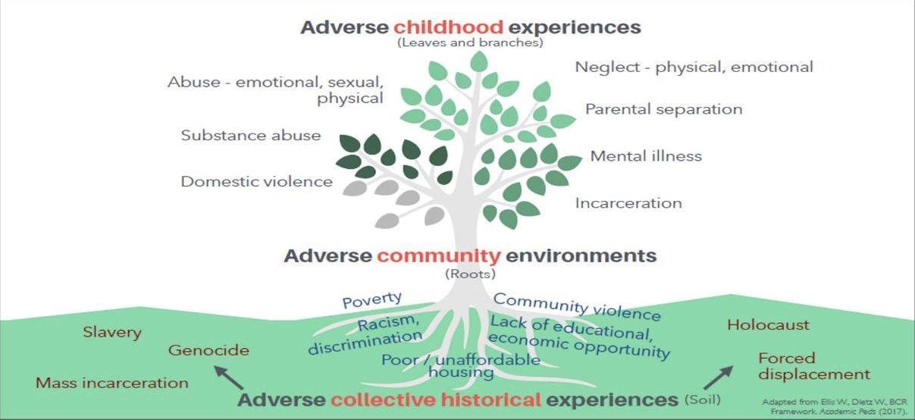
Notes:
Theresa
So –all of This all leads us to a more complex and full understanding of ACES- where we see that the leaves on this tree are the ACES we originally spoke about. But what if we go beyond that and look at the Roots of that tree. What about people who are living in adverse environments due to structural racism.
There is a Higher risk for trauma exposure and disparities in core resources that may prevent traumatization when we are exposed to chronic stress in our community.
And taking a step beyond that. What happens when the very soil our tree is planted in has a collective experience of trauma or stress. Every layer impacts how those leaves grow, how the children and families we work with grow and thrive and the struggles they may face.

Slide 26
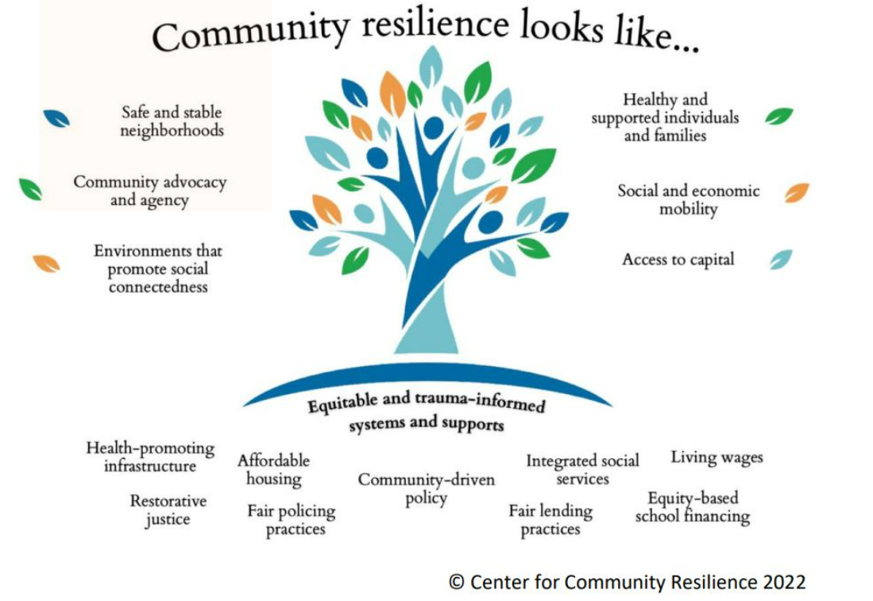
Notes:
Theresa
So what happens when we fill the roots with safety/supports/resources
When the soil is backed with restorative Justice, equity in schools, fair policies, living wage.
Most youth who experience a traumatic event do not develop significant mental health issues. However, when traumatic events are experienced without needed supports or when these types of experiences accumulate, the physiological and psychological impact becomes more significant and challenges to daily functioning more profound.
There are a number of possible trajectories for youth following a traumatic event—some that lead to health and healing, and others that lead to more significant distress. Which direction youth take depends on the unique combination of individual and environmental risk and protective factors for each child.

Slide 27
Traumatic Stress Symptoms
Re-experiencing
  “It pops into my mind.”
  “Feels like it’s happening again.”
  “I get upset when something
  reminds me of it.”
Avoidance
  “I block it out - try not to think about
  it.”
  “I try to stay away from things that
  remind me of it.”
Negative Changes in Mood/Cognition
      “My child just becomes sad/mad/upset for no reason OR more than before”
      “My child is just irritable all the time now and she yells at me”
      “I think what happened is my fault”
Increased arousal
  “I am always afraid something bad
  will happen.”
  “I jump at any loud noise.”
  “I can’t concentrate, can’t sleep.”
Dissociation
  “It felt unreal -- like I was
  dreaming.”
  “I can’t even remember parts of it.”
New Fears
  “My child started being scared of the dark and being alone”
  “Before my child was in the hospital, my child used to be able to handle being separated from me”

Slide 28
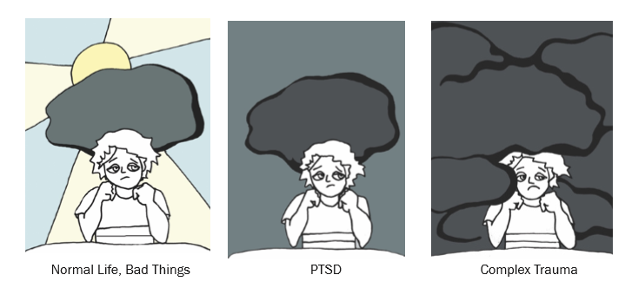
Complex Trauma
Children’s exposure to multiple or prolonged traumatic events & the impact of this exposure on their development (Spinazzola et al., 2005).
Usually involves:
  Simultaneous or Sequential occurrence of traumatic events, including psychological maltreatment, neglect, physical and sexual abuse, exposure to interpersonal violence, etc.
  Chronic
  Begins in early childhood and impacts the primary caregiving system
*Image from What is Complex Trauma? A Resource Guide for Youth The National Child Traumatic Stress Network www.NCTSN.org

Slide 29
Key Capacities Affected by Complex Trauma
Ability to identify and regulate feelings and behavior
Capacity to identify and regulate body states/functions
Sense of personal safety & ability to read safety/danger cues
Ability to trust others and form relationships
Ability to form a coherent and positive identity
Effectiveness in navigating life changes and envisioning a future
Notes:
Catharine
SO, in a bit more detail -- What we see with Complex trauma, are some key areas of development being derailed or delayed or disrupted
Regulation – of your body and emotions
Ability to identify and regulate feelings and behavior
Capacity to identify and regulate body states/functions
Impacts the blueprint for adaptive relationships – so difficult to
Sense of personal safety & ability to read safety/danger cues
Ability to trust others and form relationships
Impacts the ability to form a sense of self
Ability to form a coherent and positive identity
Effectiveness in navigating life changes and envisioning a future
Next, will go over a case example to try to illustrate these complex trauma exposure, historical/intergenerational trauma, related symptoms and why trauma-informed care is essential. Just reminder that the example will have trauma related content that could be distressing – invite everyone to please feel free to take a break if needed. Also let you know that this is not a real case – it has aspects that are very similar to kids we serve, but this is historical fiction.

Slide 30

Complex Trauma
https://www.cctassifilms.org/child-trauma/
DISCLAIMER: This film is inspired by a true story. This story shows the various ways that trauma can impact youth. It contains adult language and includes scenes with family violence and sexual assault, which may be upsetting to watch. People who have experienced historical trauma, institutionalized racism, sexism and other forms of oppression may be uniquely impacted by the content of this film.
Notes:
catharine
Now, we will watch a short film designed to help providers understand how complex trauma can present and develop in youth
16 min
Trauma is the great imitator – can look like bipolar, adhd, depression, anxiety, conduct disorder – different diagnoses? Or what could explain all of it.
This film is inspired by a true story. This story shows the various ways that trauma can impact youth. It contains adult language and includes scenes with family violence and sexual assault, which may be upsetting to watch. People who have experienced historical trauma, institutionalized racism, sexism and other forms of oppression may be uniquely impacted by the content of this film.

Slide 31

Complex Trauma
Notes:
catharine
Now, we will watch a short film designed to help providers understand how complex trauma can present and develop in youth
16 min
Trauma is the great imitator – can look like bipolar, adhd, depression, anxiety, conduct disorder – different diagnoses? Or what could explain all of it.
This film is inspired by a true story. This story shows the various ways that trauma can impact youth. It contains adult language and includes scenes with family violence and sexual assault, which may be upsetting to watch. People who have experienced historical trauma, institutionalized racism, sexism and other forms of oppression may be uniquely impacted by the content of this film.

Slide 32
“Manny”
Ability to trust others and form adaptive relationships
As a child, getting into fights and struggling to get along with peers
Increased Arousal
Trouble with attention and focus
Emotion Regulation and Dissociation
As a child, sometimes “explodes” or acts aggressive
Self-concept
Struggles to name any positive qualities or attributes
“Hyperactive”
Appears to struggle to build trust with school counselor as child
Other times, appears to “go off into another world”
As a young adult, feels angry and struggles to calm down
Thinking his child and partner might be “better off without” him
Notes:
Catharine
When a child grows up afraid or under constant or extreme stress, the immune system and body’s stress response systems may not develop normally. Later on, when the child or adult is exposed to even ordinary levels of stress, these systems may automatically respond as if the individual is under extreme stress. For example, an individual may experience significant physiological reactivity such as rapid breathing or heart pounding, or may "shut down" entirely when presented with stressful situations. These responses, while adaptive when faced with a significant threat, are out of proportion in the context of normal stress and are often perceived by others as “overreacting” or as unresponsive or detached.

Slide 33
Complex Trauma: “Manny”
What are the different labels or diagnoses you heard for Manny during the film? What other labels might he carry?
Notes:
catharine
Now, we will watch a short film designed to help providers understand how complex trauma can present and develop in youth
16 min
Trauma is the great imitator – can look like bipolar, adhd, depression, anxiety, conduct disorder – different diagnoses? Or what could explain all of it.
This film is inspired by a true story. This story shows the various ways that trauma can impact youth. It contains adult language and includes scenes with family violence and sexual assault, which may be upsetting to watch. People who have experienced historical trauma, institutionalized racism, sexism and other forms of oppression may be uniquely impacted by the content of this film.

Slide 34
Complex Trauma: “Manny”
How do you think these labels impacted his relationship with his family, how he was treated by professionals, or the services he received?
Notes:
catharine
Now, we will watch a short film designed to help providers understand how complex trauma can present and develop in youth
16 min
Trauma is the great imitator – can look like bipolar, adhd, depression, anxiety, conduct disorder – different diagnoses? Or what could explain all of it.
This film is inspired by a true story. This story shows the various ways that trauma can impact youth. It contains adult language and includes scenes with family violence and sexual assault, which may be upsetting to watch. People who have experienced historical trauma, institutionalized racism, sexism and other forms of oppression may be uniquely impacted by the content of this film.

Slide 35
Trauma-Organized System
  Sanctuary Model (Bloom & Farragher, 2013):
  Systems of Care are “living complex systems”
  Vulnerable to effects of ongoing workplace stress
    Effects of trauma exposure on staff
    Fiscal pressures
    Regulatory Responsibilities
    Loss (of sense of meaning, of co-workers, of leaders)
Notes:
Catharine
Now – pulling back the lens for a moment –
Since being a trauma-informed provider depends on working within a trauma-informed system
Going to talk a bit about the potential effects of chronic stress on systems or organizations.

Slide 36
Trauma-Organized System
    Impact of Chronic Stress on a System:
    Unsafe
    Punitive
    Stuck
    Missionless
    Crisis Driven
    Fragmented
    Overwhelmed
    Valueless
    Directionless
  Sanctuary Model (Bloom & Farragher, 2013)
Notes:
Catharine
Now – pulling back the lens for a moment –
Since being a trauma-informed provider depends on working within a trauma-informed system
Going to talk a bit about the potential effects of chronic stress on systems or organizations.

Slide 37
Impact of Chronic Stress on the System (Examples)
Emotion Management & Unresolved Grief
  “It feels like everything is a crisis.”
  “There isn’t time or a way to acknowledge or manage the emotional impact of this work.”
  “My co-worker/supervisor left and I feel lost and demoralized.”
Organizational Learning Difficulties
  “I can’t express any ideas that disagree with my manager/leadership.”
  “Things are too stressful and there are too many crises to take time to listen to staff ideas.”
Miscommunication/Conflict
      “Things are confusing and it feels like the different departments/teams don’t communicate with each other.”
      “We can’t talk about real issues during meetings.”
Organizational Hyperarousal
  “I am always afraid something bad
  will happen at work.”
  “When there is a crisis, everyone reacts quickly with strong emotions.”
  “I keep seeing problems with participants and co-workers, not strengths or positives.”
  “I feel too unsafe at work to try new things or learn new skills – it feels risky.”
Organizational Injustice
  “Things are really hierarchical and I will get in trouble if I speak up.”
  “It feels too risky to let go of our hierarchy and change anything.”
  (Sanctuary Model, Bloom & Farragher, 2013)
Notes:
Catharine
Things that might come up – like the symptoms we might see for participants – see symptom clusters for the organization

Slide 38

How do we care for Manny?
How do we care for the systems caring for Manny?
What is the most helpful way for service providers (healthcare, mental health, school, etc.) to work with Manny and his family?
What can these systems do to care for themselves, in order to better serve Manny and his family?

Slide 39
Trauma-Informed Care
A program, organization, or system that is trauma informed:
Realizes the widespread impact of trauma and understand potential paths for recovery;
Recognizes the signs and symptoms of trauma in clients, families, staff, and others involved with the system;
Responds by fully integrating knowledge about trauma into policies, procedures, and practices; and seeks to actively resist re-traumatization”
Substance Abuse Mental Health Administration (SAMHSA, 2014)
Notes:
Catharine
So then – we are left asking ourselves --How do we best care for these children and families, who have likely experienced complex trauma, in the context of structural racism, and may be experiencing both the symptoms of PTSD and more profound effects on their development?
What is the most helpful way for service providers (healthcare, mental health, school, etc.) to work with our families
Answer -- comprehensive trauma informed care –
conceptual framework developed by SAMHSA –Substance abuse and mental health administration
Begin this work, SAMHSA conducted an environmental scan of trauma definitions and models of trauma informed care.
SAMHSA convened a group of national experts who had done extensive work in this area.
This included trauma survivors who had been recipients of care in multiple service system; practitioners from an array of fields, who had experience in trauma treatment; researchers whose work focused on trauma and the development of trauma-specific interventions; and policymakers in the field of behavioral health.

Slide 40
Overarching Principles
Safety
Trustworthiness & Transparency
Peer Support
Collaboration & Mutuality
Empowerment, Voice & Choice
Cultural, Historical & Gender Issues
(SAMHSA, 2014)
Notes:
Catharine - SAMHSA’s principles of trauma-informed care – we drew from these

Slide 41
Six Core Components of Complex Trauma Intervention
Trauma Experience Integration
Relational Engagement
Self-Reflective Information Processing
Self-Regulation
Positive Affect Enhancement
Safety
(Cook, et al., 2005)
Notes:
And also drew from elements that we focus on in trauma-focused treatment (not because being trauma-informed means you are doing trauma therapy – but because many of the core ideas are still important to a trauma-informed approach)

Slide 42
NCTSN RESOURCE:
“Being Anti-Racist is Central to Trauma-Informed Care: Principles of An Anti-Racist, Trauma-Informed Organization”
NCTSN Resource
Bearing Witness, Centering Voices, & Honoring Lived Experience
Organizational Values, Governance, and Strategic Oversight
Structural Reforms, Partnerships, & Systems Change
Human Resources, Staff Support, & Leadership Development
Powell, W., Agosti, J., Bethel, T.H., Chase, S., Clarke, M., Jones, L.F., Lau Johnson, W.F., Noroña, C.R., Stolbach, B.C., & Thompson, E. (2022). Being Anti-Racist is Central to Trauma-Informed Care: Principles of An Anti-Racist, Trauma-Informed Organization. Los Angeles, CA & Durham, NC: National Center for Child Traumatic Stress.

Slide 43
Taken Together…
Trauma Awareness & Knowledge
Relationships & Trust
Safety
Strengths-Focused
Empowerment & Power-Sharing
Anti-Racism and Cultural Humility
Self-Reflection & Regulation

Slide 44
Information & Resources
ACE study findings and information
Center for Injury Prevention and Control
Center for the Study of Social Policy - Information on Strengthening Families and Protective Factors
National Center for Trauma-Informed Care
National Child Traumatic Stress Network
National Scientific Council on the Developing Child
SAMHSA
How Structural Racism Works Project
Structural Racism Core Concepts and Resources

Slide 45
References
Bloom, S. L., & Farragher, B. J. (2013). Restoring sanctuary: A new operating system for trauma-informed systems of care. Oxford: Oxford University Press.
Chen, P. , Voisin, D. R. , Marotta, P. L. , & Jacobson, K. C. (2020). Racial and ethnic comparison of ecological risk factors and youth outcomes: A test of the desensitization hypothesis. Journal of Child and Family Studies, 29(10), 2722–2733.
Comas-Díaz, L. (2016). Racial trauma recovery: A race-informed therapeutic approach to racial wounds. In Alvarez, A.N. (Ed); Liang, C. T. H. (Ed); Neville, H. A. (Ed), The cost of racism for people of color: Contextualizing experiences of discrimination. Cultural, racial, and ethnic psychology book series (pp. 249-272). Washington, DC, US: American Psychological Association.
Cook A, Spinazzola J, Ford J, Lanktree C, Blaustein M, Cloitre M, van der Kolk B. Complex trauma in children and adolescents. Psychiatric Annals. 2005;35:390.
Copeland-Linder N, Lambert SF, Ialongo NS. Community violence, protective factors, and adolescent mental health: a profile analysis. Journal of Clinical Child and Adolescent Psychology. 2010;39(2):176-86
Cummings Center for the History of Psychology (2021). Examining psychology’s contributions to the belief in racial hierarchy and perpetuation of inequality for People of Color in the United States. Cummings Center for the History of Psychology (proposed for vote to receive in Council of Representatives meeting scheduled for October 2021).
Fagan AA, Wright EM, Pinchevsky GM. The protective effects of neighborhood collective efficacy on adolescent substance use and violence following exposure to violence. Journal of Youth and Adolescence. 2014 Sep;43(9):1498-512.

Slide 46
References
Gee, G.C. & Ford, C.L. (2011). Structural racism and health inequities: Old issues, new directions. Du Bois Review. 2011; 8:1.
Giano, Z., Wheeler, D.L. & Hubach, R.D. The frequencies and disparities of adverse childhood experiences in the U.S.. BMC Public Health 20, 1327 (2020).
Hamberger, L.K., Barry, C., & Franco, Z. (2019) Implementing Trauma-Informed Care in Primary Medical Settings: Evidence-Based Rationale and Approaches. Journal of Aggression, Maltreatment & Trauma, 28:4, 425-444.
Hays, P. A. (2001). Addressing Cultural Complexities in Practice: A Framework for Clinicians and Counselors. Washington, D. C. : American Psychological Association.
Helms, J.E. (2003). A pragmatic view of social justice. The Counseling Psychologist, 31(3), 305–313.
hooks, (1995). Killing rage: Ending racism. New York: Henry Holt and Company.
Jernigan, M. M., Green, C. E., Perez-Gualdron, Liu, M. M, Henze, K. T., Chen, C….Helms, J. E. (2015).#racialtraumaisreal. Institute for the Study and Promotion of Race and Culture, Chestnut Hill, MA. Retrieved from: www.bc.edu/content/dam/files/schools/Lynch School_sites/isprc/pdf/racialtraumaisrealManuscript.pdf
Jay J. Structural Racism and Long-term Disparities in Youth Exposure to Firearm Violence. JAMA Network Open. 2023;6(5):e2312425.
Jay J﻿, Martin R﻿, Patel M﻿, Xie K﻿, Shareef F﻿, Simes JT﻿. Analyzing child firearm assault injuries by race and ethnicity during the COVID-19 pandemic in 4 major US cities. JAMA Network Open. 2023;6(3):e233125.
James SA. Confronting the moral economy of US racial/ethnic health disparities. Am J Public Health. 2003;93(2):189.

Slide 47
References
Jones CP. Levels of racism: a theoretic framework and a gardener’s tale. Am J Public Health. 2000;90(8):1212–1215.
Jones CP. Toward the science and practice of anti-racism: launching a national campaign against racism. Ethnicity and Disease. 2018;28(suppl 1):231–234.
Kilpatrick, D. G., Saunders, B., & Smith, D. (2003). Youth victimization-Prevalence and implications. Washington, DC: U.S. Department of Justice, National Institute of Justice.
Krieger N. Discrimination of health inequities. International Journal of Health Services. 2014;44:643–710.
Kumagai AK, Lypson ML. Beyond cultural competence: Critical consciousness, social justice, and multicultural education. Academic Medicine. 2009;84(6):782–787
Liebow, Nabina. Internalized Oppression and Its Varied Moral Harms: Self-Perceptions of Reduced Agency and Criminality. Hypatia, vol. 31, no. 4, Fall2016, pp. 713-729.
Lipsky, L. v. D., & Burk, C. (2009). Trauma stewardship: An everyday guide to caring for self while caring for others. San Francisco, CA: Berrett-Koehler Publishers.
Michael B. Sauter, Evan Comen and Samuel Stebbins; Chicago One of America's Most Segregated Cities; 1/12/2018; MSN network
Moore, Natalie Y. (2016). The South Side: A portrait of Chicago and American Segregation. New York City, NY: St. Martin’s Press.
Mosley D. V. Neville H. A. Chavez‐Dueñas N. Y. Adames H. Y. Lewis J. A. &French B. H.(2020). Radical hope in revolting times: Proposing a culturally relevant psychological framework. Social and Personality Psychology Compass 14(1) e12512.

Slide 48
References
National Child Traumatic Stress Network. (n.d.). Understanding child traumatic stress. Retrieved from http://www.nctsnet.org/sites/default/files/assets/pdfs/understanding_child_traumatic_stress_brochure_9-29-05.pdf
Prograis L, Pellegrino E, eds. African American Bioethics: Culture, Race, and Identity. Washington, DC: Georgetown University Press; 2007.
Powell, W., Agosti, J., Bethel, T.H., Chase, S., Clarke, M., Jones, L.F., Lau Johnson, W.F., Noroña, C.R., Stolbach, B.C., & Thompson, E. (2022). Being Anti-Racist is Central to Trauma-Informed Care: Principles of An Anti-Racist, Trauma-Informed Organization. Los Angeles, CA & Durham, NC: National Center for Child Traumatic Stress.
Salzinger S, Rosario M, Feldman RS, Ng-Mak DS. Role of Parent and Peer Relationships and Individual Characteristics in Middle School Children's Behavioral Outcomes in the Face of Community Violence. Journal of Research on Adolescence. 2011 Jun;21(2):395-407.
Smith JR. Unequal burdens of loss: examining the frequency and timing of homicide deaths experienced by young black men across the life course. American Journal of Public Health. 2015;105(suppl):S483-490.
Special Section on Complex Posttraumatic Stress Disorder, Journal of Traumatic Stress, October, 2005.
Substance Abuse and Mental Health Services Administration. (2012). SAMHSA’s Working Definition of Trauma and Principles and Guidance for a Trauma-Informed Approach 4. Jennings, A. (2004). Models for Developing Trauma-Informed Behavioral Health Systems and Trauma-Specific Services.

Slide 49
References
Stein BD, et al., 2003. Prevalence of child and adolescent exposure to community violence. Clinical Child and Family Psychology Review 6 (4), 247–264.
Stolbach, B.C. (2007). Developmental trauma disorder: a new diagnosis for children affected by complex trauma. International Society for the Study of Trauma and Dissociation News, 25(6): 4-6.
Stolbach BC, Minshew R, Rompala V, Dominguez RZ, Gazibara T, Finke R. Complex trauma exposure and symptoms in urban traumatized children: a preliminary test of proposed criteria for developmental trauma disorder. Journal of Traumatic Stress. 2013 Aug;26(4):483-91.
Strauss Swanson, C., & Szymanski, D. M. (2020). From pain to power: An exploration of activism, the #Metoo movement, and healing from sexual assault trauma. Journal of Counseling Psychology, 10.1037/cou0000429. Advance online publication.
Sue, D.W., Capodilupo, C., Torino, G, Bucceri, J., Holder, A., Nadal, K., & Equin, M. (2007). Racial Microaggressions in Everyday Life: Implications for Clinical Practice. The American Psychologist , 62 (4) 271-286.
Tervalon M, Murray-Garcia J. Cultural humility versus cultural competence: A critical distinction in defining physician training outcomes in multicultural education. Journal of Health Care for the Poor and Underserved. 1998;9(2):117–125.
van der Kolk, B.A. (2005). Developmental trauma disorder: toward a rational diagnosis for children with complex trauma histories. Psychiatric Annals, 35(5), 401-408.
van der Kolk, B. A. (2014). The body keeps the score: Brain, mind, and body in the healing of trauma. New York: Viking.

Slide 50
References
World Health Organization. (2002). World Report on Violence and Health. Brussels, Belgium: WHO.
Wilson, K. R., Hansen, D. J., & Li, M. (2011). The traumatic stress response in child maltreatment and resultant neuropsychological effects (Faculty Publications Paper 549). Lincoln, NE: University of Nebraska, Department of Psychology.
Zhang X, Monnat SM. Racial/ethnic differences in clusters of adverse childhood experiences and associations with adolescent mental health. SSM Population Health. 2021 Dec 16;17:100997.
Zimmerman GM, Messner SF. Individual, family background, and contextual explanations of racial and ethnic disparities in youths' exposure to violence. American Journal of Public Health. 2013 Mar;103(3):435-42.

Slide 51
Questions ?

Slide 52

County Care Spotlight​
Nominated by Detonya Armstrong
Deborah Delahaye
Community Based Nurse Care Coordinator​
​
Deborah possesses the most suitable qualifications for this award due to her exceptional skill set and extensive knowledge.
She demonstrates a strong sense of compassion and actively collaborates with others. Deborah goes above and beyond; she consistently demonstrates tremendous dedication and commitment in her interactions with patients.
She always helps everyone and builds the team together, making her the “go-to” person on the team. She does an excellent job of capturing the essence of what a true team player and patient advocate really is. ​
​
Thank you, Deborah.​

Slide 53
Announcements
Next webinar is December 20th, 2023!
Slides posted on CountyCare Care Coordination Webpage:
  http://www.countycare.com/carecoordination
Have feedback? Please share.
  https://redcap.link/23k1fzzb
Please email questions/concerns: raphael.daniels@cookcountyhealth.org

Slide 54
Thank You

