Slide 1
December Care Management Webinar
Wednesday, December 20, 2023

Slide 2

Trauma-Informed Care
12/20/2023
Catharine Thomann, Ph.D.
Theresa Valach, LCSW

Slide 3
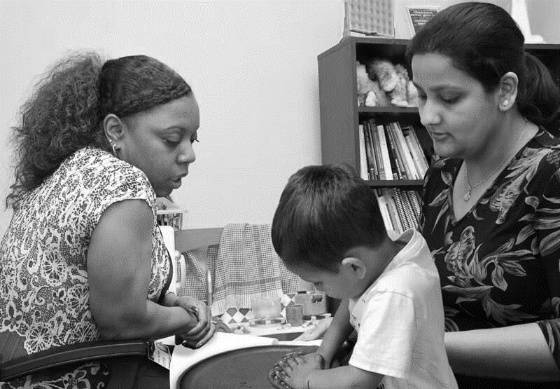
The Chicago Child Trauma Center (CCTC)
The CCTC is a community treatment site of the National Child Traumatic Stress Network
Located in one of the most racially and economically segregated areas in the United States
Primary mission:
Ensure that expert trauma-focused psychological services are available to children on Chicago's south side and south suburban Cook County where their risk of exposure to traumatic stress is great.
Aprox. 80% of the population that we serve at the CCTC identifies as Black or African American and 13% as Latinx

Slide 4
Goals
Trauma Informed Care
REALIZE:
WHAT IS TRAUMA, COMPLEX TRAUMA, RACIAL TRAUMA? HOW DO THESE INTERACT?
RESPOND:
CARING for OURSELVES (Secondary Traumatic Stress)
CARING for STAFF
CARING for the INSTITUTION
RECOGNIZE:
WHAT IS THE POTENTIAL IMPACT OF TRAUMA ON PROVIDERS and ORGANIZATIONS?
RESPOND:
STRATEGIES TO SUPPORT ORGANIZATIONS WORKING WITH PARTICIPANTS EXPERIENCING TRAUMA

Slide 5
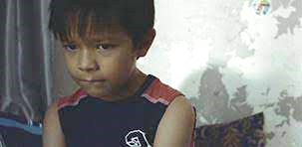

Manny
Trauma exposures:
DV exposure (implied chronic)
Community violence exposure (including assault of sister)
Potential physical abuse/emotional abuse

Slide 6
Manny
Attachment & Relationships
As a child, getting into fights and struggling to get along with peers
Increased Arousal
Trouble with attention and focus
Emotion Regulation and Dissociation
As a child, sometimes “explodes” or acts aggressive
Self-concept
Struggles to name any positive qualities or attributes
“Hyperactive”
Appears to struggle to build trust with school counselor as child
Other times, appears to “go off into another world”
As a young adult, feels angry and struggles to calm down
Thinking his child and partner might be “better off without” him

Slide 7
How do we care for Manny?
How do we care for the systems caring for Manny?
What is the most helpful way for service providers (healthcare, mental health, school, etc.) to work with Manny and his family?
What can these systems do to care for themselves, in order to better serve Manny and his family?

Slide 8
Trauma-Informed Care
A program, organization, or system that is trauma informed:
Realizes the widespread impact of trauma and understand potential paths for recovery;
Recognizes the signs and symptoms of trauma in clients, families, staff, and others involved with the system;
Responds by fully integrating knowledge about trauma into policies, procedures, and practices; and seeks to actively resist re-traumatization”
Substance Abuse Mental Health Administration (SAMHSA, 2014)

Slide 9
Taken Together…
Trauma Awareness & Knowledge
Relationships & Trust
Safety
Strengths-Focused
Empowerment & Power-Sharing
Anti-Racism and Cultural Humility
Self-Reflection & Regulation

Slide 10
Trauma Awareness & Knowledge
Assessment & screening
01
Of participants
Of staff/organization
Pathways to training & referrals
02
Referrals for participants
Training for staff/organization

Slide 11
Trauma Awareness & Knowledge
Screen children for trauma exposure/symptoms:
03
NCTSN Trauma-Screening Checklist (0-18)
Screening the Agency:
04
Agency Self-Assessment for Trauma-Informed Care
See table of screening instruments

Slide 12
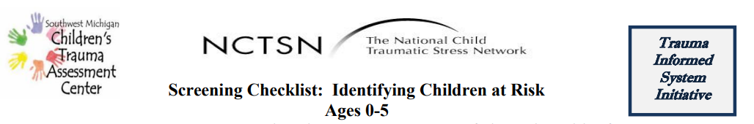
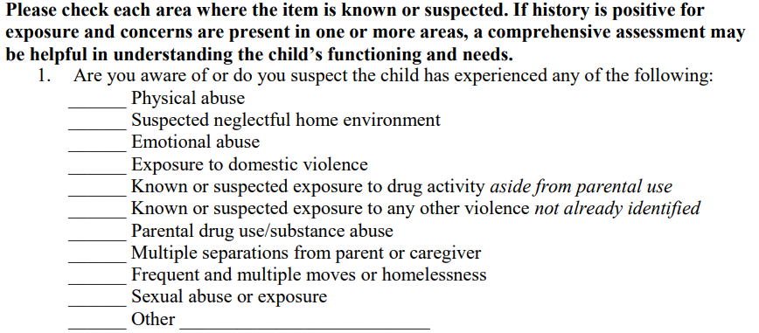
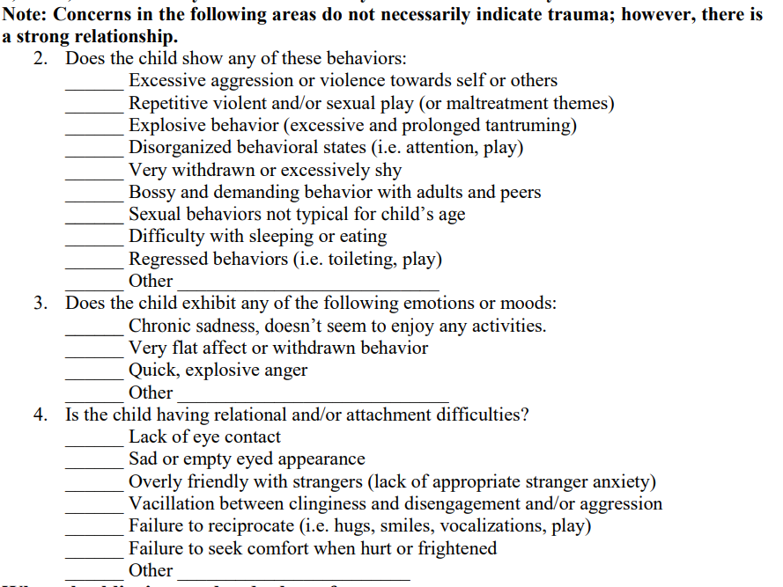

Slide 13
Participant Application: Trauma Awareness & Knowledge
When were there opportunities for trauma screening?
What could have happened next?
“Manny”

Slide 14
ORGANIZATIONAL APPLICATION: Agency Self-Assessment For Trauma-Informed Care
Look for areas with:
* Mostly “strongly disagree,” “disagree,” & “do not know”
* Range of responses extremely varied
Assessing & Planning Services
Involving Consumers
Creating a Safe & Supportive Environment
Adapting Policies
Supporting Staff Development
Adapted from the National Center on Family Homelessness Trauma-Informed Organizational Self-Assessment and “Creating Cultures of Trauma-Informed Care: A Self Assessment and Planning Protocol” article by Roger D. Fallot, Ph.D. & Maxine Harris, Ph.D.

Slide 15
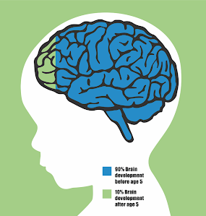
Relationships and Trust
Early Childhood Brain Development
Young children develop in the context of relationships
Children use caregivers:
To regulate (learn by co-regulation)
Form internal models (schemas)
Provide secure base for exploration/interaction in the world
To learn about forming healthy relationships with others
Developing a coherent, positive sense of self
To understand the world

Slide 16

Relationships and Trust
We rely of relationships in this world to learn about ourselves, our place in the world, and to make meaning of things in life
Often trauma happens within the context of a relationship.
When someone's ability to trust others and form healthy safe relationships is compromised, it may impact their ability to thrive in this world
Healing also happens within the context of relationships

Slide 17
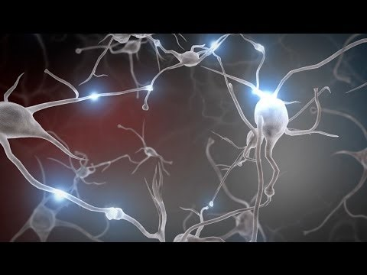
Early Childhood Brain Development

Slide 18
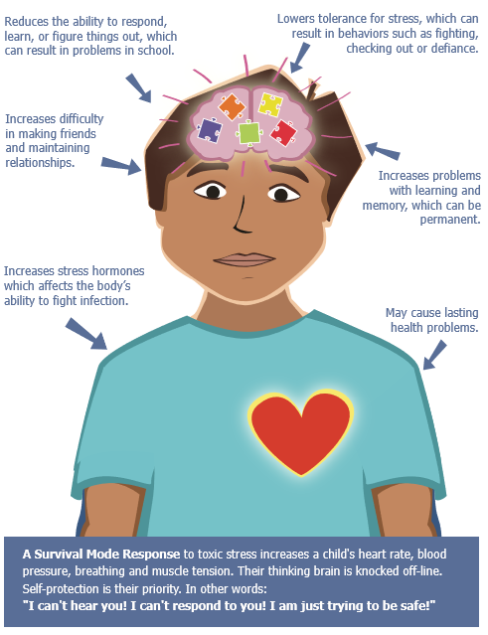
Toxic Stress and the Brain

Slide 19
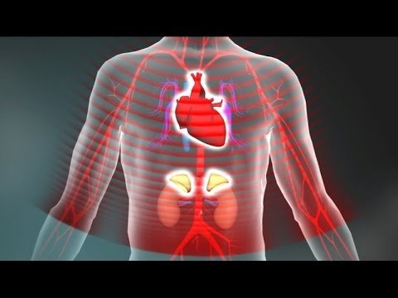
Toxic Stress

Slide 20
How Do We Build Trusting Relationships With Participants and Each Other?
Look to those with lived experience. Listen to them and equitably compensate them for their thoughts/feedback/knowledge
Approach with curiosity and openness – what do you know about their stories?
Create opportunities to for people to share their stories
Always thinking – “What may have happened to them?” Instead of “What’s wrong with them?”
Attend to important relationships for participants and within an organization.

Slide 21
Relationships & Trust
How does this apply to organizations, to teams that we lead, to co-workers?
Supportive relationships help us all heal, regulate, manage emotions that may come up related to our jobs.
Attuning to our colleagues, staff, teams at work helps build relationships and trust
When employees feel appreciated and supported, they care about the organization and they work harder to do their job and meet expectations.
Leadership is often isolating. Connect with leaders who typically have more power to make meaningful change.

Slide 22
Participant Application: Relationships & Trust
“Manny”
Providers also work to build a trusting relationship with primary caregiver
Sensitive to her experiences of trauma and shared trauma experiences with Manny

Slide 23
Organizational Application: Relationships & Trust
Consider the impact on staff when they are working to support both Manny and his mother
What routines or structures are in place to facilitate building relationships among staff and between staff and leadership?
How does leadership become aware of issues or difficulties facing staff? Are there structures in place?

Slide 24
Safety
If children’s (or any person’s) experience of safety is threatened it can take more effort for them feel safe compared to others.
Attend to physical & emotional safety for both families & staff
Privacy, confidentiality, & mutual respect
Making sure there are routines, plans, predictability, and systems in place around client and staff safety.
Attend to how culture can affect perceptions of trauma, safety, and privacy

Slide 25
How To Create Safety
Be
aware of body language, tone of voice, how your words and actions come across to others
Predictable with schedules, routines, expectations
Tell
the truth
Be as transparent with decision making as possible – for both families and staff
Let
People have choices when possible
Provide reassurance and hope
The more in control people feel, the safer they feel

Slide 26
Safety
Co-regulation strategies
How do you use yourself to guide reaction. Movement, Breath, Tone of Voice?
Encourage safe physical support/touch from “safe object”
Learn their triggers if possible. If not, be alert to how their reactions may be related to trauma triggers/reactions
Example: Using restraints or even casual touch for a child who was sexually abused may be distressing
A child with a history of neglect may be excessively distressed by a time-out/seclusion type of consequence

Slide 27
Participant Application: Safety
Example – Manny is at a doctor’s appointment with his mother. In the waiting area, Manny becomes very dysregulated. He starts hitting his mom and throwing toys aggressively. He knocks everything off the table. He is crying and running around the room. Manny’s mom looks anxious, frozen, and doesn’t do anything.
Trauma-informed de-escalation
Do: Determine who is “safe person” or the “solid object”
Do: Use the word “safe”
Do: Show you are there to support and reassurance and aren’t angry upset - “I am here to help you”
Do: Offer simple clear choices (gives some control to child)
Do: Be aware of your body and proximity to someone in distress
Don’t: Try do to much reasoning/problem solving with child
Don’t: Threaten (do not threaten punishment/to call police/not see parent)

Slide 28
Organizational Application: Safety
Create structures and routines to build emotional safety within teams and between staff and supervisors
Example: During the COVID-19 pandemic, create:
Systems around supporting physical safety/limiting exposure
Regular times for staff to check in with each other and process feelings and experiences
Hold space for a range of emotional reactions and needs

Slide 29
Strengths-Focused
Identify Strengths
Personal attributes/skills
Experiences & knowledge
Social/community resources
Cultural/spiritual rituals & activities
Develop related coping skills
Further develop identity
“What is right with you?” (Ginwright, 2018)

Slide 30
Participant Application: Strengths-Focused
“Manny”
At the end of the film, we see Manny bonding with his son and his girlfriend, demonstrating his strength as a loving parent who cares for his family and child
Open and courageous with the therapist – expressing his desire to better understand and change behaviors that have led to negative situations.

Slide 31
Strengths-Focused
Create and support opportunities for agency
Critical consciousness – locating trauma in the conditions and systems that created it (instead of within the self).
Facilitating opportunities for civic engagement and activism, if this fits for the family
With an eye on balancing self-care for the child/family – not responsible for changing systems that are oppressing them
Example: A 17-year-old girl with a history of chronic sexual abuse begins to use her personal essays in English class as a way to process her experiences of trauma. After assuring that she is safe and is engaged in appropriate treatment, her teacher provides opportunities for her to engage in activism related to gender inequality and sexual violence (as the student has been asking about how to access these types of activities). She reports a greater sense of purpose and regains feelings of power and control.

Slide 32
Organizational Application: Strengths-Focused
Develop routines to regularly recognize staff strengths
Collaborate with staff to facilitate building on these strengths to further staff development
What are new opportunities or projects that will enhance a staff member’s strengths?
Create opportunities for staff to participate in activism related to your organization’s mission and the community being served

Slide 33
Empowerment & Power Sharing
CENTER participant voices in direct service work
Seek out input and listen
Be open to participant suggestions about what may work best
Collaborate and partner
Choices when possible
Goal setting
Decision-making

Slide 34
Organizational Application: Empowerment & Power Sharing
NCTSN RESOURCE “Being Anti-Racist is Central to Trauma-Informed Care: Principles of an Anti-Racist, Trauma-Informed Organization”
Partner with community members/those with lived experience throughout all of the ongoing aspects of program development
Provide staff with the information and skills needed to make sure they are able to listen/honor/share power
Ensure that spaces and materials show respect and value for the communities being served
Compensate those with lived experiences equitably for their work
Example: Incorporate peer support and consumer advisory committees in a real and intentional way

Slide 35
Participant Application: Empowerment & Power Sharing
Example:
A 5-year-old boy is hospitalized after a car accident in which his sister died. His mother is struggling to share the news about his sister’s death with him. She asks the child’s treatment team to please tell him about the death for her.
Ideas for how the team should respond?

Slide 36
Organizational Example: Empowerment & Power Sharing
Focus on breaking down power differentials between staff and clients and among staff with the organization
Sandra Bloom’s Sanctuary Model discusses commitments to make an organization more trauma informed:
Commitment to Open Communication - we can earn respect by actively listening to each other and considering other opinions
Commitment to Democracy – thoughts and opinions of staff matter and there is a shared responsibility to solve problems.
Commitment to Social Learning – we learning collectively from each other
Example: Consider - how are meetings run? Are there opportunities for feedback, transparent discussion of policy changes, a chance to add to the agenda?

Slide 37

Anti-Racism & Cultural Humility
"Beloved community is formed not by the eradication of difference but by its affirmation, by each of us claiming the identities and cultural legacies that shape who we are and how we live in the world."
bell hooks, 1995

Slide 38
Cultural Humility
Ongoing, lifelong process (no end point, not a class to be completed)
Learn about impacts of history & structural oppression
Examine own beliefs and cultural identities
Understand your values/assumptions/biases
-Tervalon & Murray-Garcia, 1998; Kumagai & Lypson, 2009

Slide 39
Cultural Humility
Humility: the more you learn about other cultures, the more you realize you do not know.
Explore strengths, challenges, advantages, & privileges of belonging to certain groups – Don’t generalize
Work to break down power imbalances
Advocate for cultural humility within larger systems
-Tervalon & Murray-Garcia, 1998; Kumagai & Lypson, 2009

Slide 40
“Being Anti-Racist is Central to Trauma-Informed Care: Principles of an Anti-Racist, Trauma-Informed Organization”
NCTSN Resource
Review current structures, policies, procedures, practices, outcomes through a racial justice impact frame and adjust as needed
Leverage your organization’s influence w/ partners and funders to name and foster the dismantling of systemic/structural racism within service systems
Create formal and informal spaces in the workplace to identify and address stress related to trauma and racism
Accountability tools for leadership re: dismantling racism
Anti-racist work related skills & competencies → hiring/promotion/performance evaluation

Slide 41
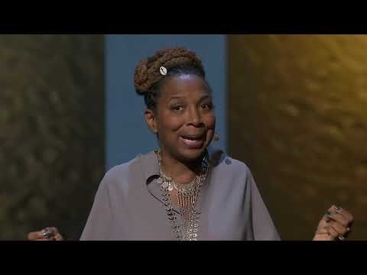
Intersectionality: Kimberlé Crenshaw

Slide 42
Cultural Humility
Example:
A well publicized act of racist violence has occurred.
As a:
Supervisor/Leader: How do you respond to this event with your team/staff? How does it affect the approach to work with participants?
Team member: How do you wish your supervisor might respond to this event? How are you adjusting in terms of work with participants?

Slide 43
Cultural Humility
Supervisor/Leader:
Consider and reflect on your identity spaces and the relationship of these areas of privilege/oppression to the event.
Seek consultation as needed
Hold space for your team members to have different reactions and needs (no identity space is a monolith!)

Slide 44
Self-Reflection & Regulation
Know yourself
Know your narrative
Understand your triggers
Build regulation strategies

Slide 45
Stress in Direct Service Work
Event
Experience
Helplessness
Effects
Burnout Moral Injury Resilience
Compassion fatigue Posttraumatic Stress Disorder Posttraumatic Growth
Ineffectiveness
Hearing about death
Hearing about families who have witnessed violence
Witnessing suffering
Working with children who have experienced abuse and neglect
Acute Stress Disorder

Slide 46
Stress in Direct Service Work
Effects
Burnout
Related to the job environment
Contributing factors include professional isolation, emotional and physical drain, cynicism, ambiguous success, lack of expected rewards or accomplishment
Exhaustion may show up in work through absenteeism, tardiness, reduced productivity

Slide 47
Stress in Direct Service Work
Effects
Compassion Fatigue
A change in world view and identity related to high levels of empathy
Can come about in any caregiving positon where there is a gap between desire and self-efficacy to alleviate others’ suffering and pain
Impacts individuals outside of work

Slide 48
Stress in Direct Service Work
Effects
Secondary Traumatic Stress / Vicarious Traumatization
Typically solely associated with working with survivors of trauma- “invasion of others’ trauma”
Onset can be immediate (ST) or over time (VT)
Involves:
bio-physiological responses similar to that of the primary victim
a change in worldview and identity
Can rise to level of ASD or PTSD

Slide 49
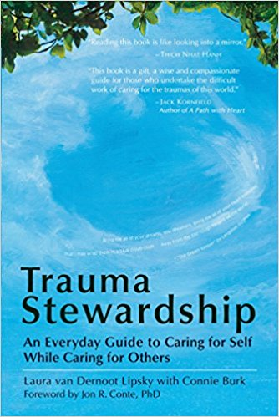
Trauma Stewardship
“A daily practice through which individuals, organizations, and societies tend to the hardship, pain, or trauma experienced by humans, other living beings, or our planet itself. By developing the deep sense of awareness needed to care for ourselves while caring for others and the world around us, we can greatly enhance our potential to work for change, ethically and with integrity, for generations to come. “
(van Dernoot Lipsky & Burk, 2009)

Slide 50
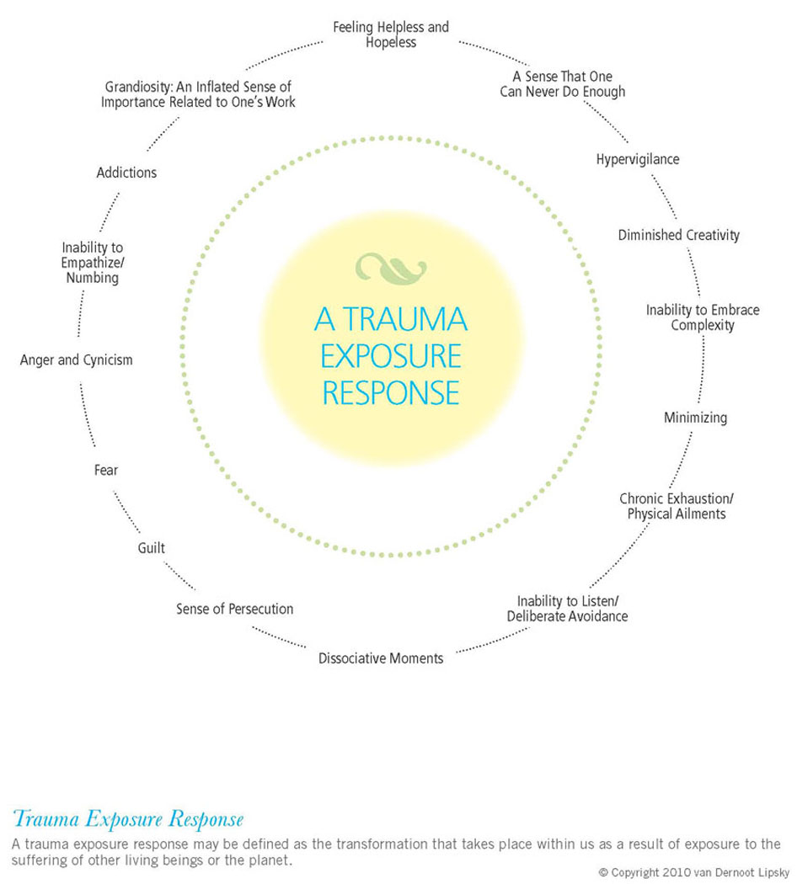

Slide 51

North
“Just as all known forms of life depend on water, the quality of our livelihood depends on understanding our intention in regard to our work?“
Reflection:
What motivates us to do what we do?
Before starting each work day ask yourself this
Find someone to consult with you trust who can listen to you and offer feedback. (Don’t work in isolation)
Write down why you do what you do. Keep that intention somewhere you can read it from time to time.
Is this working for Me?
List 5 things that are working for you about your job
List 5 ways you can see your work benefitting yourself or those you serve

Slide 52
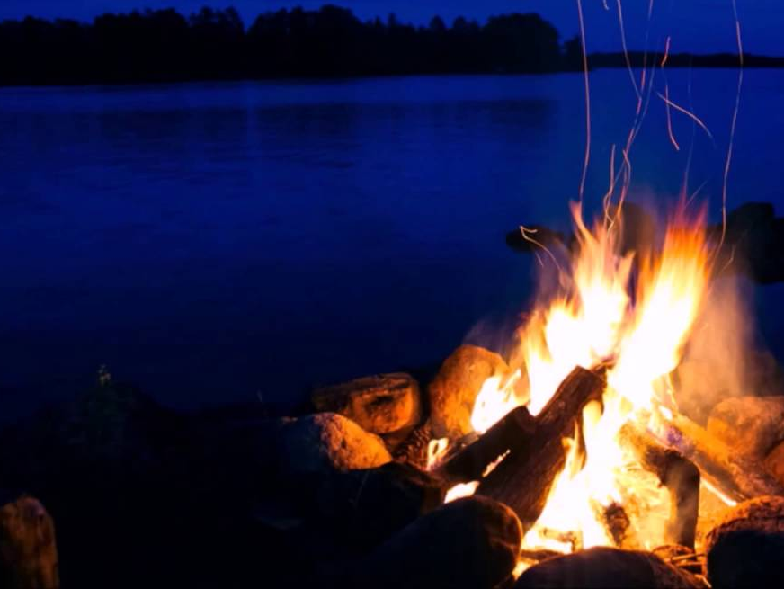
EAST
East
“With fire we call upon new life and enlightenment. In many cultures fire is the keeper of trust and originator of all energy”
Reflection:
Where am I putting my focus
Think of a challenging situation at work. Write down 3 things that makes it challenging. Write down 3 things you appreciate about it. Where do you focus?
When you look in the mirror what are the first 3 things you notice? Are they Positive? Negative?
Can we see what went well in our day?
What is my plan B?
If you weren’t doing this work what would you do instead? Name 5 things you can do to get closer to realizing your dream.
Tell someone so they can encourage you.

Slide 53

West
Engaging with Our lives Outside of Work
What is one thing you would love to incorporate into your daily work routine but feel it is not possible? Now do everything in your power to make it possible
How much PTO do you have? Plan a vacation! Honor those before us (labor movement) who worked hard to create humane working conditions. Do you take your breaks? Work on weekends?
Moving Energy
Raise hands above head, breathe in. As you lower your arms, breath out. Do this 20 times slowly.
Commit to get outside once a day and notice something beautiful around you. Breathe it in.
Find a co-worker, colleague, friend to co-counsel. Let friend start talking for 5 minutes and actively attune and listen. Then switch. Say whatever is in your heart, on your mind, needs to move out of your system, while your partner listens.
Gratitude
At the beginning and end of your work day take a moment to think of one thing you are grateful for.
Every day think of one person you are grateful to and tell that person.
Find a way to express gratitude to each other at work. (Bulletin board, gratitude box)
“ By striving to achieve balance in our lives and remind ourselves what we are grateful for, we attend to our basic needs as basic as the air we breathe.”

Slide 54

South
“By developing a microculture of supportive friendships and family, we create an environment that sustains us, just as the earth sustains us.”
Reflection:
Promoting compassion for myself and others
Think of someone in your early life who showed you compassion. Can you remember what it felt like to be with them? Do you give yourself this same compassion?
Pick someone who you know you struggle with and approach them with more compassion. Do you notice a shift over time?
What can I do to create Large-Scale systematic change?
Think of an area in your life where you are part of the dominant culture (gender, race, class, sexual identity, religion, etc.) What is one way you actively work to disrupt this system of unearned privilege?
Develop a relationship with someone in leadership. (Share a meal, offer to help with something). Leaders are often isolated. Help keep leaders connected and grounded.

Slide 55

Center
The 4 directions lead us to within ourselves
“Develop a daily practice of centering oneself”
Reflection:
Set your intentions
At the beginning of each day take some deep breaths, close your eyes, ask “What is my intention today?
At the end of your day before you fall asleep ask yourself “What can I put down? What am I ready to be done with? What don’t I need to carry with me for another day?” Put it down and release it.
Designate a day of rest
Have a weekly day of rest where you have no obligations and you can enjoy yourself and your relationships in your life.
Remember who you are as an individual and as a member of this society

Slide 56
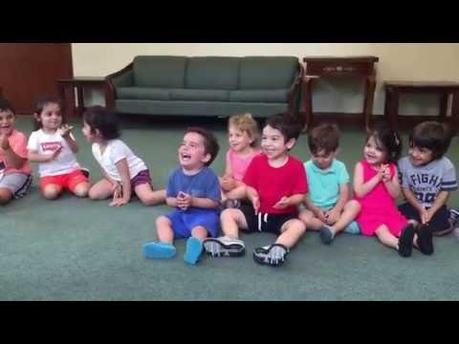
Find moments to laugh!

Slide 57
Information & Resources
ACE study findings and information
Center for Injury Prevention and Control
Center for the Study of Social Policy - Information on Strengthening Families and Protective Factors
National Center for Trauma-Informed Care
National Child Traumatic Stress Network
National Scientific Council on the Developing Child
SAMHSA
How Structural Racism Works Project
Structural Racism Core Concepts and Resources

Slide 58
References
Bloom, S. L., & Farragher, B. J. (2013). Restoring sanctuary: A new operating system for trauma-informed systems of care. Oxford: Oxford University Press.
Chen, P. , Voisin, D. R. , Marotta, P. L. , & Jacobson, K. C. (2020). Racial and ethnic comparison of ecological risk factors and youth outcomes: A test of the desensitization hypothesis. Journal of Child and Family Studies, 29(10), 2722–2733.
Comas-Díaz, L. (2016). Racial trauma recovery: A race-informed therapeutic approach to racial wounds. In Alvarez, A.N. (Ed); Liang, C. T. H. (Ed); Neville, H. A. (Ed), The cost of racism for people of color: Contextualizing experiences of discrimination. Cultural, racial, and ethnic psychology book series (pp. 249-272). Washington, DC, US: American Psychological Association.
Cook A, Spinazzola J, Ford J, Lanktree C, Blaustein M, Cloitre M, van der Kolk B. Complex trauma in children and adolescents. Psychiatric Annals. 2005;35:390.
Copeland-Linder N, Lambert SF, Ialongo NS. Community violence, protective factors, and adolescent mental health: a profile analysis. Journal of Clinical Child and Adolescent Psychology. 2010;39(2):176-86
Cummings Center for the History of Psychology (2021). Examining psychology’s contributions to the belief in racial hierarchy and perpetuation of inequality for People of Color in the United States. Cummings Center for the History of Psychology (proposed for vote to receive in Council of Representatives meeting scheduled for October 2021).
Fagan AA, Wright EM, Pinchevsky GM. The protective effects of neighborhood collective efficacy on adolescent substance use and violence following exposure to violence. Journal of Youth and Adolescence. 2014 Sep;43(9):1498-512.

Slide 59
References
Gee, G.C. & Ford, C.L. (2011). Structural racism and health inequities: Old issues, new directions. Du Bois Review. 2011; 8:1.
Giano, Z., Wheeler, D.L. & Hubach, R.D. The frequencies and disparities of adverse childhood experiences in the U.S.. BMC Public Health 20, 1327 (2020).
Hamberger, L.K., Barry, C., & Franco, Z. (2019) Implementing Trauma-Informed Care in Primary Medical Settings: Evidence-Based Rationale and Approaches. Journal of Aggression, Maltreatment & Trauma, 28:4, 425-444.
Hays, P. A. (2001). Addressing Cultural Complexities in Practice: A Framework for Clinicians and Counselors. Washington, D. C. : American Psychological Association.
Helms, J.E. (2003). A pragmatic view of social justice. The Counseling Psychologist, 31(3), 305–313.
hooks, (1995). Killing rage: Ending racism. New York: Henry Holt and Company.
Jernigan, M. M., Green, C. E., Perez-Gualdron, Liu, M. M, Henze, K. T., Chen, C….Helms, J. E. (2015).#racialtraumaisreal. Institute for the Study and Promotion of Race and Culture, Chestnut Hill, MA. Retrieved from: www.bc.edu/content/dam/files/schools/Lynch School_sites/isprc/pdf/racialtraumaisrealManuscript.pdf
Jay J. Structural Racism and Long-term Disparities in Youth Exposure to Firearm Violence. JAMA Network Open. 2023;6(5):e2312425.
Jay J﻿, Martin R﻿, Patel M﻿, Xie K﻿, Shareef F﻿, Simes JT﻿. Analyzing child firearm assault injuries by race and ethnicity during the COVID-19 pandemic in 4 major US cities. JAMA Network Open. 2023;6(3):e233125.
James SA. Confronting the moral economy of US racial/ethnic health disparities. Am J Public Health. 2003;93(2):189.

Slide 60
References
Jones CP. Levels of racism: a theoretic framework and a gardener’s tale. Am J Public Health. 2000;90(8):1212–1215.
Jones CP. Toward the science and practice of anti-racism: launching a national campaign against racism. Ethnicity and Disease. 2018;28(suppl 1):231–234.
Kilpatrick, D. G., Saunders, B., & Smith, D. (2003). Youth victimization-Prevalence and implications. Washington, DC: U.S. Department of Justice, National Institute of Justice.
Krieger N. Discrimination of health inequities. International Journal of Health Services. 2014;44:643–710.
Kumagai AK, Lypson ML. Beyond cultural competence: Critical consciousness, social justice, and multicultural education. Academic Medicine. 2009;84(6):782–787
Liebow, Nabina. Internalized Oppression and Its Varied Moral Harms: Self-Perceptions of Reduced Agency and Criminality. Hypatia, vol. 31, no. 4, Fall2016, pp. 713-729.
Lipsky, L. v. D., & Burk, C. (2009). Trauma stewardship: An everyday guide to caring for self while caring for others. San Francisco, CA: Berrett-Koehler Publishers.
Michael B. Sauter, Evan Comen and Samuel Stebbins; Chicago One of America's Most Segregated Cities; 1/12/2018; MSN network
Moore, Natalie Y. (2016). The South Side: A portrait of Chicago and American Segregation. New York City, NY: St. Martin’s Press.
Mosley D. V. Neville H. A. Chavez‐Dueñas N. Y. Adames H. Y. Lewis J. A. &French B. H.(2020). Radical hope in revolting times: Proposing a culturally relevant psychological framework. Social and Personality Psychology Compass 14(1) e12512.

Slide 61
References
National Child Traumatic Stress Network. (n.d.). Understanding child traumatic stress. Retrieved from http://www.nctsnet.org/sites/default/files/assets/pdfs/understanding_child_traumatic_stress_brochure_9-29-05.pdf
Prograis L, Pellegrino E, eds. African American Bioethics: Culture, Race, and Identity. Washington, DC: Georgetown University Press; 2007.
Powell, W., Agosti, J., Bethel, T.H., Chase, S., Clarke, M., Jones, L.F., Lau Johnson, W.F., Noroña, C.R., Stolbach, B.C., & Thompson, E. (2022). Being Anti-Racist is Central to Trauma-Informed Care: Principles of An Anti-Racist, Trauma-Informed Organization. Los Angeles, CA & Durham, NC: National Center for Child Traumatic Stress.
Salzinger S, Rosario M, Feldman RS, Ng-Mak DS. Role of Parent and Peer Relationships and Individual Characteristics in Middle School Children's Behavioral Outcomes in the Face of Community Violence. Journal of Research on Adolescence. 2011 Jun;21(2):395-407.
Smith JR. Unequal burdens of loss: examining the frequency and timing of homicide deaths experienced by young black men across the life course. American Journal of Public Health. 2015;105(suppl):S483-490.
Special Section on Complex Posttraumatic Stress Disorder, Journal of Traumatic Stress, October, 2005.
Substance Abuse and Mental Health Services Administration. (2012). SAMHSA’s Working Definition of Trauma and Principles and Guidance for a Trauma-Informed Approach 4. Jennings, A. (2004). Models for Developing Trauma-Informed Behavioral Health Systems and Trauma-Specific Services.

Slide 62
References
Stein BD, et al., 2003. Prevalence of child and adolescent exposure to community violence. Clinical Child and Family Psychology Review 6 (4), 247–264.
Stolbach, B.C. (2007). Developmental trauma disorder: a new diagnosis for children affected by complex trauma. International Society for the Study of Trauma and Dissociation News, 25(6): 4-6.
Stolbach BC, Minshew R, Rompala V, Dominguez RZ, Gazibara T, Finke R. Complex trauma exposure and symptoms in urban traumatized children: a preliminary test of proposed criteria for developmental trauma disorder. Journal of Traumatic Stress. 2013 Aug;26(4):483-91.
Strauss Swanson, C., & Szymanski, D. M. (2020). From pain to power: An exploration of activism, the #Metoo movement, and healing from sexual assault trauma. Journal of Counseling Psychology, 10.1037/cou0000429. Advance online publication.
Sue, D.W., Capodilupo, C., Torino, G, Bucceri, J., Holder, A., Nadal, K., & Equin, M. (2007). Racial Microaggressions in Everyday Life: Implications for Clinical Practice. The American Psychologist , 62 (4) 271-286.
Tervalon M, Murray-Garcia J. Cultural humility versus cultural competence: A critical distinction in defining physician training outcomes in multicultural education. Journal of Health Care for the Poor and Underserved. 1998;9(2):117–125.
van der Kolk, B.A. (2005). Developmental trauma disorder: toward a rational diagnosis for children with complex trauma histories. Psychiatric Annals, 35(5), 401-408.
van der Kolk, B. A. (2014). The body keeps the score: Brain, mind, and body in the healing of trauma. New York: Viking.

Slide 63
References
World Health Organization. (2002). World Report on Violence and Health. Brussels, Belgium: WHO.
Wilson, K. R., Hansen, D. J., & Li, M. (2011). The traumatic stress response in child maltreatment and resultant neuropsychological effects (Faculty Publications Paper 549). Lincoln, NE: University of Nebraska, Department of Psychology.
Zhang X, Monnat SM. Racial/ethnic differences in clusters of adverse childhood experiences and associations with adolescent mental health. SSM Population Health. 2021 Dec 16;17:100997.
Zimmerman GM, Messner SF. Individual, family background, and contextual explanations of racial and ethnic disparities in youths' exposure to violence. American Journal of Public Health. 2013 Mar;103(3):435-42.

Slide 64
Announcements
Next webinar is January 17th, 2024!
Slides posted on CountyCare Care Coordination Webpage:
http://www.countycare.com/carecoordination
Have feedback? Please share.
https://redcap.link/23k1fzzb
Please email questions/concerns: raphael.daniels@cookcountyhealth.org

Slide 65
Thank You

